Slide 1
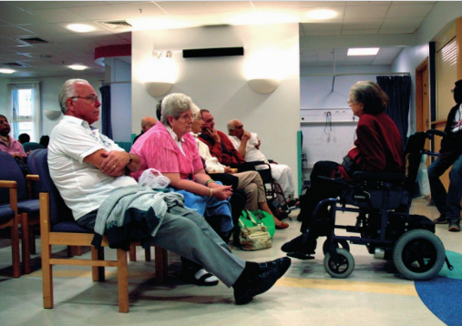
* Learning Objective P 146
WILLINGNESS:
Success Criteria:
CULTURE
GENDER
EDUCATION
EFFECTS
Why am I doing this ?
ITS HARD TO HELP PEOPLE WHO DON’T WANT THE HELP

Slide 2
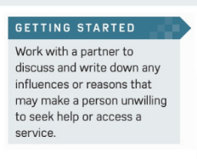

Slide 3
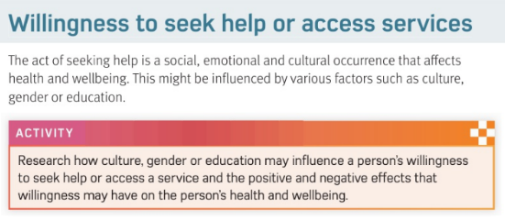

Slide 4
WILLINGNESS TO SEEK HELP
THE ACT OF SEEKING HELP IS WHAT KIND OF OCURENCE?
SOCIAL, EMOTIONAL & CULTURAL

Slide 5
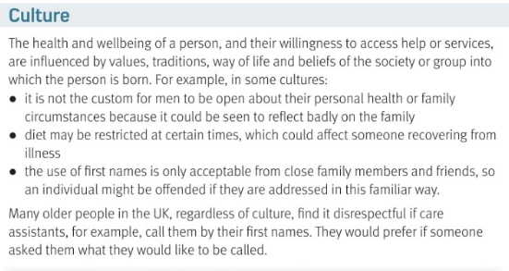

Slide 6
WHAT 3 THINGS CAN AFFECT THIS WILLINGNESS?
C………. | G………. | E…………
THIS MEANS VALUES OR… IT IS NOT THE CUTSOM FOR MEN TO BE… SOME PEOPLE RE OFFENDED IF YOU USE…. | MEN MIGHT FIND A PROTATE EXAM TO BE.. SOME MEN WILL TRY TO COPE ON… WOMEN MIGHT NOT WANT TO SEE A MALE…. | BETTER EDUCATED PEOPLE WILL BE MORE…. THEY WILL BE MORE AWARE OF …
CULTURAL
TRADITIONS
OPEN
FIRST NAMES

Slide 7
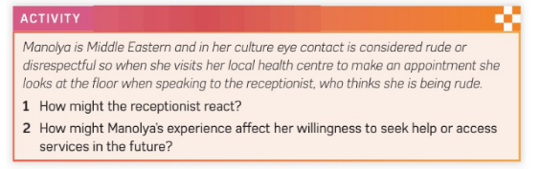

Slide 8
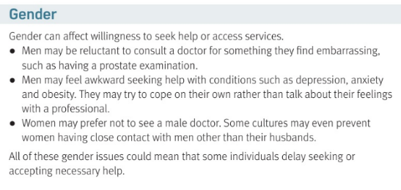

Slide 9
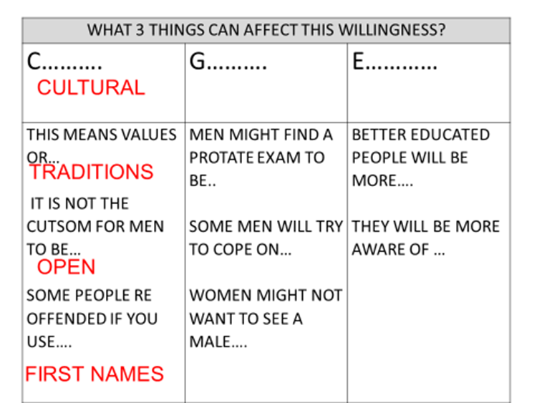
GENDER
EMBARRASING
OWN
DOCTOR

Slide 10
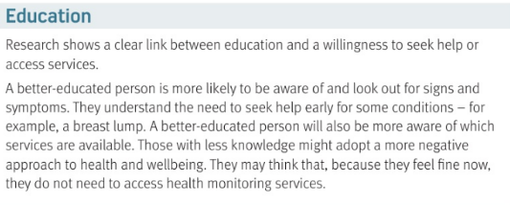

Slide 11
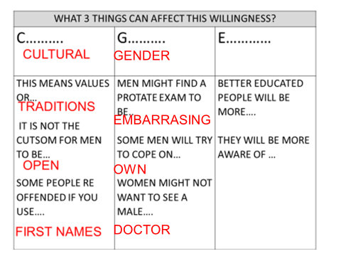
EDUCATION
AWARE
SERVICES

Slide 12
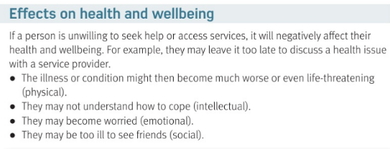

Slide 13
IF A PERSON IS UNWILLING TO SEEK HELP THE EFFECT WILL BE…..
PHYSICAL : THE ILLNESS MIGHT GET… | INTELLECTUAL: THEY MIGHT NOT …..
EMOTIONAL : THEY MAY FEEL…. | SOCIAL : THEY MAY NOT GET TO SEE….
NEGATIVE
WORSE
UNERSTAND IT
UNHAPPY
FRIENDS

Slide 14
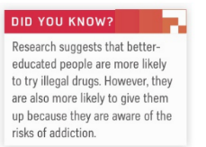
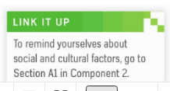
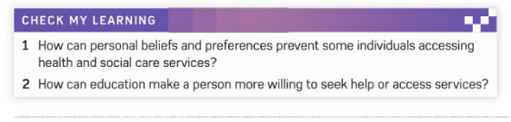

Slide 15
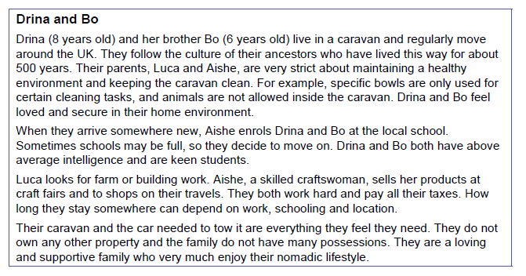

Slide 16
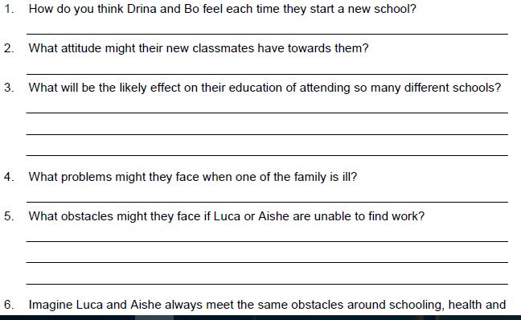

Slide 17
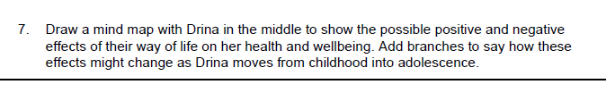

Slide 18
SMHW
c3 laa definitions & GENETICS & WILLINGNESS
https://www.youtube.com/watch?v=C8N4wka3wak

Slide 19
* Learning Objective P 146
WILLINGNESS:
Success Criteria:
CULTURE
GENDER
EDUCATION
EFFECTS
Why am I doing this ?
ITS HARD TO HELP PEOPLE WHO DON’T WANT THE HELP

