Slide 1
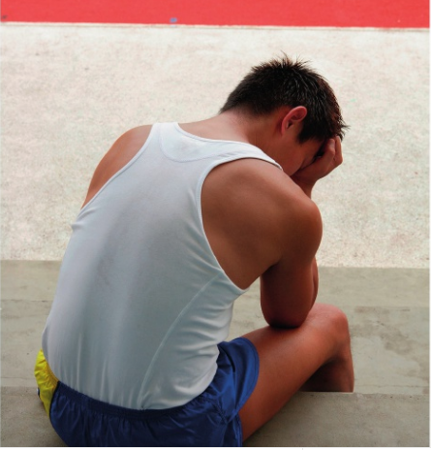
* Learning Objective: p 200
Unachievable Targets
Success Criteria:
For the individual
For the timescale
Why am I doing this ?
Its not worth trying to do the impossible – you will just fail

Slide 2
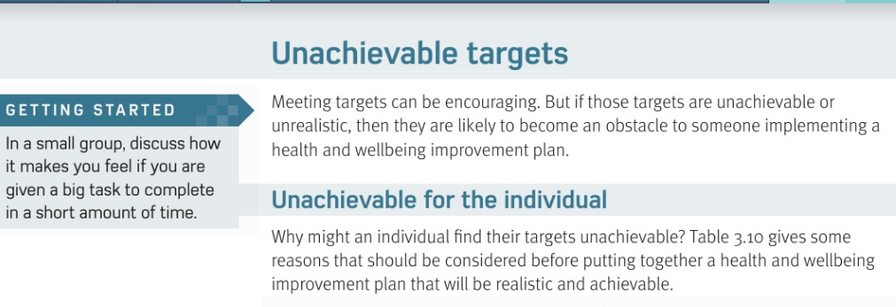

Slide 3
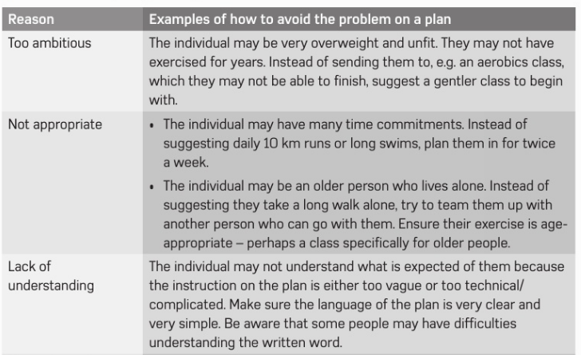

Slide 4
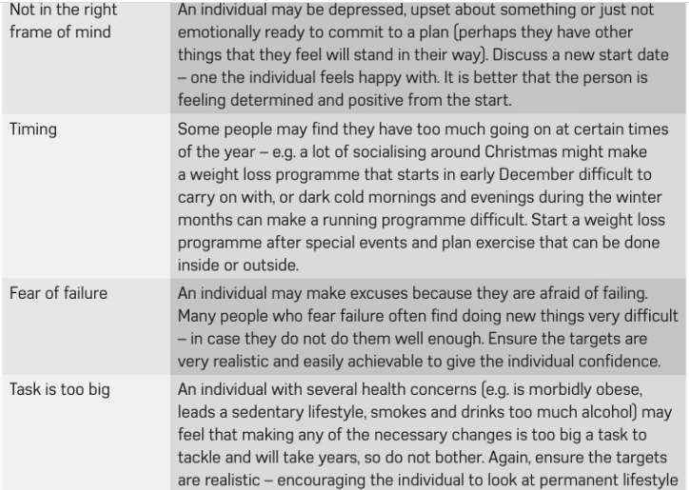

Slide 5
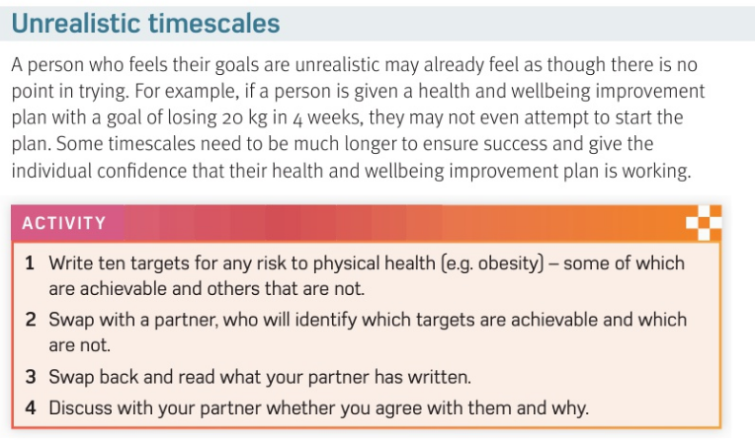

Slide 6
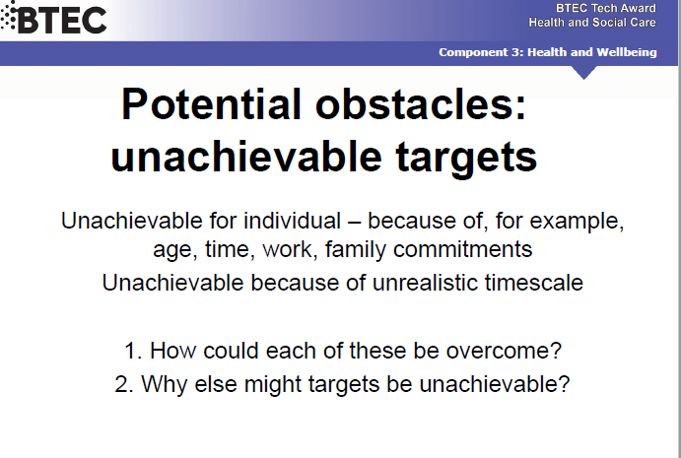

Slide 7
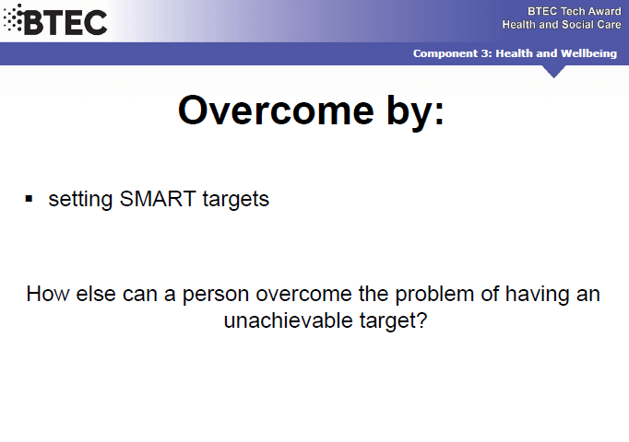

Slide 8
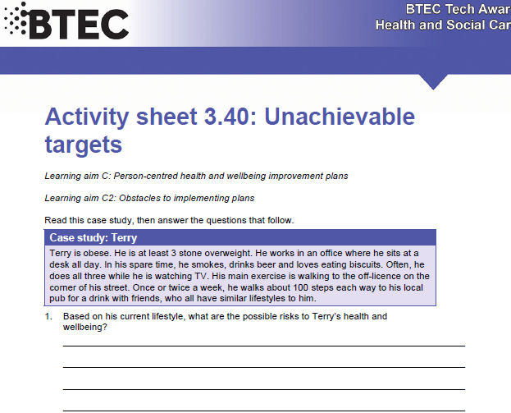

Slide 9
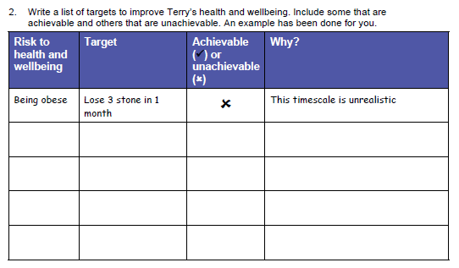

Slide 10
SMHW
h&sc c3 lac unachievable
Video
Ex - https://www.youtube.com/watch?v=Mje4WKlcCTk

Slide 11
* Learning Objective: p 200
Unachievable Targets
Success Criteria:
For the individual
For the timescale
Why am I doing this ?
Its not worth trying to do the impossible – you will just fail

