Slide 1

* Learning Objective:p 196
Time constraints
Success Criteria:
Why an obstacle?
Work & study commitments
Family commitments
Why am I doing this ?
There seems never to be enough of it

Slide 2
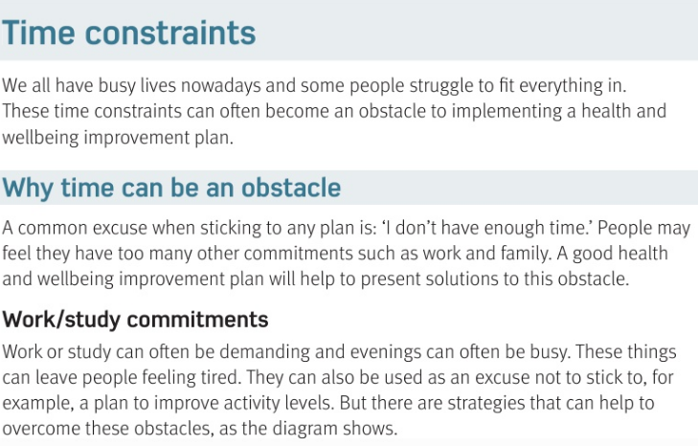

Slide 3
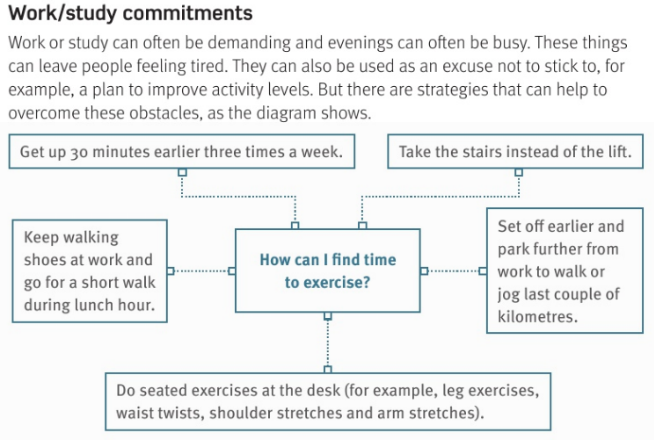

Slide 4
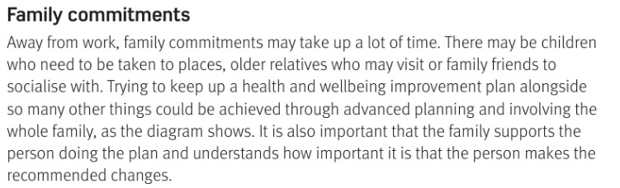

Slide 5
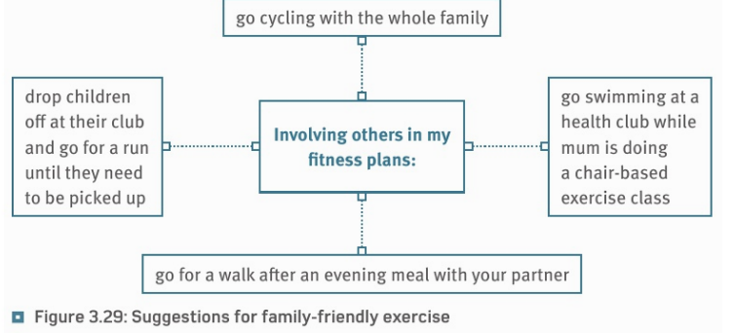

Slide 6
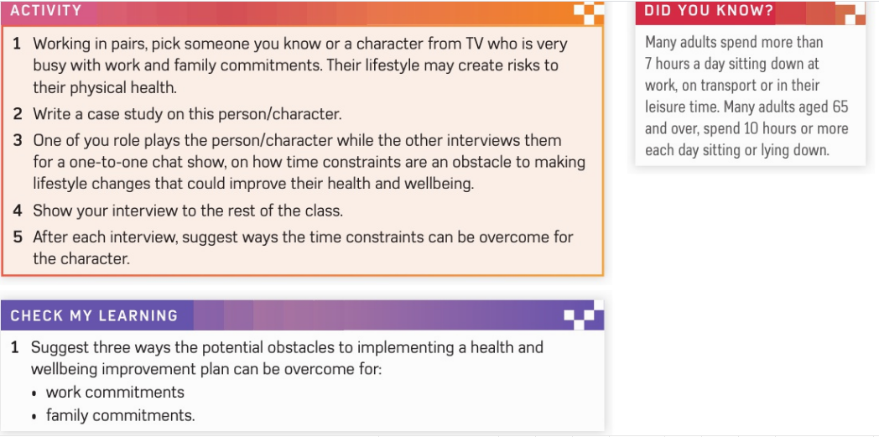

Slide 7
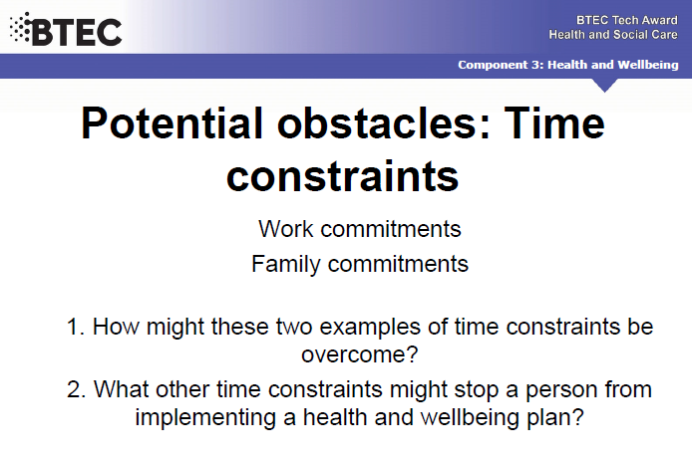

Slide 8
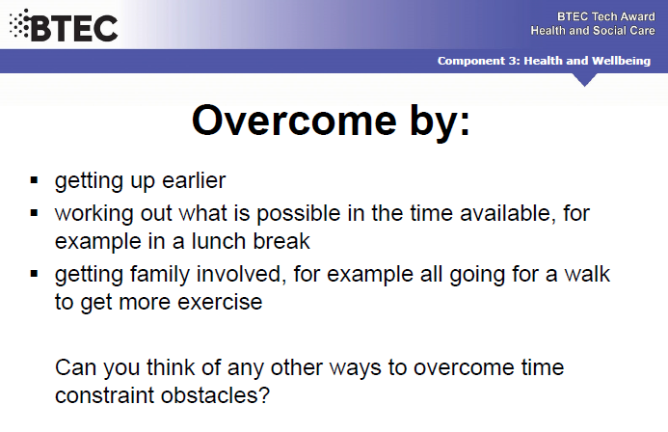

Slide 9
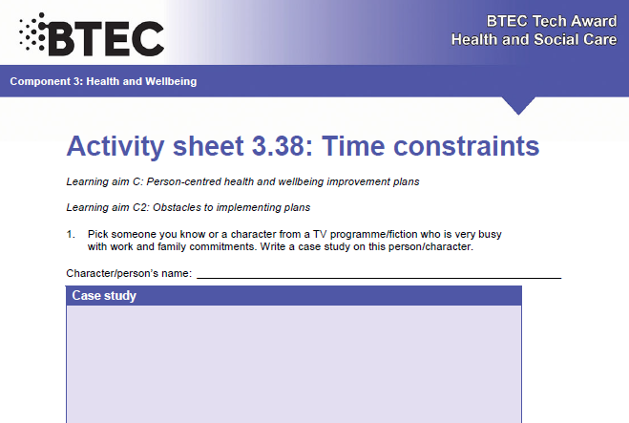

Slide 10
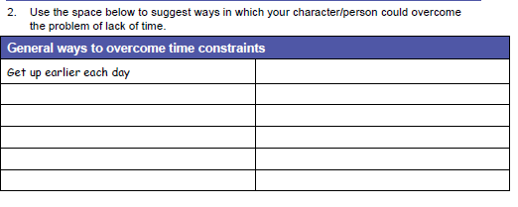

Slide 11
SMHW
h&sc c3 lac TIME
VIDEO
https://www.youtube.com/watch?v=RiI1NkaDXlQ
EX - https://www.youtube.com/watch?v=XVL2Lj3mUj0

Slide 12
* Learning Objective:p 196
Time constraints
Success Criteria:
Why an obstacle?
Work & study commitments
Family commitments
Why am I doing this ?
There seems never to be enough of it

