Slide 1
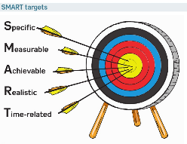
* Learning Objective:P 188
Short & long term targets
Success Criteria
Creating Targets
SMART
Monitoring Targets
Reviewing targets
Why am I doing this ?
You are not going to succeed, If you don’t k now where you are going
Notes:
‹#›

Slide 2
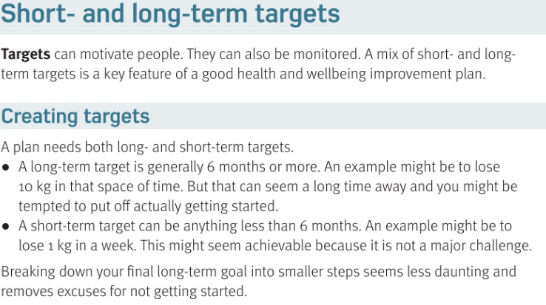

Slide 3
Short & long term Targets
A target is a …
Long term means… | Short term means…
Why break big targets down into smaller ones?
Challenge to help you reach a goal
6 months or MORE
6 months or Less
Its less daunting and more Do-able

Slide 4
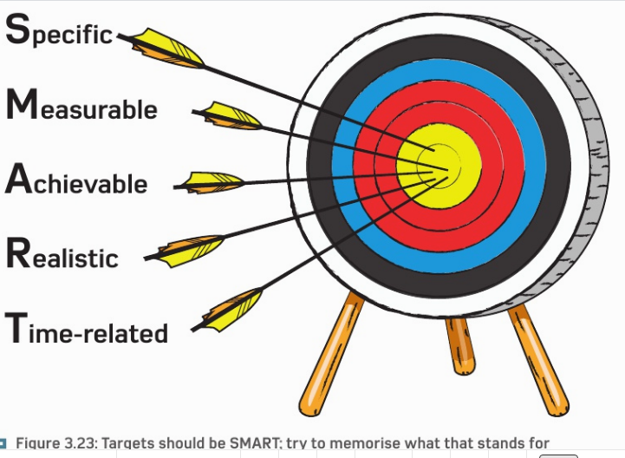

Slide 5
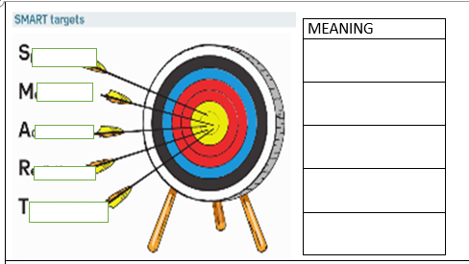
Exact, precise
pecific
easurable
A numbered amount
chievable
Something you CAN do
ealistic
Not impossible
ime related
deadline

Slide 6
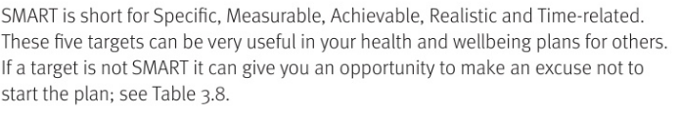

Slide 7
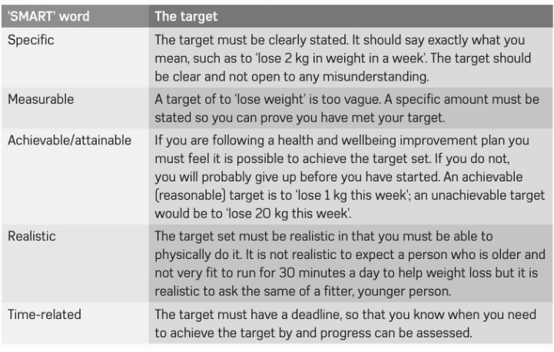

Slide 8
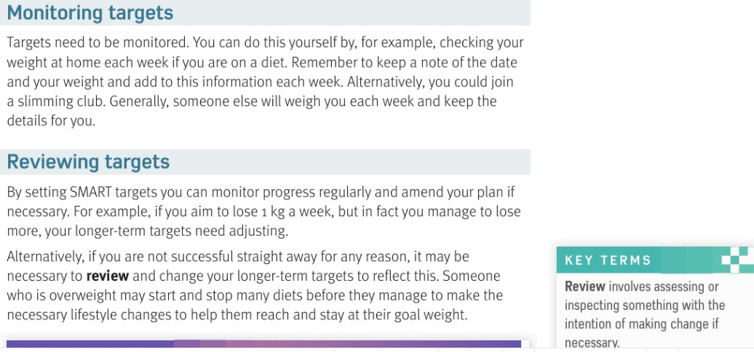

Slide 9
Why do you need to Monitor targets?
Why do you need to REVIEW targets?
To see if you are heading in the right direction – Motivate you
Did you meet the target, and change the target if needed

Slide 10
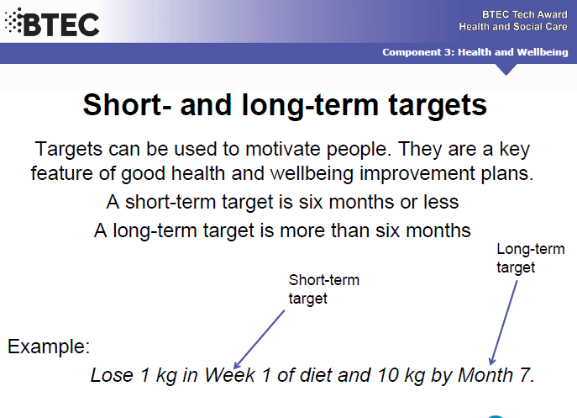

Slide 11
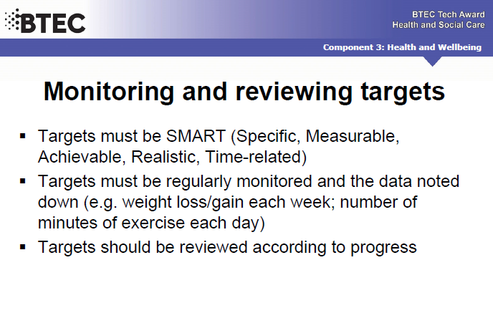

Slide 12
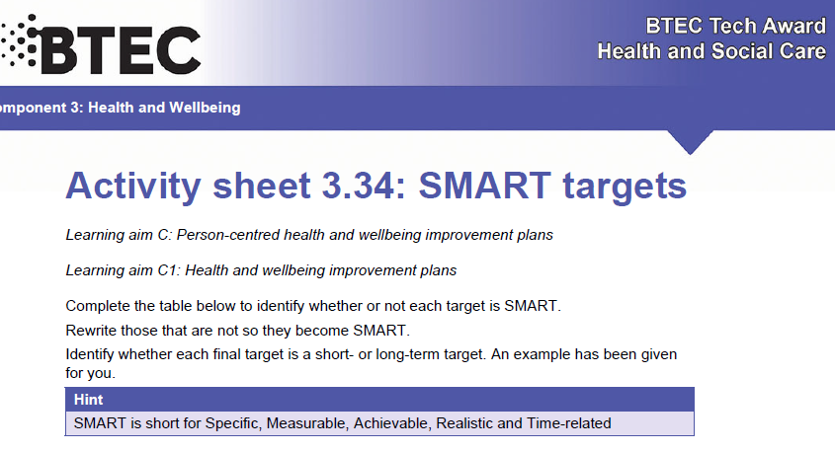

Slide 13
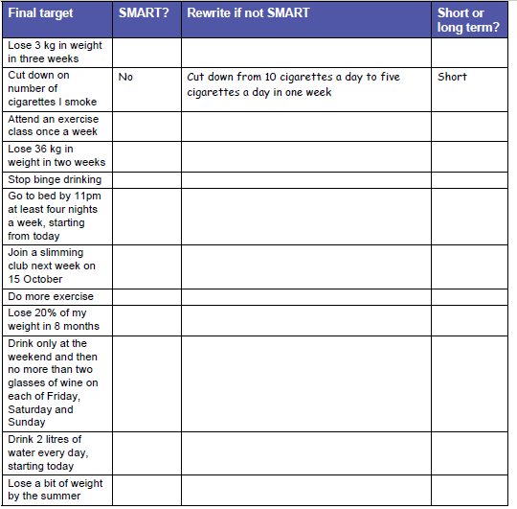
Yes
short
Yes
short
no
Lose 3kg in 2 weeks
short
no
..in next 8 months
long
short
Yes

Slide 14
short
Yes
no
How much , when ?
no
10 % is more realistic
Yes
short
Yes
short
no
How much , when ?

Slide 15
Smhw
h&sc c3 lac Targets
Targets
https://www.youtube.com/watch?v=yA53yhiOe04
Ex - https://www.youtube.com/watch?v=L4N1q4RNi9I

Slide 16
* Learning Objective:P 188
Short & long term targets
Success Criteria
Creating Targets
SMART
Monitoring Targets
Reviewing targets
Why am I doing this ?
You are not going to succeed, If you don’t k now where you are going
Notes:
‹#›

