Slide 1

* Learning Objective: p 190
Sources of Support
Success Criteria:
Formal
Informal
Voluntary
Why am I doing this ?
https://www.youtube.com/watch?v=0C58ttB2-Qg

Slide 2
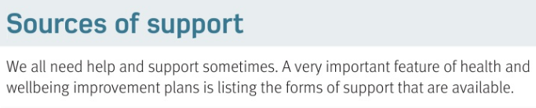
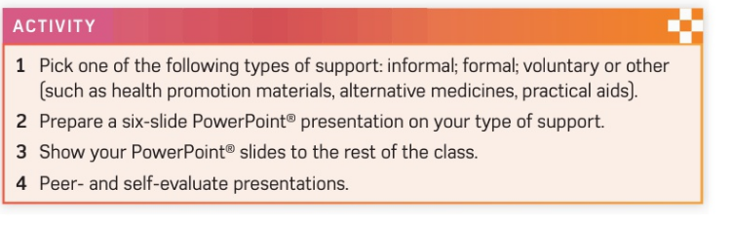
Optional EX

Slide 3
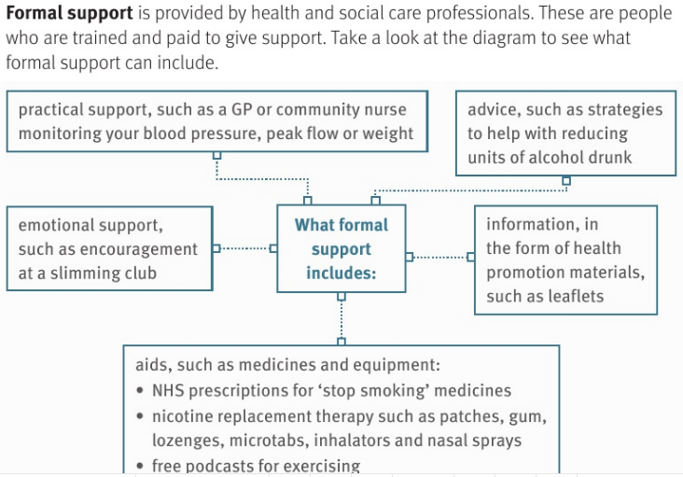

Slide 4
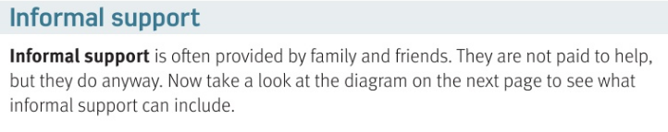
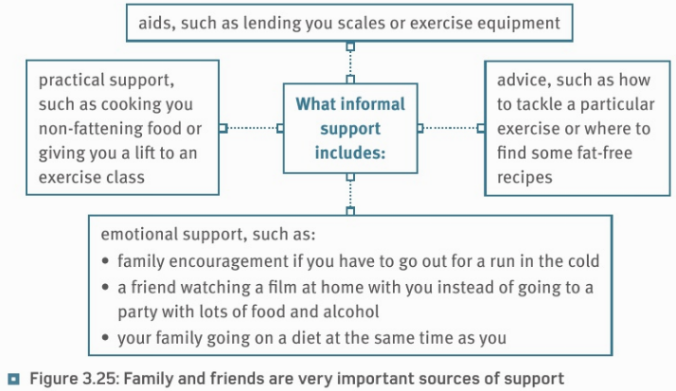

Slide 5


Slide 6
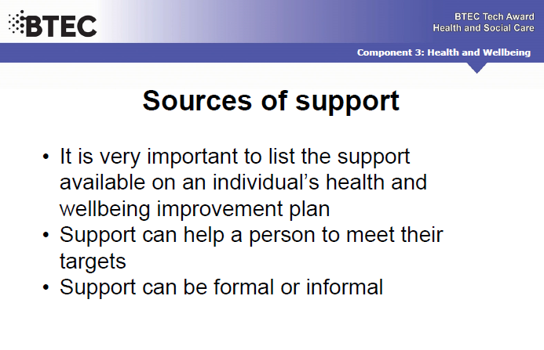

Slide 7


Slide 8
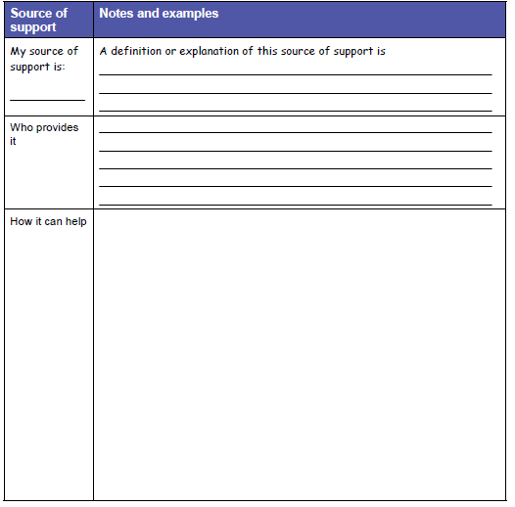

Slide 9
SMHW
h&sc c3 lac SUPPORT
Video
https://www.youtube.com/watch?v=GgX8QtsLBwI
EX https://www.youtube.com/watch?v=2-8ams9yG98

Slide 10
* Learning Objective: p 190
Sources of Support
Success Criteria:
Formal
Informal
Voluntary
Why am I doing this ?
https://www.youtube.com/watch?v=0C58ttB2-Qg

