Slide 1

* Learning Objective: 138
SUBSTANCE ABUSE
Success Criteria:
alcohol
nicotine
illegal drugs
Why am I doing this ?
It happens, and you need to know about it

Slide 2
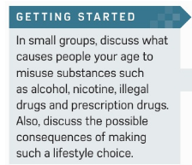

Slide 3
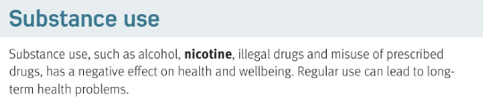

https://www.youtube.com/watch?v=6fmhLcYSn-Y

Slide 4
Substance abuse
List 3 abused substances
Overall, are they positive or negative for health ? |  | Regular use can lead to what ?
drugs
alcohol
nicotine
Long term health problems
negative

Slide 5
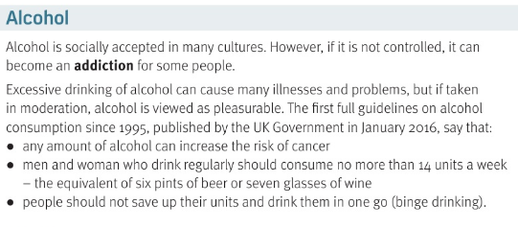
https://www.youtube.com/watch?v=B_TlRfKTEqM

Slide 6
Alcohol is a socially accepted drug – what does that mean ?
Can socially accepted drugs still cause problems?
What is addiction?
Any amount of alcohol can increase risk of.. | How many Units a week should you have… | What is binge drinking ?
Not ilegal
yes
Not having control of taking something
cancer
14
All at once

Slide 7

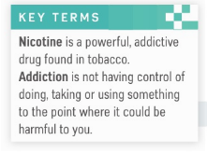
https://www.youtube.com/watch?v=rJSDgvWQSYI

Slide 8
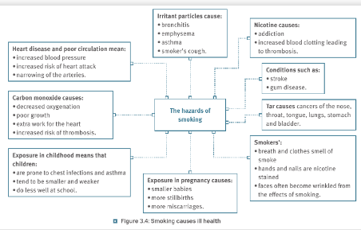
https://www.youtube.com/watch?v=Y18Vz51Nkos

Slide 9
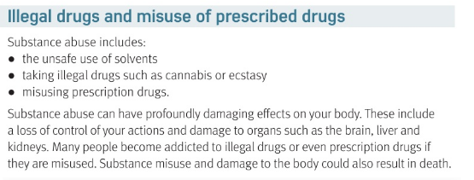
https://www.youtube.com/watch?v=cITuKremX9A glue
https://www.youtube.com/watch?v=Q5kgiYnqAZY cannabis
https://www.youtube.com/watch?v=E7L77_vEsMU prescription drug

Slide 10
Tell me some danger of solvents | Tell me some danger of cannabis
Tell me some dangers of prescription drugs

Slide 11
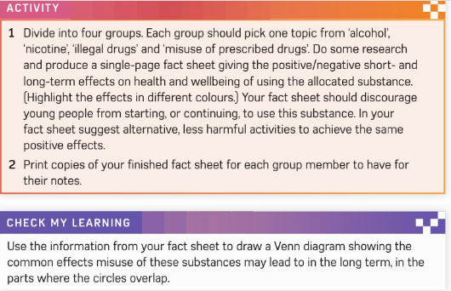

Slide 12
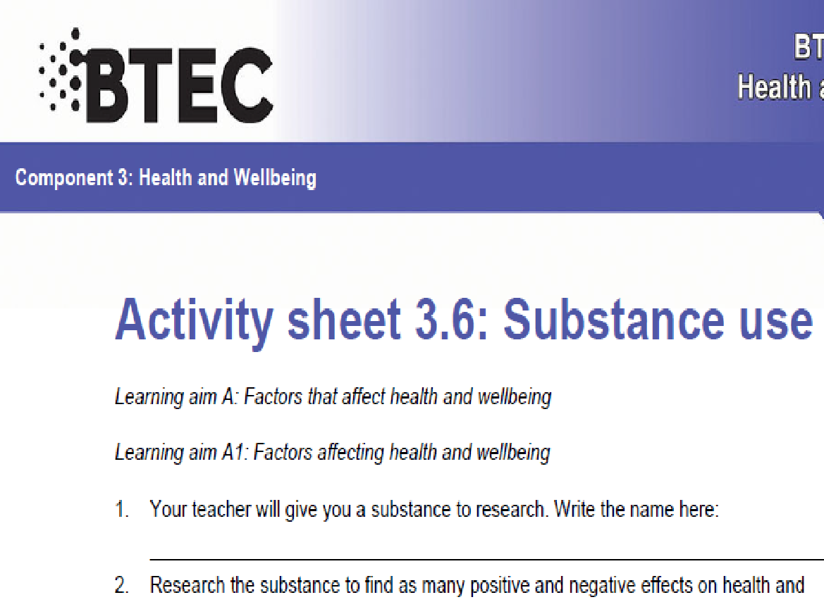

Slide 13
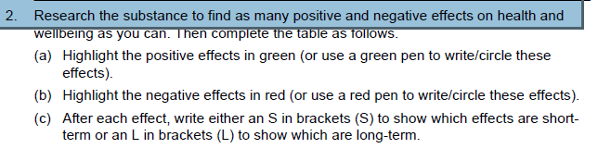

Slide 14
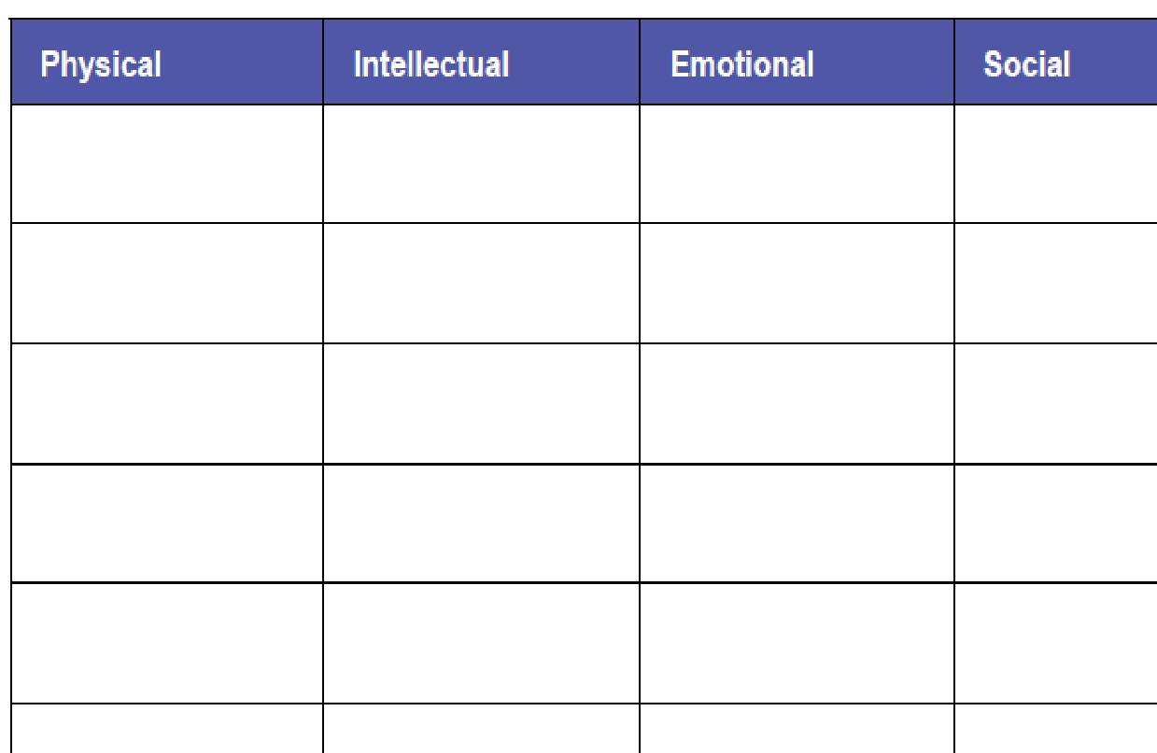

Slide 15
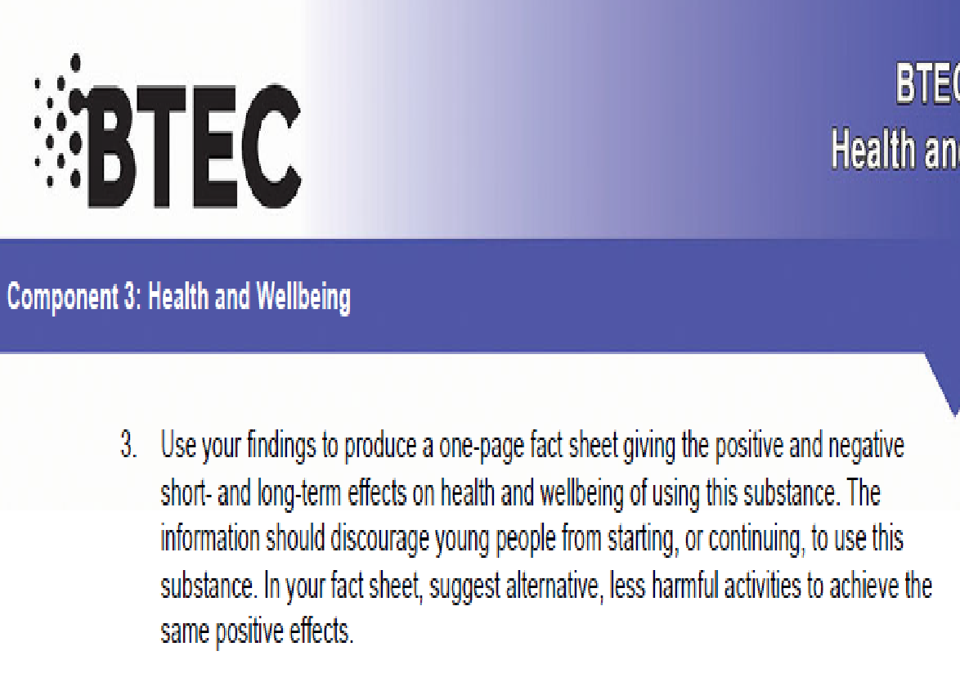

Slide 16
Smhw
C3 laa definitions & GENETICS & Ill health & diet & exercise & drugs
Kahoot
https://create.kahoot.it/share/substance-abuse/2e286722-169c-489a-9b4a-2a3acd79c18c

Slide 17
* Learning Objective: 138
SUBSTANCE ABUSE
Success Criteria:
alcohol
nicotine
illegal drugs
Why am I doing this ?
It happens, and you need to know about it

