Slide 1

* Learning Objective p 144
Stress
Success Criteria:
Stress
Hormones
affects
Why am I doing this ?
We all get stressed sometimes

Slide 2
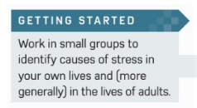

Slide 3
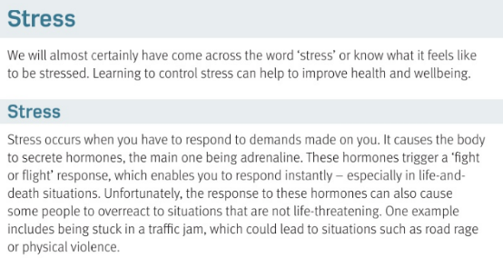

Slide 4
Stress
Controlling your stress will help….
Stress releases this hormone…
FIGHT or FLIGHT means…
People can overreact – for example…
Improve health & wellbeing
adrenaline
ACT or RUN AWAY
ROAD RAGE

Slide 5
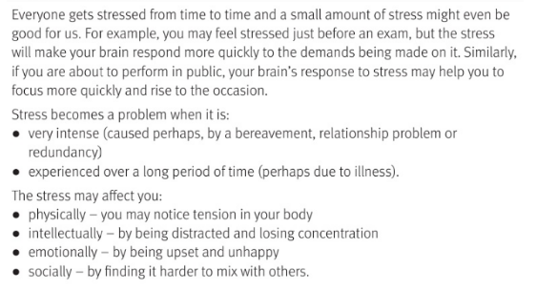

Slide 6
Some stress is good because… |  |  | Too much stress is bad because…
STRESS PIES | Physical | Intellectual |  | Emotional | Social
GET STUFF DONE
TOO MUCH , FOR TOO LONG
BODY TENSE
CANT CONCEN-TRATE
UNHAPPY
LOOSE FRIENDS

Slide 7
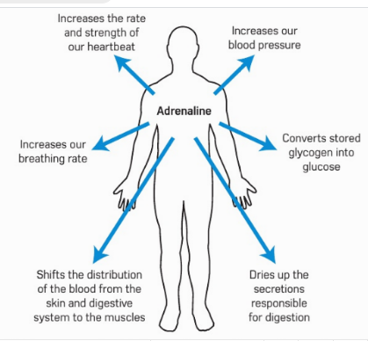

Slide 8
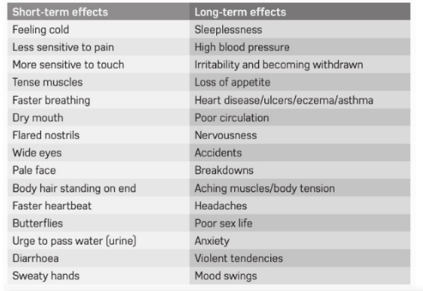

Slide 9
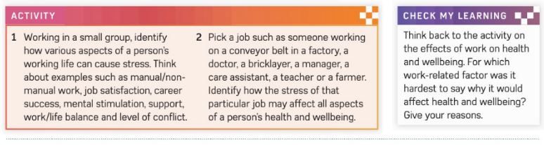

Slide 10
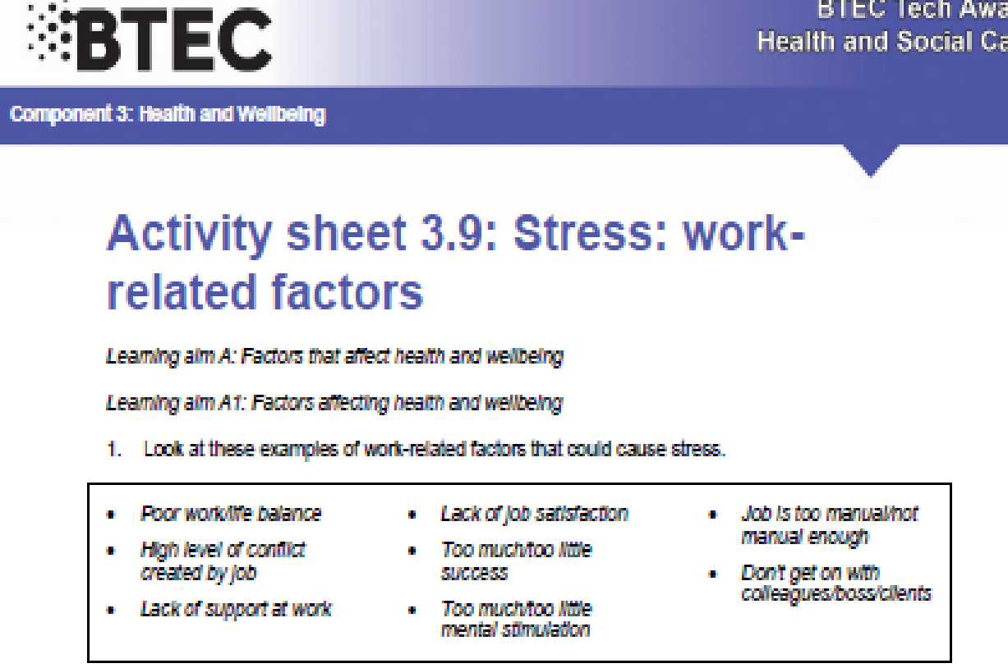

Slide 11
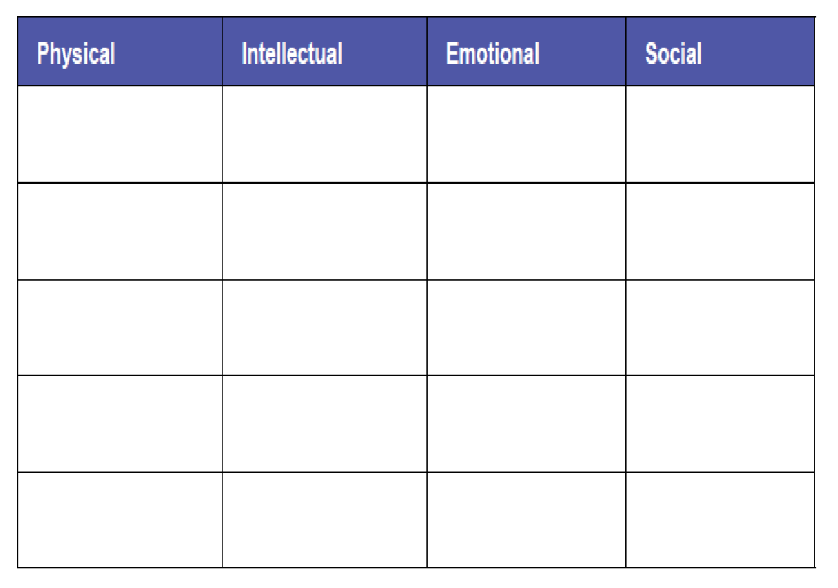

Slide 12
Smhw
c3 laa definitions & GENETICS & STRESS
https://www.youtube.com/watch?v=v-t1Z5-oPtU

Slide 13
* Learning Objective p 144
Stress
Success Criteria:
Stress
Hormones
affects
Why am I doing this ?
We all get stressed sometimes

