Slide 1

* Learning Objective: p 176
Data on SMOKING
Success Criteria:
Who makes it
What does it do
What does it show
Why am I doing this ?
This killed Mr Hallam’s Brother and Dad – Has it taken one of YOUR loved ones?

Slide 2
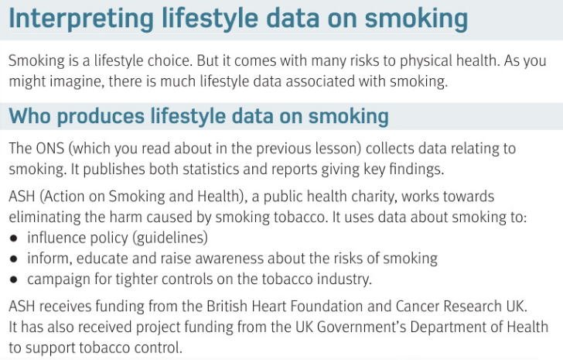

Slide 3
Smoking if what kind of choice? |  |  | What is ASH?
What 3 things do ASH do?
Lifestyle
Action on
Smoking
Health
Influence policy
Inform
&
Educate
Campaign AGAINST smoking

Slide 4
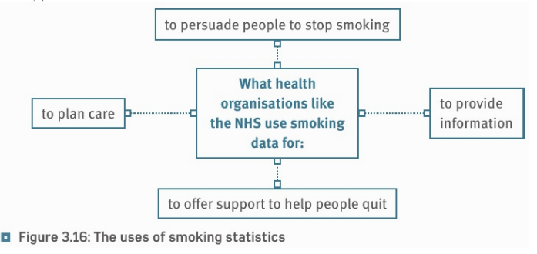

Slide 5
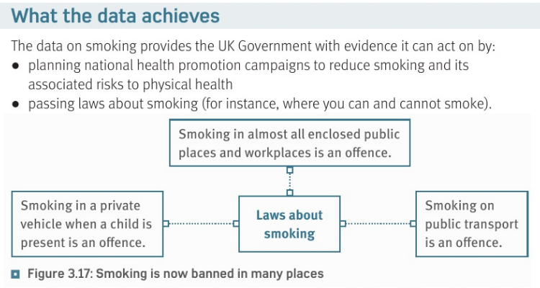

Slide 6
What 2 things does data help the government do ?
Plan health campaigns
Pass laws against moking

Slide 7
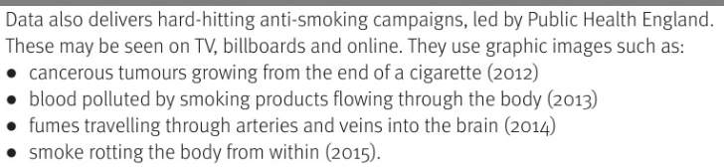
https://www.youtube.com/watch?v=AIyqcST29wQ
https://www.youtube.com/watch?v=CpRYX6j6tJI
https://www.youtube.com/watch?v=DilCEaoT8pQ

Slide 8
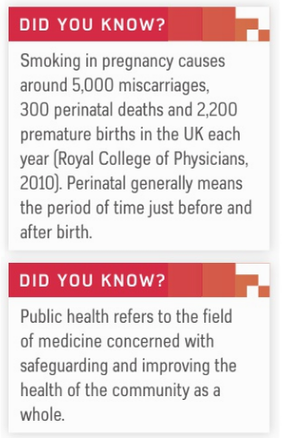
https://www.youtube.com/watch?v=oy1CAMObRzc

Slide 9
What do we mean by “hard hitting advertising campaigns”?
What is “Public Health”
Graphic ads to scare people
The health of everyone in the country

Slide 10
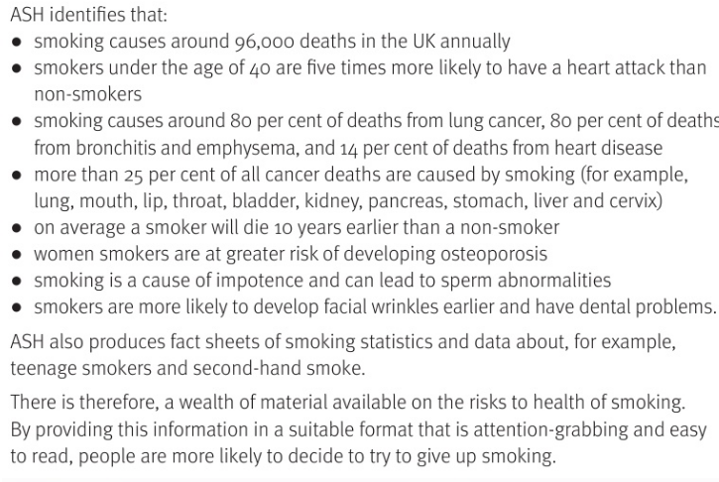

Slide 11
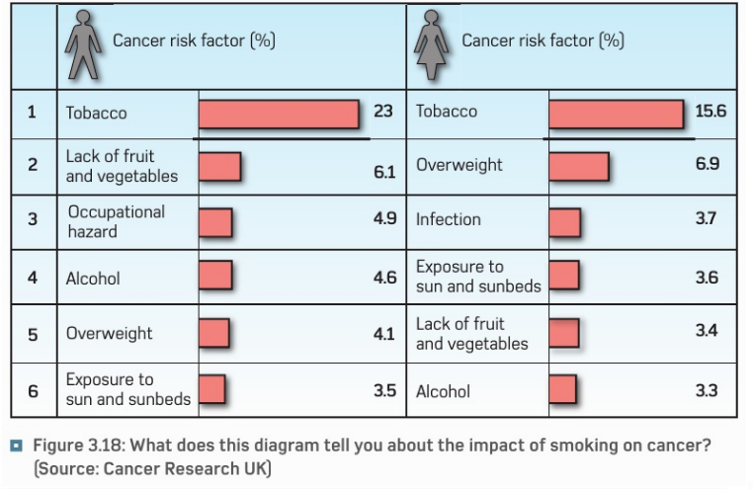

Slide 12
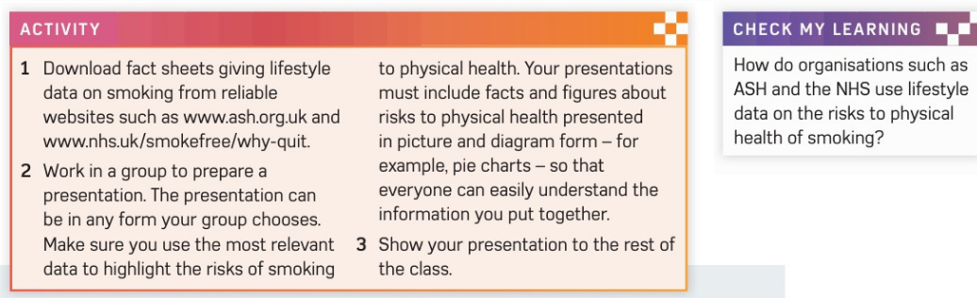

Slide 13
H&SC c3 lab smoking
SMHW
https://www.youtube.com/watch?v=_vjhae3IYCc&has_verified=1 advisory

Slide 14
* Learning Objective: p 176
Data on SMOKING
Success Criteria:
Who makes it
What does it do
What does it show
Why am I doing this ?
This killed Mr Hallam’s Brother and Dad – Has it taken one of YOUR loved ones?

