Slide 1
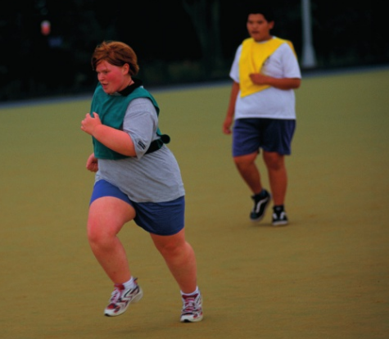
* Learning Objective: p 186
Recommended Actions
Success Criteria:
Starting a health improvement plan
Recommended actions based on Indicators
Recommended actions based on lifestyle
Why am I doing this ?
We KNOW whats bad for us – but WHAT DO WE DO ABOUT IT ?

Slide 2
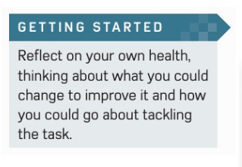

Slide 3
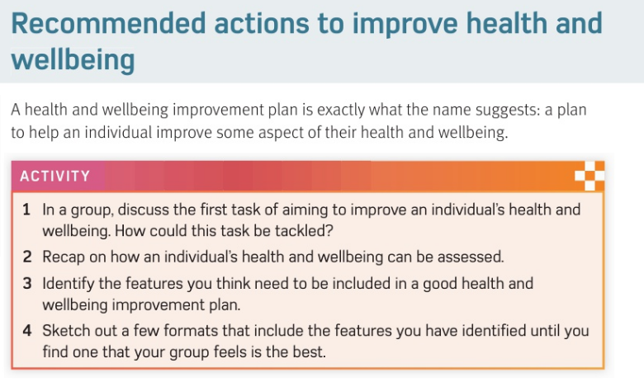

Slide 4
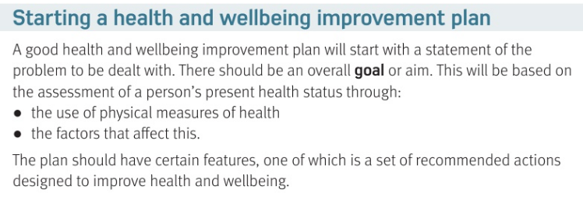
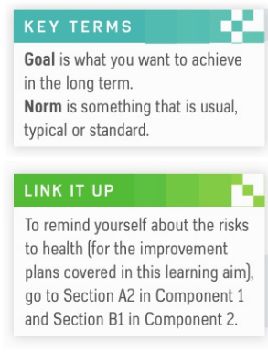

Slide 5
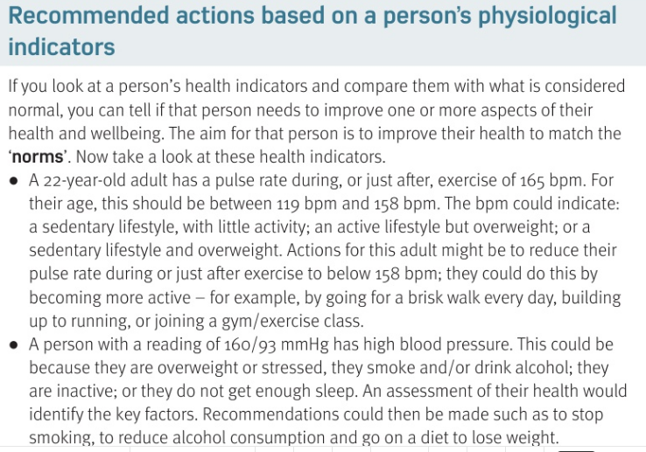

Slide 6
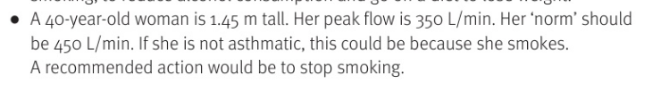


Slide 7
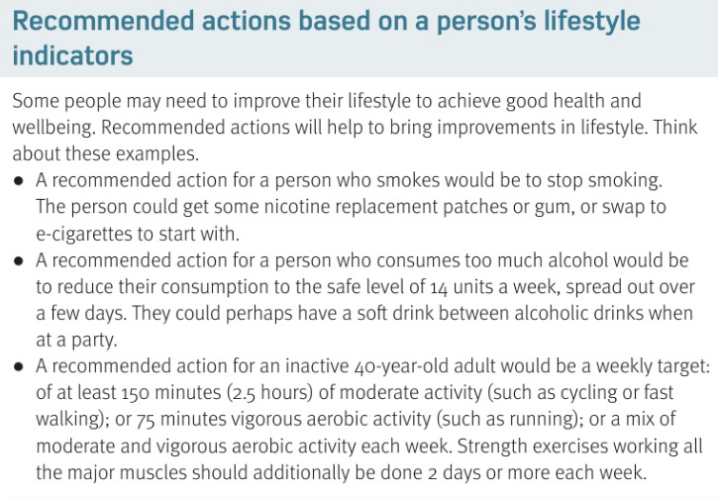

Slide 8
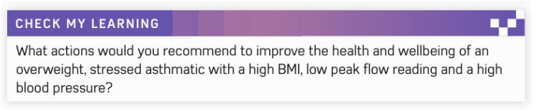

Slide 9
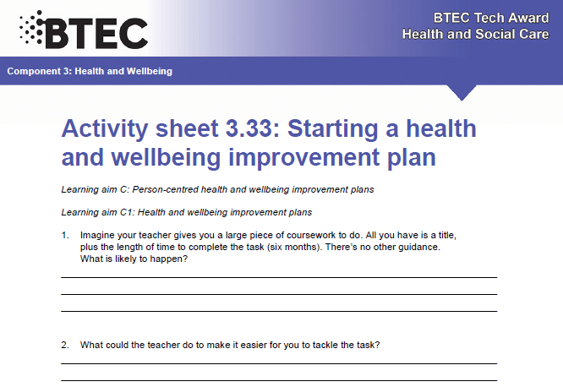

Slide 10
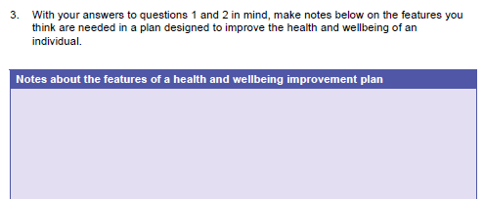
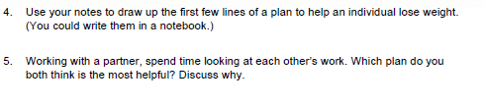

Slide 11
SMHW
video

Slide 12
* Learning Objective: p 186
Recommended Actions
Success Criteria:
Starting a health improvement plan
Recommended actions based on Indicators
Recommended actions based on lifestyle
Why am I doing this ?
We KNOW whats bad for us – but WHAT DO WE DO ABOUT IT ?

