Slide 1
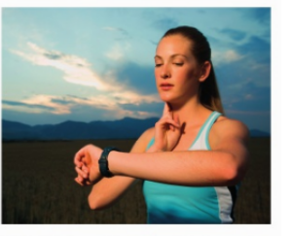
* Learning Objective :p 162
Resting pulse rate and recovery after exercise
Success Criteria
Pulse rate
Resting pulse rate
Recovery after exercise
Why am I doing this ?
This is a great measure of your Health

Slide 2
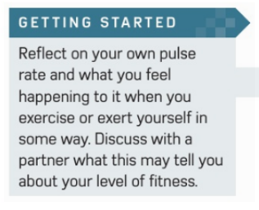
https://www.youtube.com/watch?v=wWGulLAa0O0

Slide 3
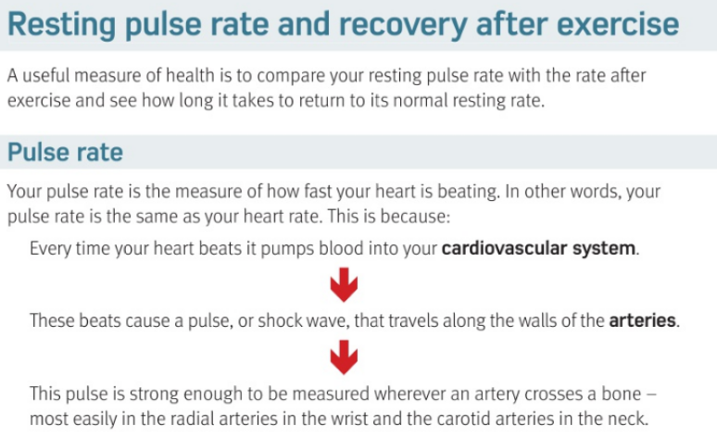

Slide 4
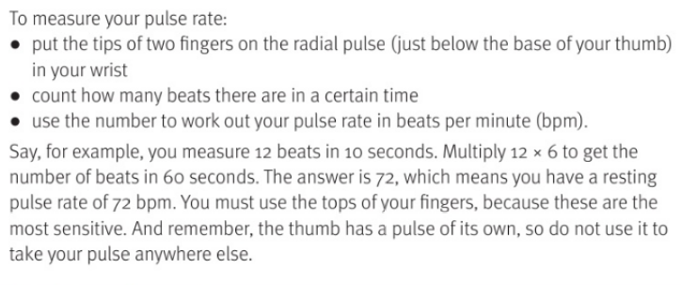

Slide 5
Resting pulse rate & recovery after exercise
This is a useful measure of how…
Cardiovascular system means..
Arteries are ….
Your pulse rate is the same as your …
BPM means…
How would you measure your own pulse..
Healthy you are
System that moves blood in the body, heart blood vessels etc
Carry blood AWAY from the heart
Heart rate
Beats per minute
Two fingers, just below thumb

Slide 6
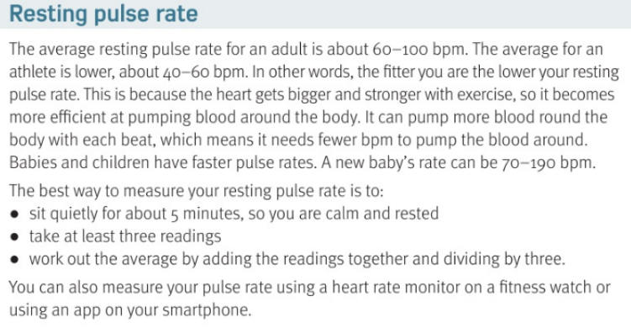

Slide 7
Average adult pulse rate = | Average ATHELTE pulse rate =
IN other words, the fitter you are …
How to measure your resting pulse rate :
60-100 bpm
40-60 bpm
Lower your pulse rate
5 minutes rest, 3 reading average or use a smart watch

Slide 8
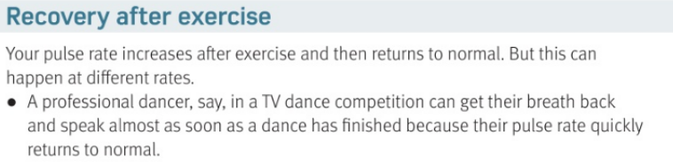
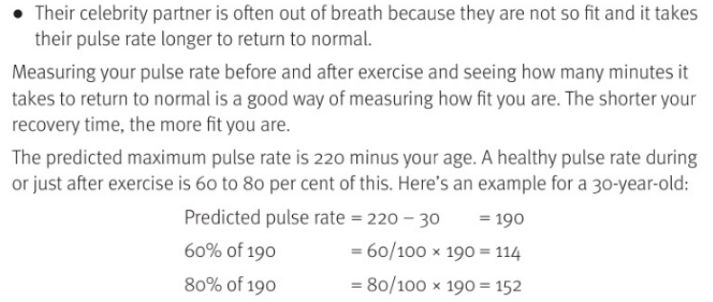

Slide 9
Your pulse rate ____________________ after exercise then returns to ___________________
The shorter your recovery time, the ____________________ you are
The predicted Maximum pulse rate =
A healthy post exercise pulse rate is _____ % of the predicted maximum
INCREASES
NORMAL
FITTER
220 MINUS your age
60-80%

Slide 10
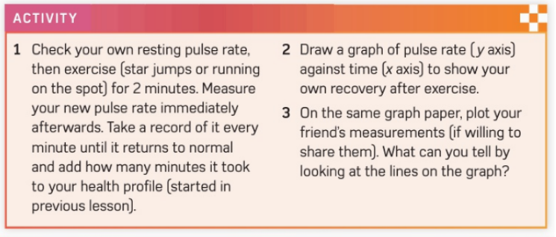
OPTIONAL

Slide 11
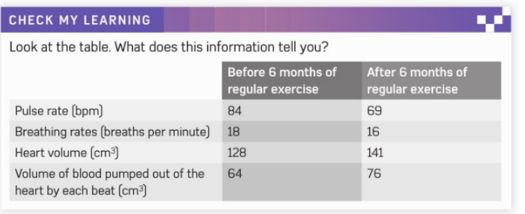

Slide 12
Health + SC
H&SC c3 lab PULSE
https://www.youtube.com/watch?v=Ejbdzt2586A

Slide 13
* Learning Objective :p 162
Resting pulse rate and recovery after exercise
Success Criteria
Pulse rate
Resting pulse rate
Recovery after exercise
Why am I doing this ?
This is a great measure of your Health

