Slide 1

* Learning Objective: p 140
Personal Hygiene
Success Criteria:
Importance
Condition
Caring for others
Why am I doing this ?
This is hugely important for H&SC

Slide 2


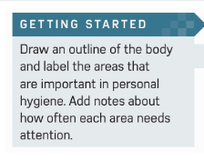
https://www.youtube.com/watch?v=8oQZZPyMg3s

Slide 3
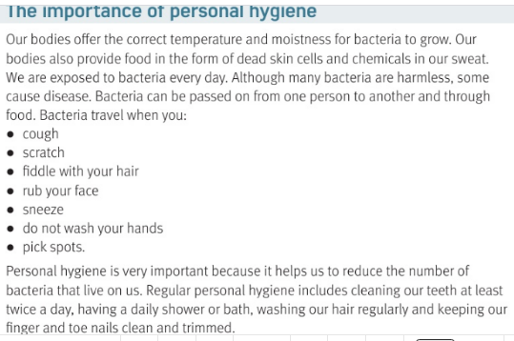
https://www.youtube.com/watch?v=g96z1P3z5yU

Slide 4
Our bodies are perfect for growing …
These travel when you | 1 | 2 | 3
4 | 5 | 6 | 7
Personal hygiene helps us ..
Bacteria or germs
cough
scratch
hair
Don’t wash
Pick spots
rub
sneeze
Reduce bacteria, keep clean, smell fresh, avoid illness

Slide 5
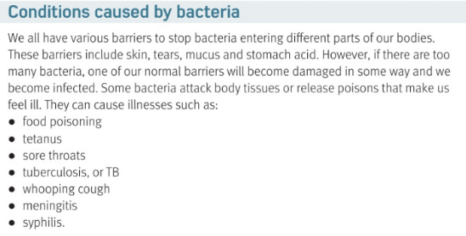

Slide 6
4 things that stop bacteria in the body :
1 |  | 2
3 |  | 4
Diseases spread by Bacteria: | 1 | 2 | 3
4 | 5 | 6 | 7
skin
tears
mucus
Stomach acid
Food poison
tetanus
Sore throat
TB
syphillis
Whooping cough
meningitis

Slide 7
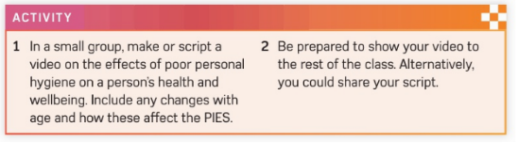

Slide 8
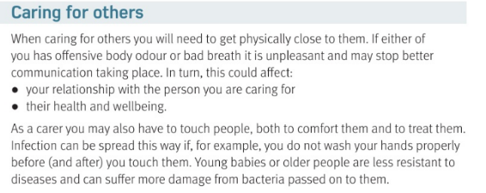
https://www.youtube.com/watch?v=C_UyC8l8-Vw

Slide 9
CARING FOR OTHERS
You will need to get physically .. | Bad body odour will be..
As a carer you will have to… | This means you must ..
What type of people are less resistant t diseases?
What causes pressure ulcer or bed sore?
close
Smelly and nasty
Touch
Wash your hands
Babies & old people
Cause by not moving

Slide 10
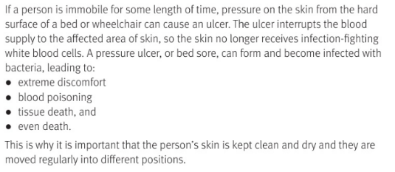

Slide 11
What 4 things can come from bed sores?
1 | 2
3 | 4
Blood poisoning
discomfort
tissue death
death

Slide 12
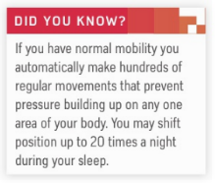

Slide 13
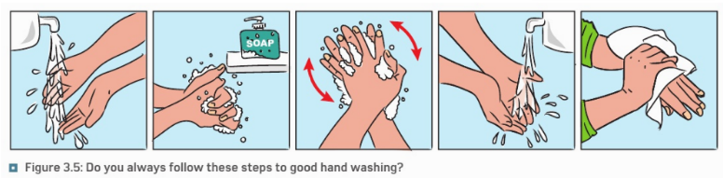

Slide 14


Slide 15
Smhw
c3 laa definitions & GENETICS & hygeine
https://www.youtube.com/watch?v=p9CggPMNrDA 15 min hwk

Slide 16
* Learning Objective: p 140
Personal Hygiene
Success Criteria:
Importance
Condition
Caring for others
Why am I doing this ?
This is hugely important for H&SC

