Slide 1

* Learning Objective: p 184
Person centred approach
Success Criteria:
History
Understanding
Benefits
Prerequisites
Health foundation
Why am I doing this ?
As a patient , you would WANT this

Slide 2
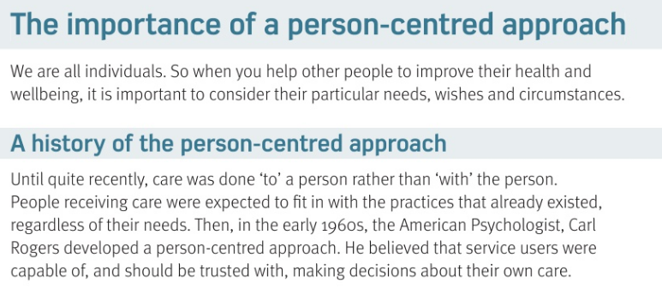

Slide 3
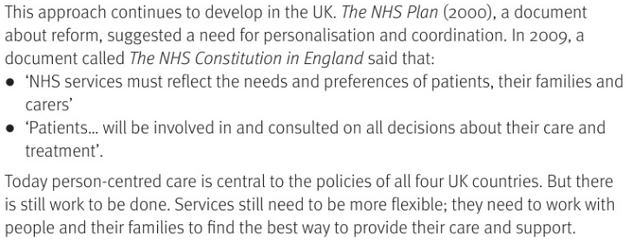

Slide 4
Person Centred Approach
We are all …. |  | So when you help other people you have to think about…
Until recently “Care” was done….. Which means people had to fit to the systems |  | But now we want to do Care …. Which Means the systems need to fit to the people
2 uk documents agree that people should be in charge of their own decisions | 2000… |  | 2009…
Individuals
THEIR needs
TO you
WITH you
NHS plan
NHS constitution

Slide 5
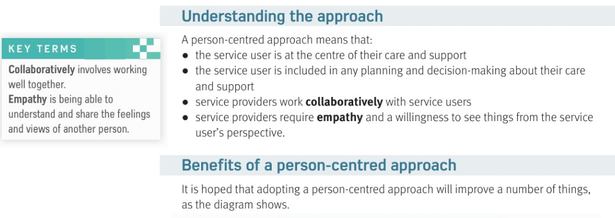

Slide 6
A person centred approach means:
1The service user is at the …. | The service user is always ….. involved in any planning
Users & providers work…together… | Service providers need to have …. Empathy
Centre

Slide 7
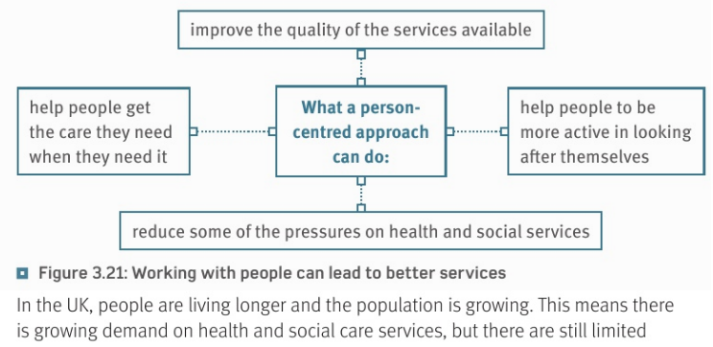
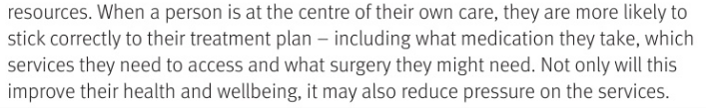

Slide 8
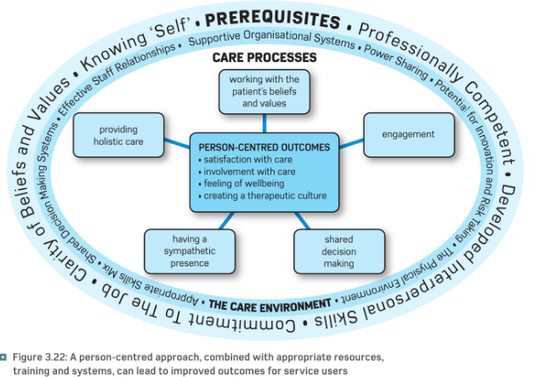

Slide 9
IN the Uk people are living …… and the population is …… This means there will be a growing ……. On H&SC
If you are involved in the decisions you are more likely to …
This will not only improve their health but also reduce……..
longer
growing
demands
Stick to it
pressure

Slide 10
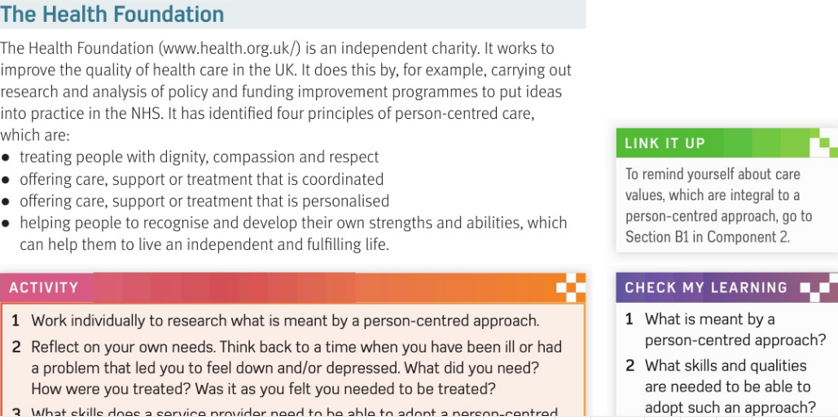

Slide 11
The health Foundation
This is a … | It tries to improve….
The 4 Principles are 1 2 3 4
Charity
healthcare
Treat people with dignity
Offer coordinated care
Offer PERSONALISED care
Help people be INDEPENDENT

Slide 12
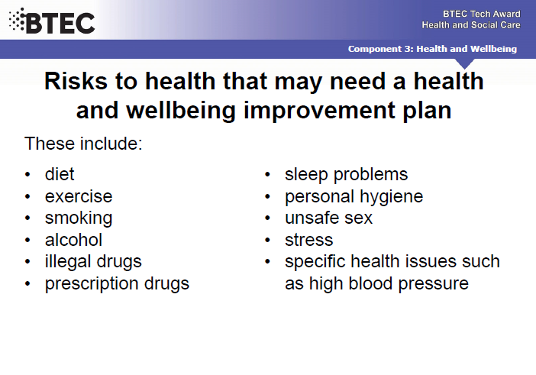

Slide 13
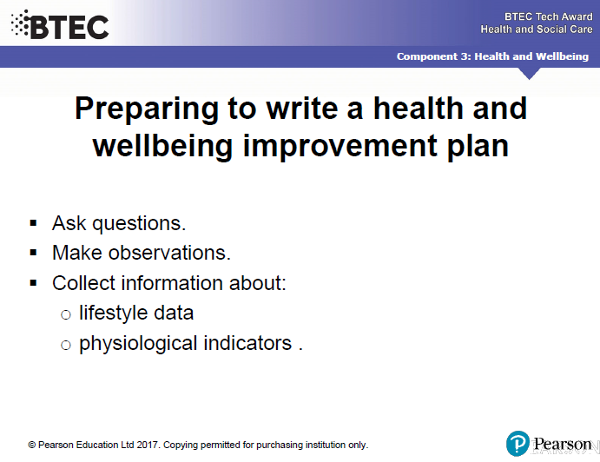

Slide 14
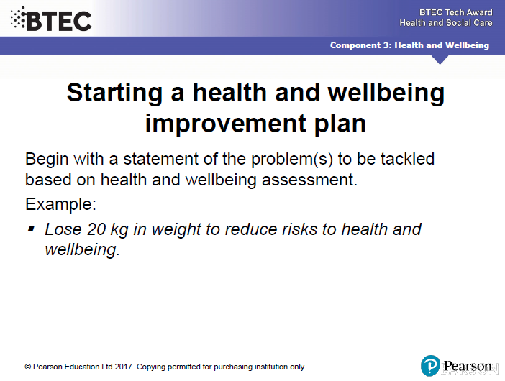

Slide 15
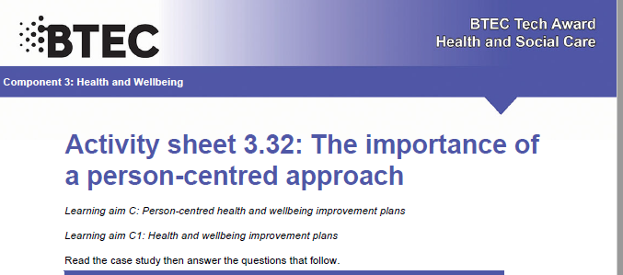

Slide 16
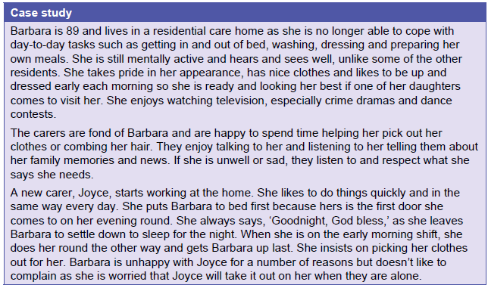

Slide 17
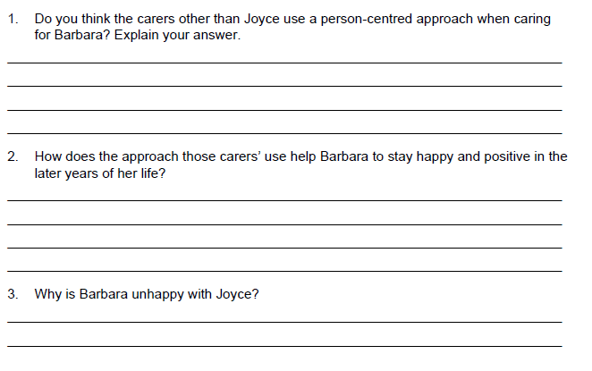
Yes, they listen, respect and care
Helps her do it her own way
Joyce does what is easiest for HER, not what is best for barbara

Slide 18
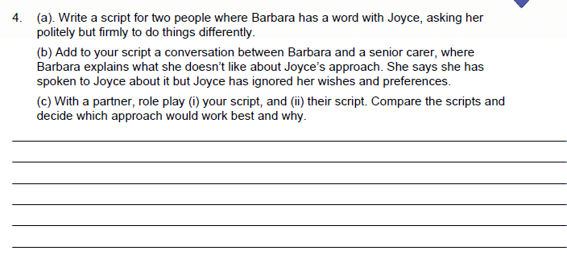

Slide 19
Smhw
h&sc c3 lac person
Video
https://www.youtube.com/watch?v=pj-AvTOdk2Q
https://www.youtube.com/watch?v=ts_S5U-07H4

Slide 20
* Learning Objective: p 184
Person centred approach
Success Criteria:
History
Understanding
Benefits
Prerequisites
Health foundation
Why am I doing this ?
As a patient , you would WANT this

