Slide 1

* Learning Objective: p 194
Emotional & Psychological Obstacles
Success Criteria:
Lack of motivation
Low self esteem
Acceptance of current state
Why am I doing this ?
Your own MIND is the biggest obstacle

Slide 2
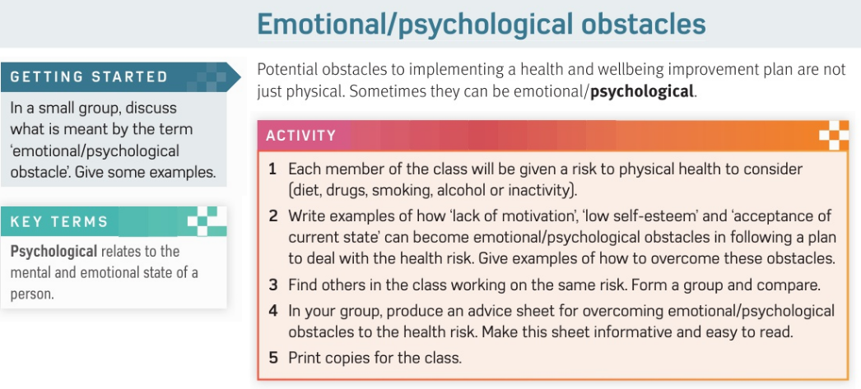
optional

Slide 3
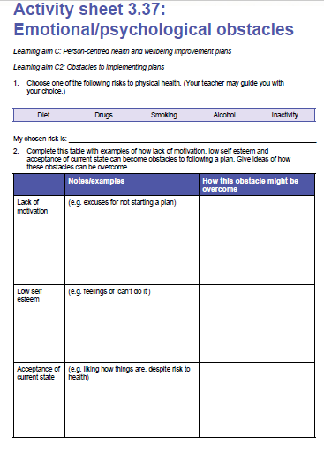

Slide 4
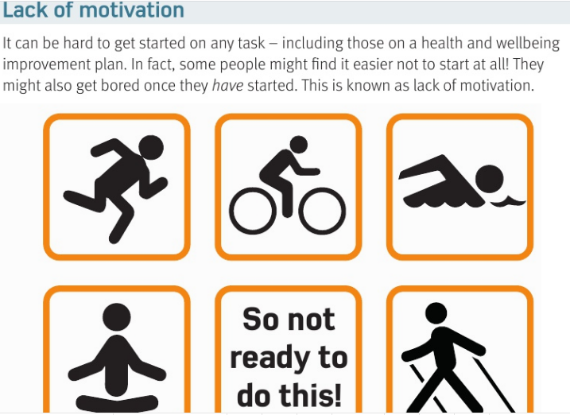

Slide 5
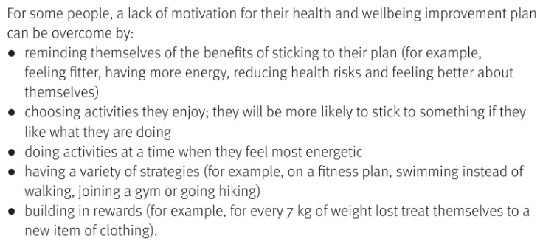

Slide 6
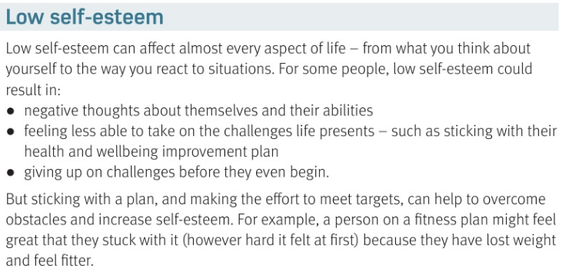

Slide 7
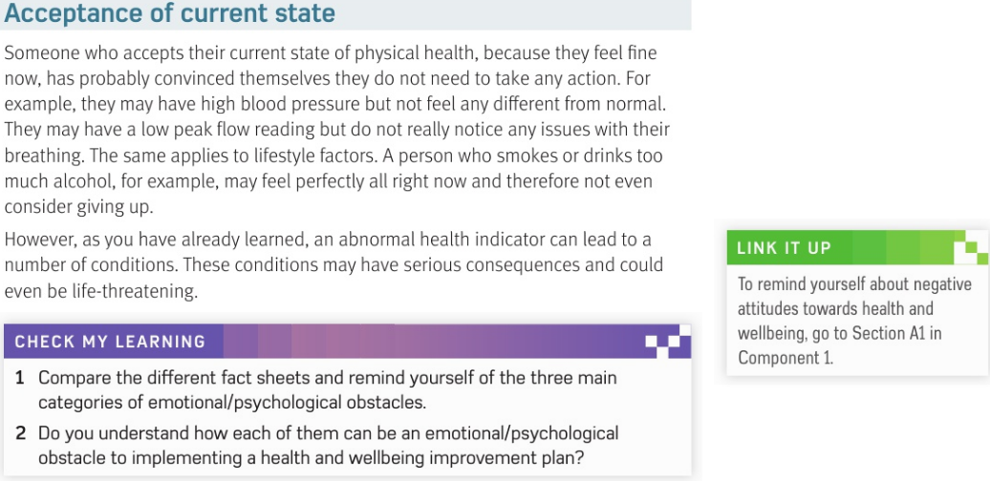

Slide 8
SMHW
h&sc c3 lac obstacles
Video
https://www.youtube.com/watch?v=7XFLTDQ4JMk
Ex - https://www.youtube.com/watch?v=NWfqBy4sSD8

Slide 9
* Learning Objective: p 194
Emotional & Psychological Obstacles
Success Criteria:
Lack of motivation
Low self esteem
Acceptance of current state
Why am I doing this ?
Your own MIND is the biggest obstacle

