Slide 1
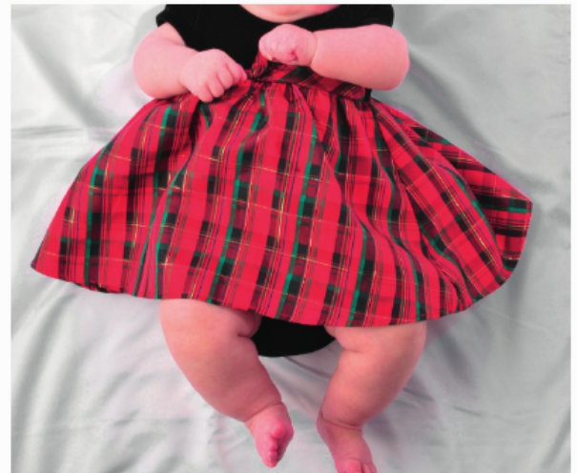
* Learning Objective:p 174
Interpreting Lifestyle data
Success Criteria:
Lifestyle data
Examples
Targets
Why am I doing this ?
H&SC workers do this all the time

Slide 2
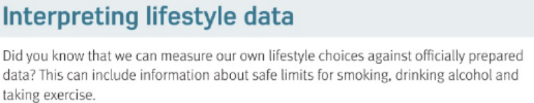
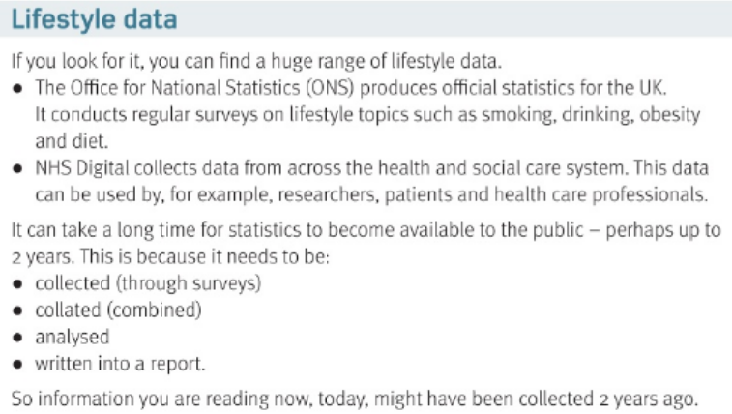

Slide 3
Interpreting Lifestyle data
What is the ONS? | What is NHS digital?
4 reasons why it might take 2 years to get data:
1 | 2
3 | 4
Office of National Statistics
Collects medical data
Time to do surveys
Time to collate it ( Put it together)
time to analyse it
Time to write report

Slide 4
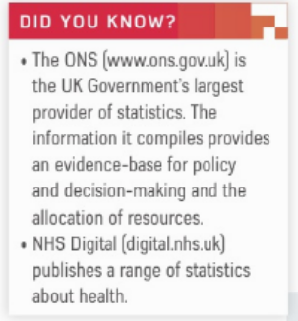
https://www.youtube.com/watch?v=jDyalG1pxo4

Slide 5
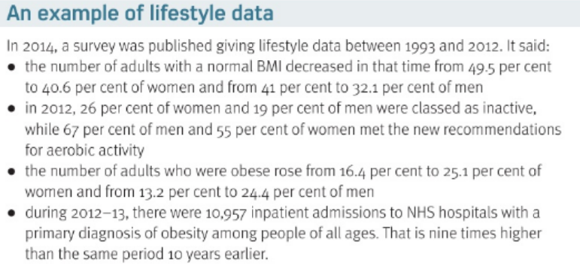

Slide 6
Between 1993 and 2012 People with a normal BMI went
In 2012 how many men and women were meeting the active targets? Men Women
In 2012-2013 how many Obese people went to hospital, and how had that changed over the 10 year previous?
Down! – meaning MORE fat people
55%
67%
10,957 – up 9 TIMES

Slide 7
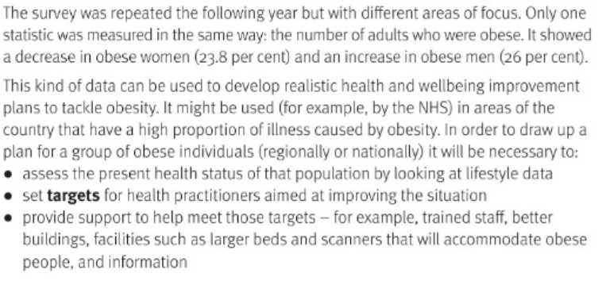
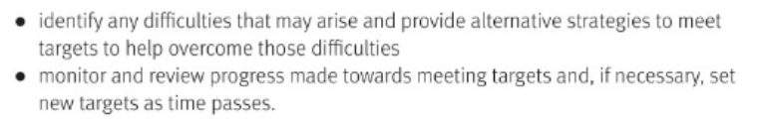

Slide 8
What can this sort of data be used for ?
Assess the… | Set ….
Provide…. | Identify…
Monitor means… | Review..
Know the size of the problems and plan a solutions
Present status
Targets for health
Support to help people
Problems & fixes
Keep checking
See if it worked at the end

Slide 9


https://www.youtube.com/watch?v=R0KcDYlg5no

Slide 10
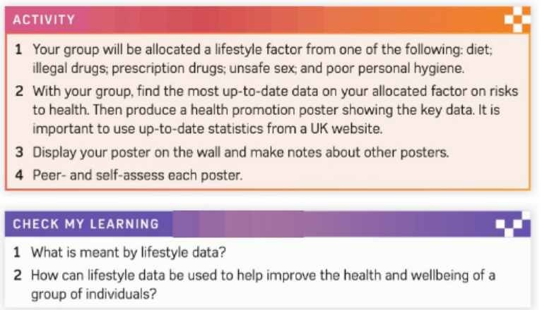

Slide 11
SMHW
H&SC c3 lab lifestyle data
https://www.youtube.com/watch?v=KvwIW2dlUj8

Slide 12
* Learning Objective:p 174
Interpreting Lifestyle data
Success Criteria:
Lifestyle data
Examples
Targets
Why am I doing this ?
H&SC workers do this all the time

