Slide 1

* Learning Objective:p 202
Lack of Support
Success Criteria:
Lack of support
Obstacles
Diet
Smoking
Alcohol
Why am I doing this ?
We all need a little help from our friends

Slide 2
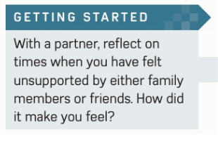

Slide 3
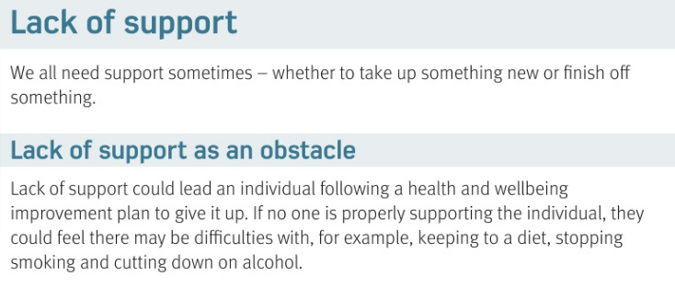

Slide 4
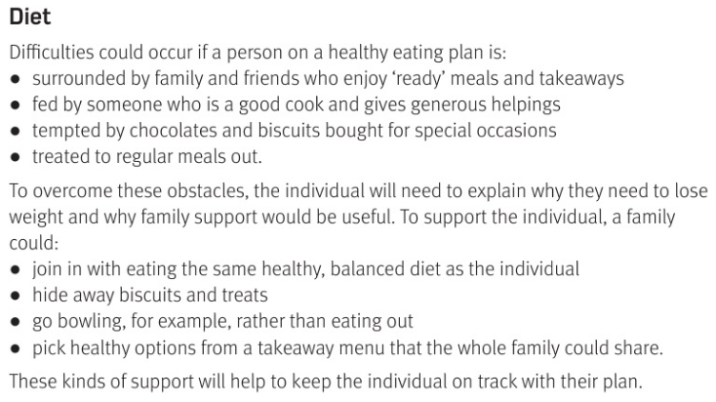

Slide 5
Lack of support
Lack of support leads to people doing what with Health & support plans?
4 problems with no DIET support
1 Surrounded by people who… | 2 Fed by someone who….
3 Tempted by…. | 4 Treated to…
4 solutions to overcome obstacles
Other people could.. | Hide…
Instead of eating out you could.. | Pick options that are..
Giving up
Eat takeaways
Giving up
chocolate
Meals out
Join in diet
biscuits
Go bowling
healthier

Slide 6
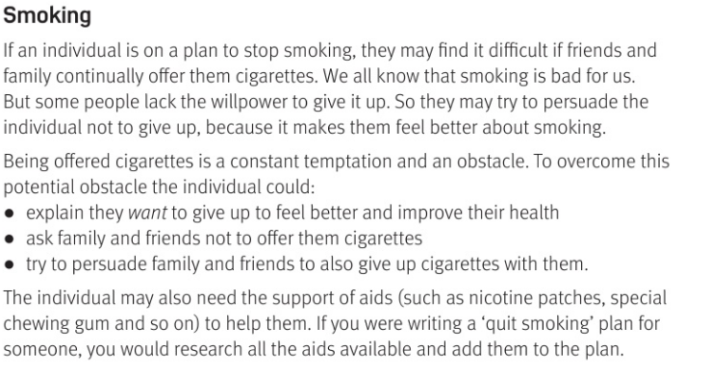

Slide 7
Smoking obstacles
Its harder to give up if other people keep… |  | Other people may not want you to quit because..
Smoking solutions
Explain that you… | Ask people… |  | Try to persuade..
Make THEM feel better
Offering cigarettes
To not OFFER you a fag
Others to join you to quit
WANT to quit

Slide 8
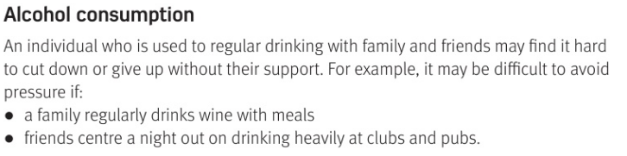
Alcohol problems:
If people drink alcohol with… | If a night out with friends…
Go to pub
Meals

Slide 9
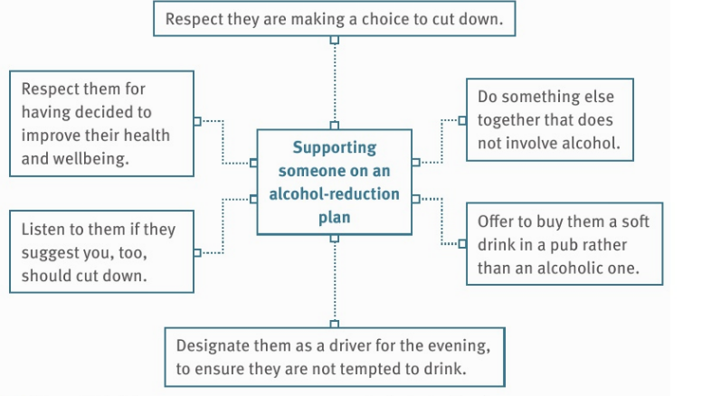

Slide 10
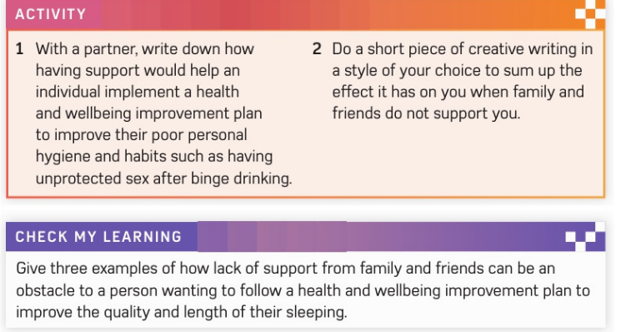
EXTENSION

Slide 11
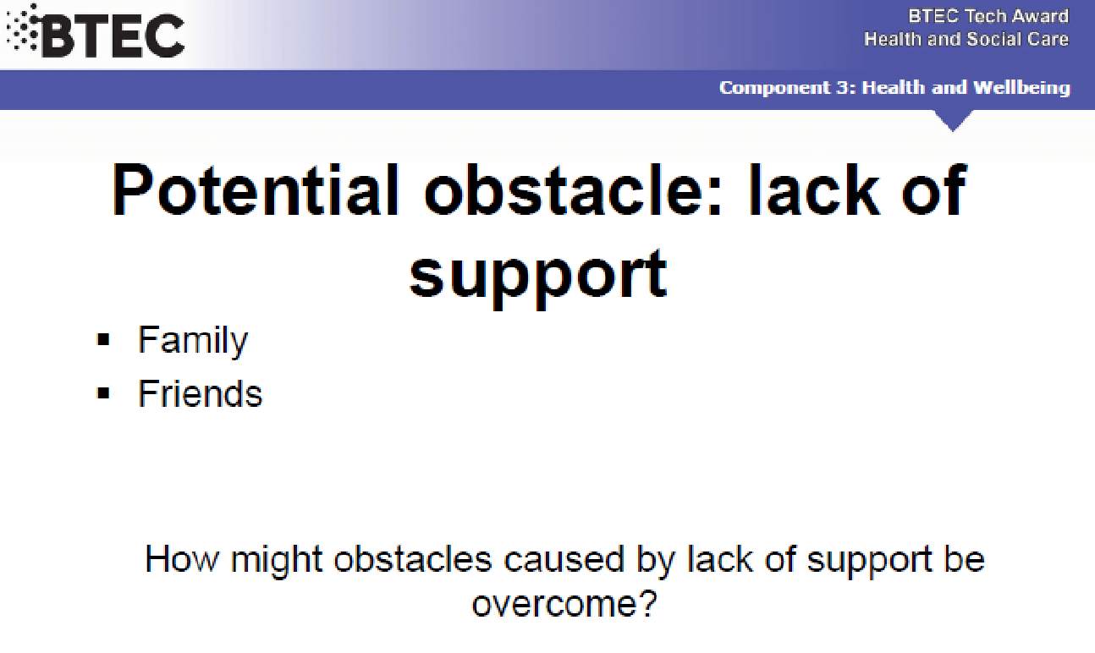

Slide 12
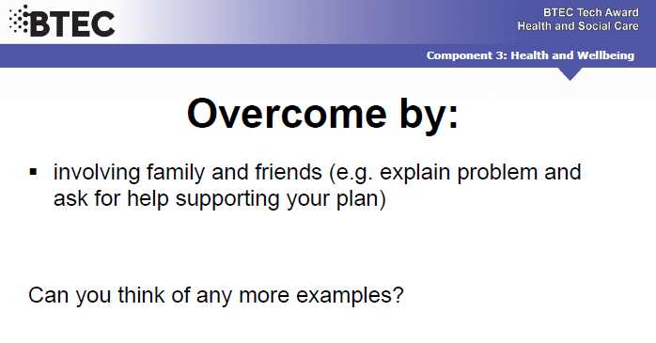

Slide 13


Slide 14
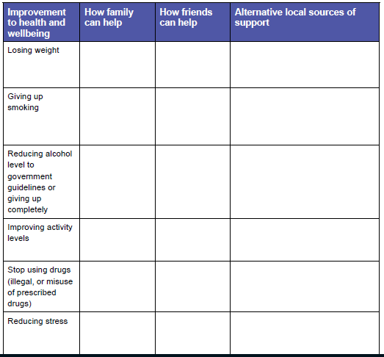
Join in
Not offer
Join weight watchers

Slide 15
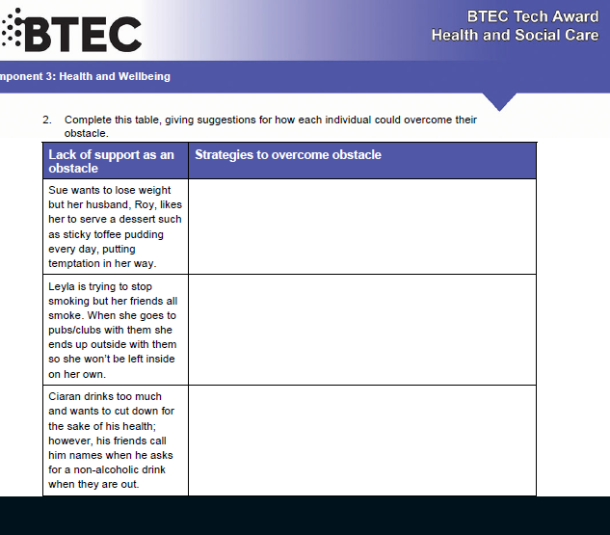
Ask Roy to NOT serve pudding

Slide 16
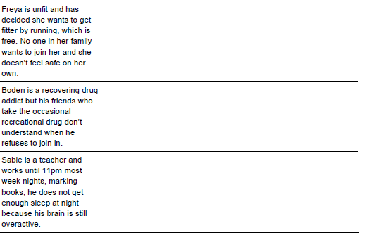

Slide 17
SMHW
h&sc c3 lac no support
Video
Ex - https://www.youtube.com/watch?v=HtDIFA5KhWo

Slide 18
* Learning Objective:p 202
Lack of Support
Success Criteria:
Lack of support
Obstacles
Diet
Smoking
Alcohol
Why am I doing this ?
We all need a little help from our friends

