Slide 1

* Learning Objective: p 180
Inactivity Data
Success Criteria:
Data on activity
Who makes it
Cost of inactivity
Why am I doing this ?
This was me 2 years ago , and why we have PE lessons ins school

Slide 2
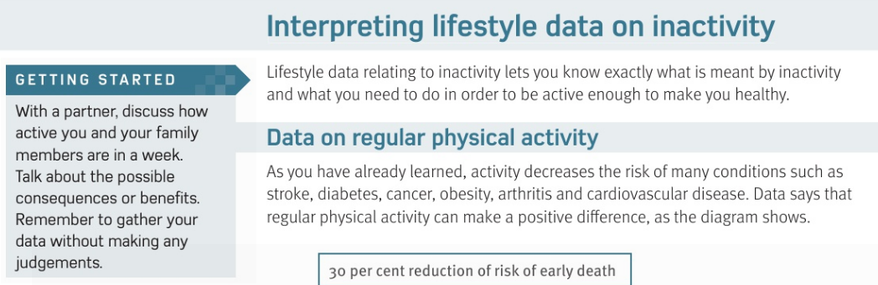

Slide 3
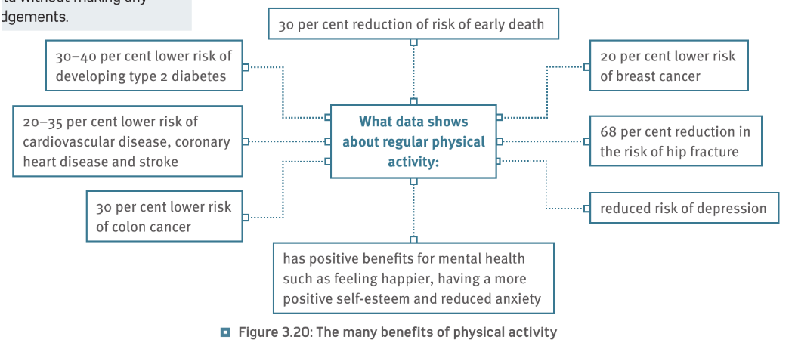

Slide 4
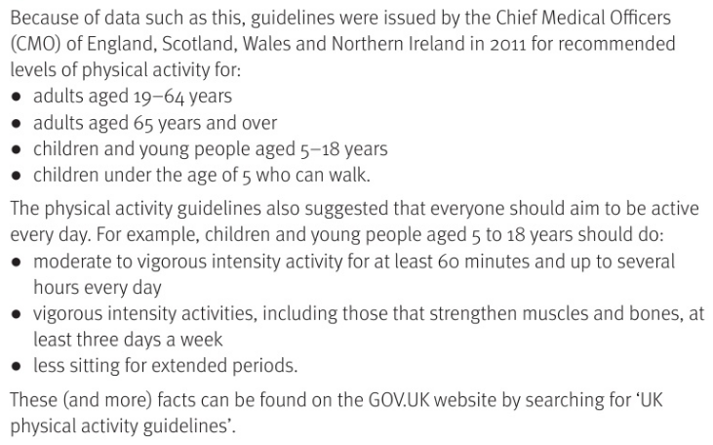

Slide 5
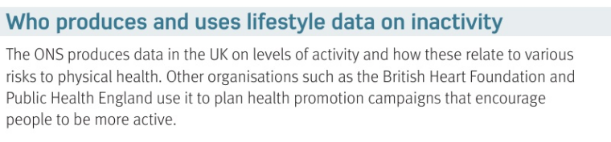
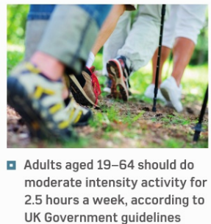

Slide 6
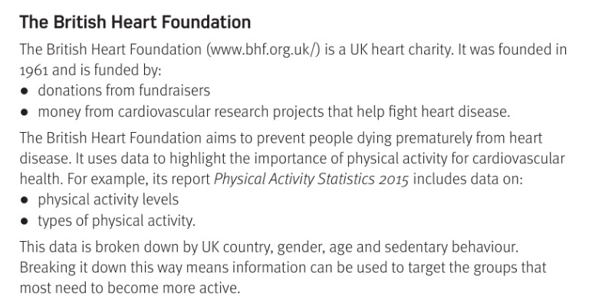

Slide 7
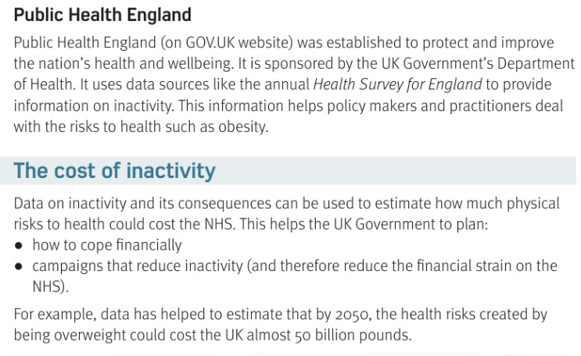

Slide 8
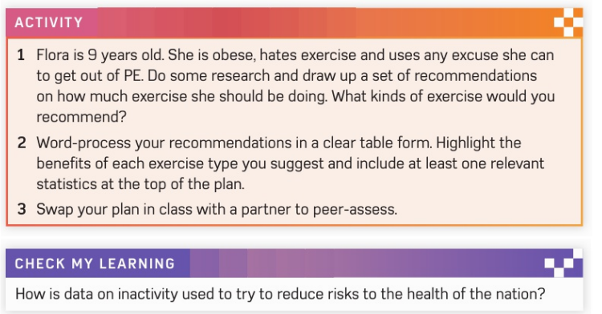

Slide 9
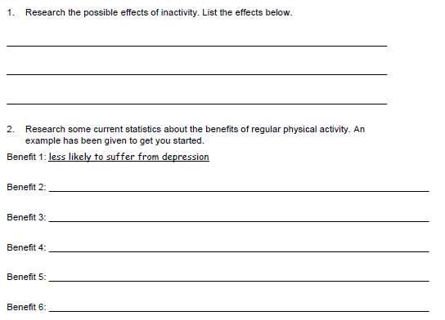

Slide 10
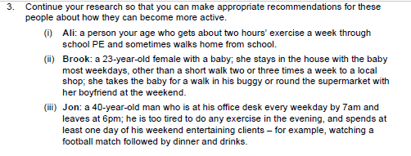

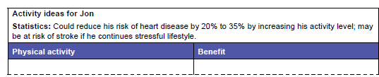

Slide 11
H&SC c3 lab inactivity data
SMHW
https://www.youtube.com/watch?v=wUEl8KrMz14

Slide 12
* Learning Objective: p 180
Inactivity Data
Success Criteria:
Data on activity
Who makes it
Cost of inactivity
Why am I doing this ?
This was me 2 years ago , and why we have PE lessons ins school

