Slide 1
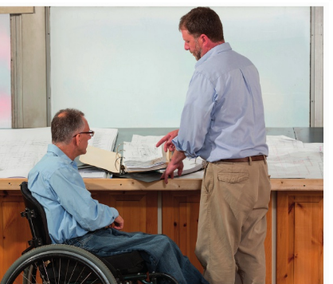
* Learning Objective: p 132
Ill Health
Success Criteria:
Chronic
Acute
Long term
Short term
Why am I doing this ?
If you work in this sector – You need to know

Slide 2
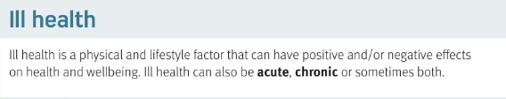
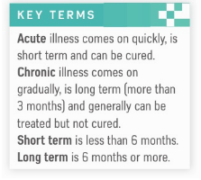

Slide 3
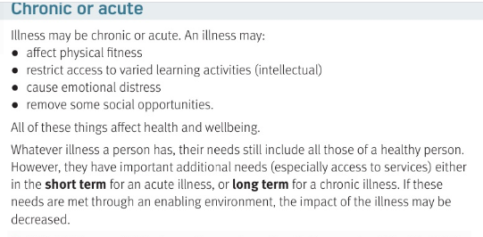

Slide 4
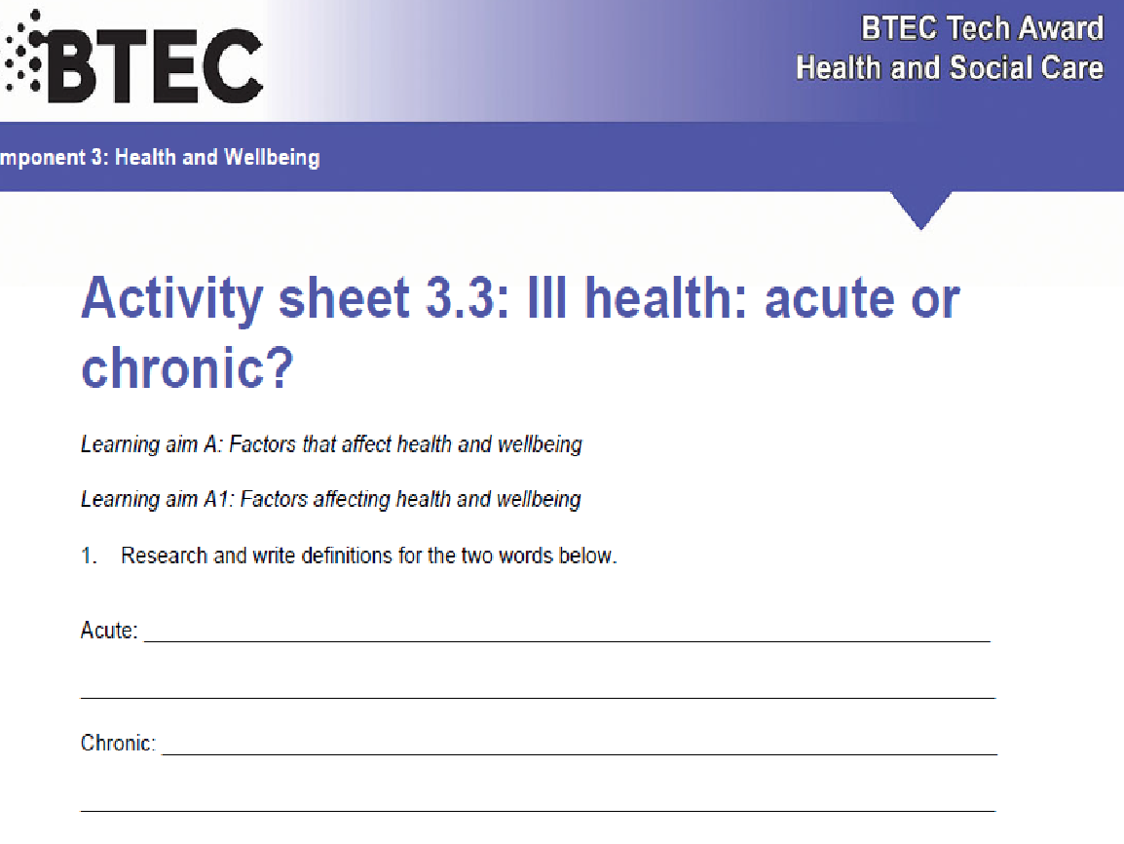
Quick; short term, curable; short term <6 months
Gradual; long term, not curable; > 6months +

Slide 5
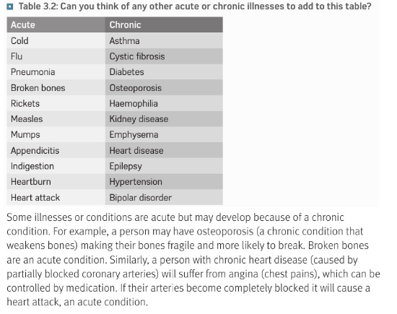

Slide 6
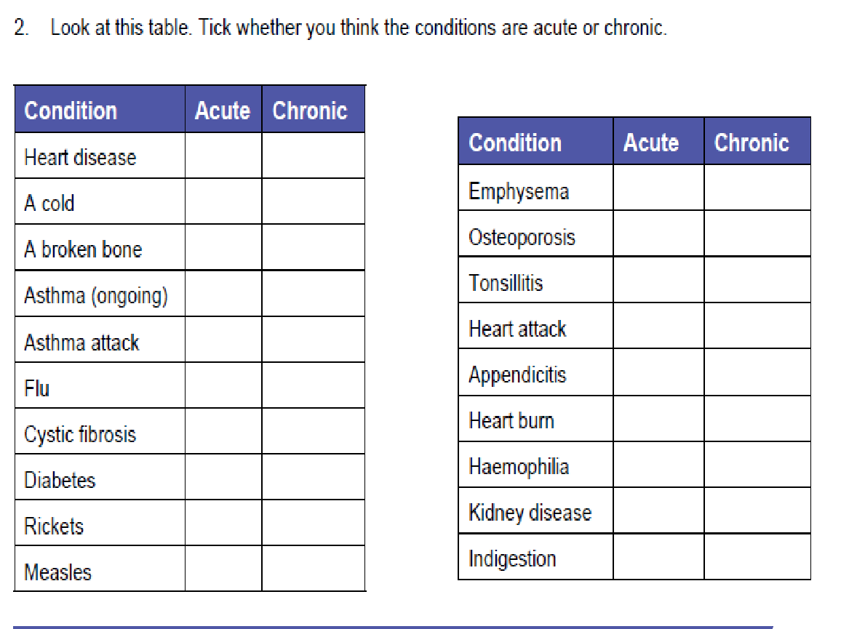


Slide 7
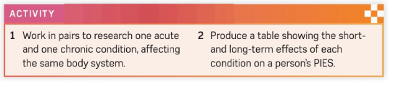
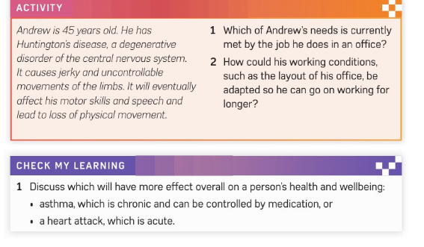

Slide 8
c3 laa definitions & GENETICS & Ill health
on smhw

Slide 9
* Learning Objective: p 132
Ill Health
Success Criteria:
Chronic
Acute
Long term
Short term
Why am I doing this ?
If you work in this sector – You need to know

