Slide 1
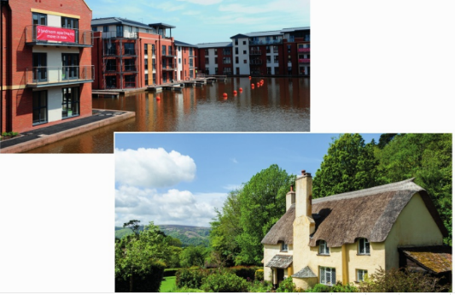
* Learning Objective: p 152
Housing
Success Criteria:
Home environment
Rural
urban
Why am I doing this ?
Where you live makes a difference to your health

Slide 2
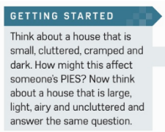

Slide 3
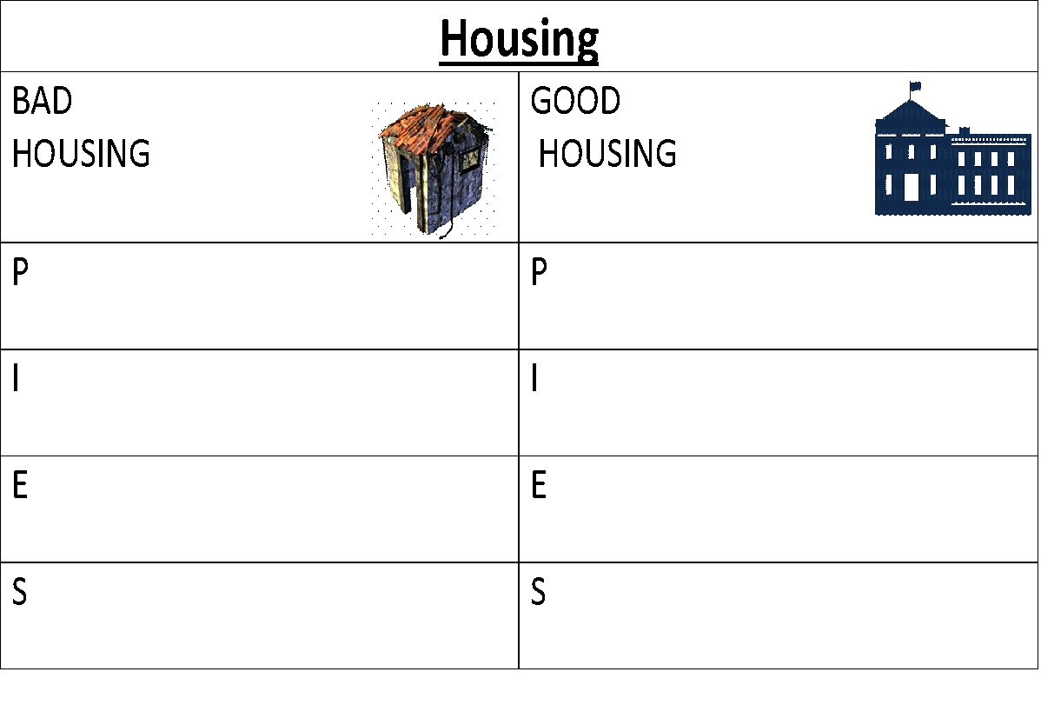

Slide 4
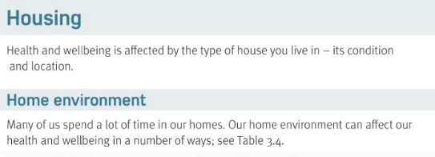
Condition of our home means…. | Location of our home means…
Where it is
What state it is in

Slide 5
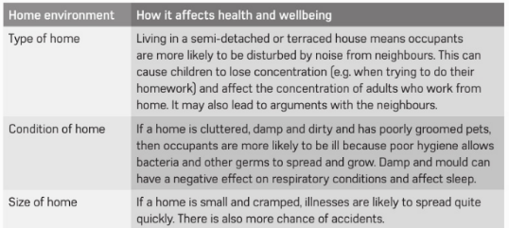

Slide 6
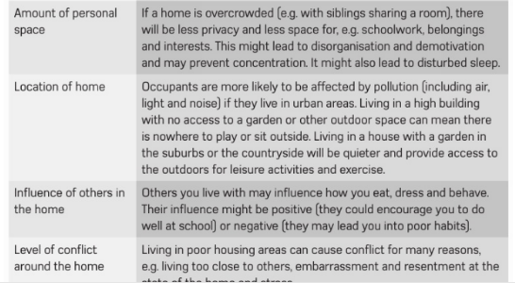

Slide 7
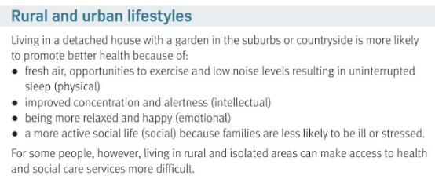

Slide 8
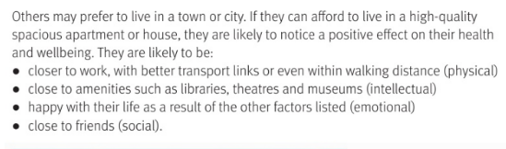

Slide 9
Rural life means.. | Urban life means…
+P | +P
+I | +I
+E | +E
+E | +S
- | -
Countryside
TOWN & CITY
Fresh air
Walking distance
Museums & libraries
concentration
relaxed
Lots to do
Hang out with family
Close to friends
More crime
FAR AWAY FROM HOSPITAL

Slide 10
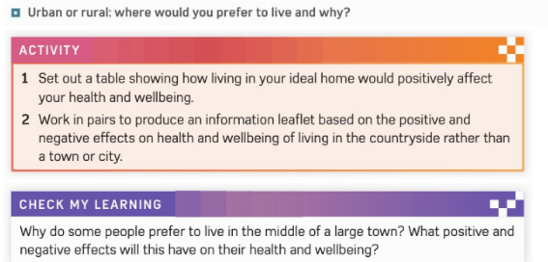
Optional

Slide 11
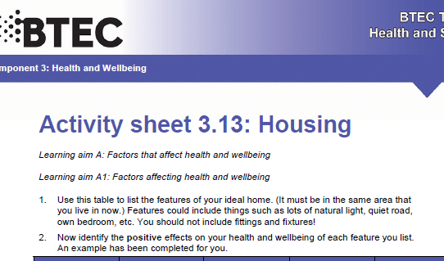

Slide 12
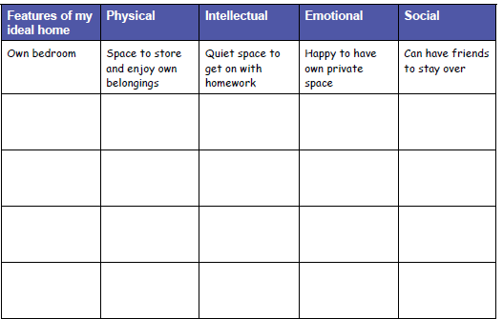

Slide 13
Smhw
c3 laa definitions & GENETICS & housing
Video
https://www.youtube.com/watch?v=zNzFnHL-8Zk

Slide 14
* Learning Objective: p 152
Housing
Success Criteria:
Home environment
Rural
urban
Why am I doing this ?
Where you live makes a difference to your health

