Slide 1
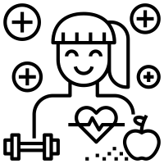
* Learning Objective: p 160
Health Indicators
Success Criteria:
Health monitoring
Ill ness prevention
Measurements of health
= & - LIFESTYLES
Observed INDICATORS
Why am I doing this ?
YOU NEED TO know IF SOMONE IS HEALTHY OR NOT

Slide 2
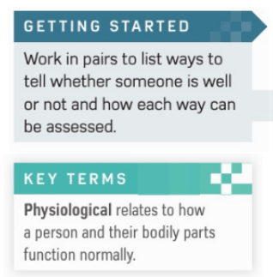

Slide 3
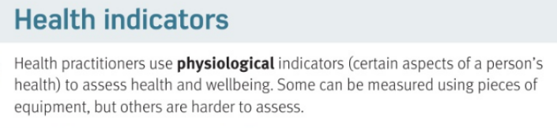

Slide 4
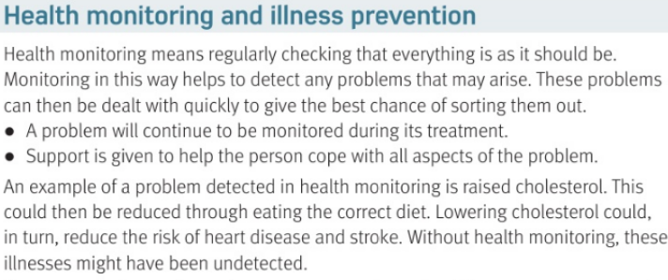

Slide 5
HEALTH INDICATORS
Physiological means…
Some indicators can be measured by ..
Health Monitoring means..
These problems can then be..
Eg problem | Eg solution
The BODY
machines
Regularly checking your health
Found and solved early
High cholesterol
Better diet

Slide 6
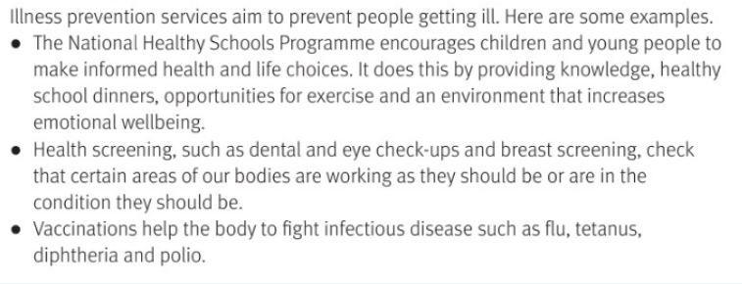

Slide 7
Illness prevention means..
Eg national healthy schools does this…
Health screening includes…
Vaccinations do what ?
Don’t get ill in the first place
Eat well, exercise etc
Dentist checks, eye tests, breast screening
Stop you getting a disease in the first place

Slide 8
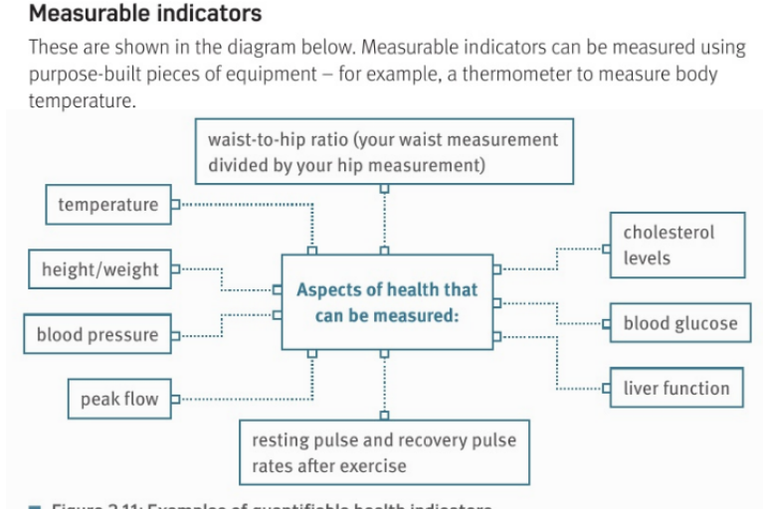
https://www.youtube.com/watch?v=mOgciP5MMXk
https://www.youtube.com/watch?v=jdA8KU_D9JU

Slide 9
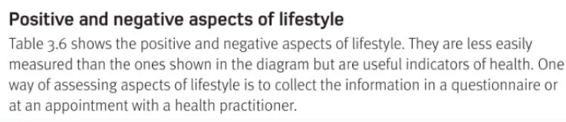
Is lifestyle easier or harder to measure: | Easier | Harder
One way to measure lifestyle is a…
_______
Questionnaire

Slide 10
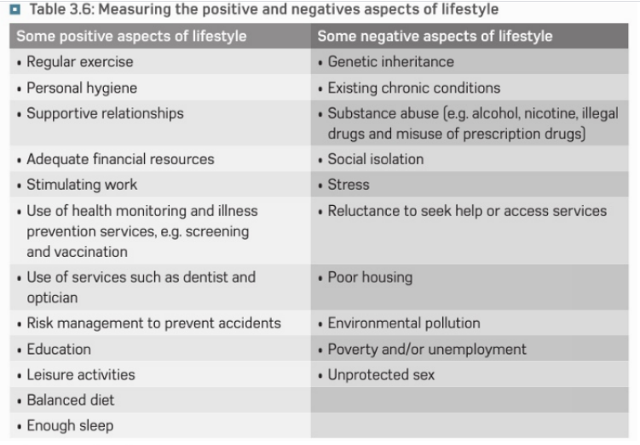

Slide 11
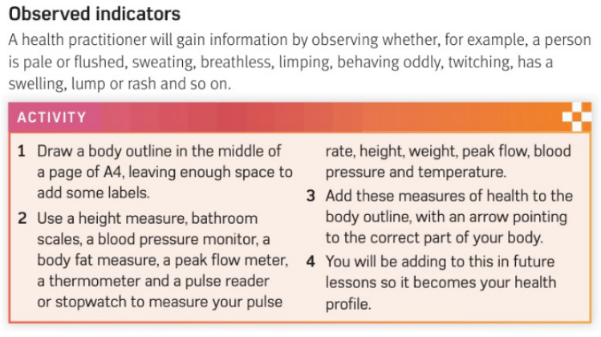
optional

Slide 12
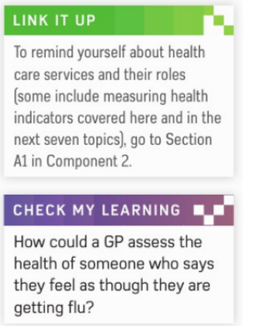

Slide 13
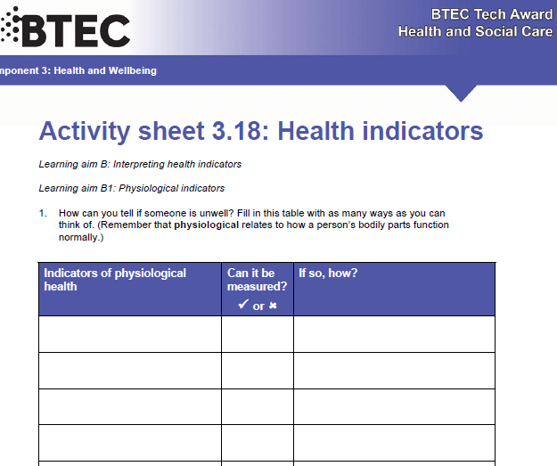

Slide 14
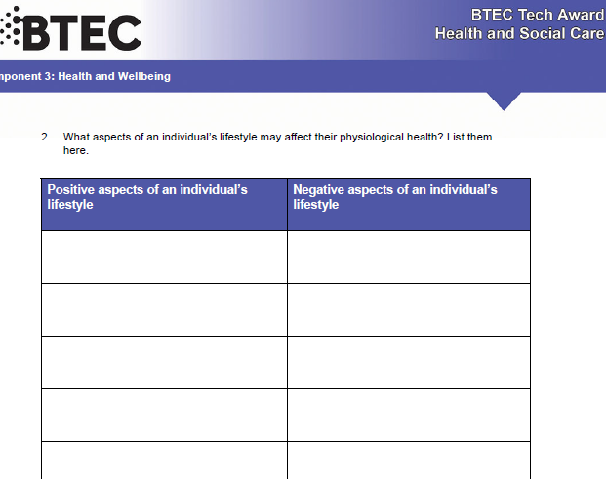

Slide 15
Smhw
H&SC c3 lab indicators
https://www.youtube.com/watch?v=-u5UxPSTBLo

Slide 16
* Learning Objective: p 160
Health Indicators
Success Criteria:
Health monitoring
Ill ness prevention
Measurements of health
= & - LIFESTYLES
Observed INDICATORS
Why am I doing this ?
YOU NEED TO know IF SOMONE IS HEALTHY OR NOT

