Slide 1
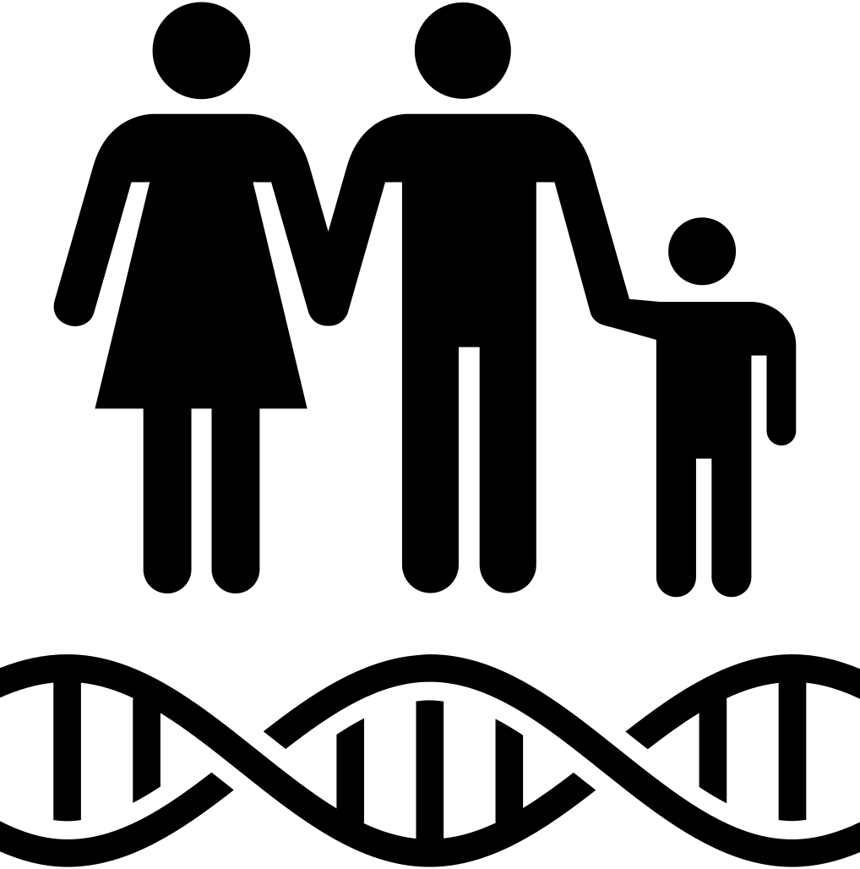
* Learning Objective: p 130
Genetic Inheritance
Success Criteria:
Inheritance
How it works
Predisposition
Why am I doing this ?
We all inherit SOME things from our parents

Slide 2

https://www.youtube.com/watch?v=K3F5BV82Lg8

Slide 3
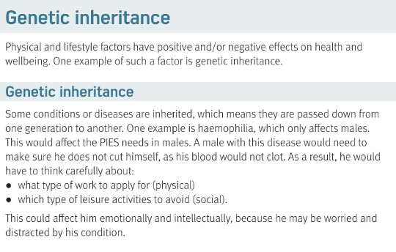

Slide 4
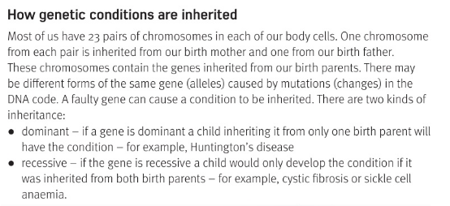

Slide 5
What type of factor is Genetics? | Social | Lifestyle | Economic |  | Physical
A genetic problem only affects 1 of the PIES? | TRUE |  |  | FALSE
We have 23 pairs of these in our bodies:
The code of Genetics is called
This means only 1 parent needs to have it to pass it on |  |  |  | eg
This means BOTH parents would need to have it to pass it on |  |  |  | eg
Chromosomes
DNA
dominant
huntingtons
recessive
Cyctic
fibrosis

Slide 6
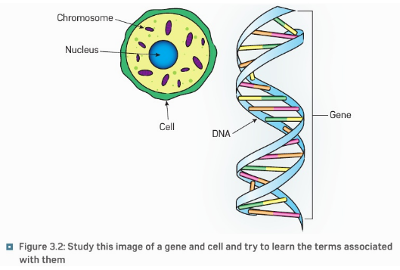
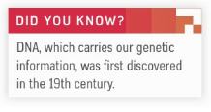

Slide 7
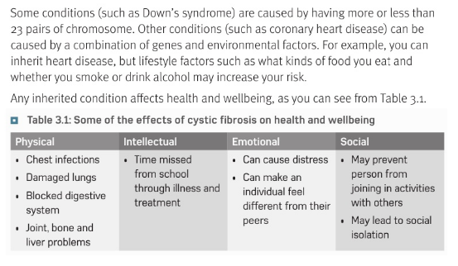

Slide 8
https://www.youtube.com/watch?v=jZOAe5eu2FE 8 minutes

Slide 9
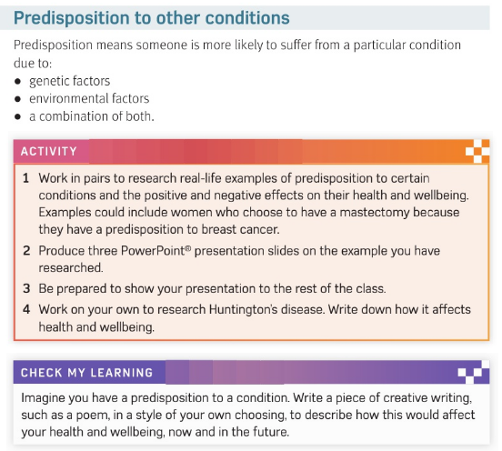

Slide 10
inherit
You can _____________________ heart disease, but ____________________ factors like what kinds of food you eat may increase your risk
Predisposition means..
This is due to
lifestyle
More likely to get it
lifestyle
genetics
Combination of both

Slide 11
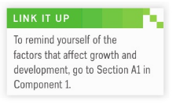
Physical
Lifestyle
Social & Cultural
Relationships & isolation
Economics

Slide 12
c3 laa definitions & GENETICS
SMHW
https://create.kahoot.it/share/5c1348d0-66ff-430b-b254-41cb578b79c2

Slide 13
* Learning Objective: p 130
Genetic Inheritance
Success Criteria:
Inheritance
How it works
Predisposition
Why am I doing this ?
We all inherit SOME things from our parents

