Slide 1
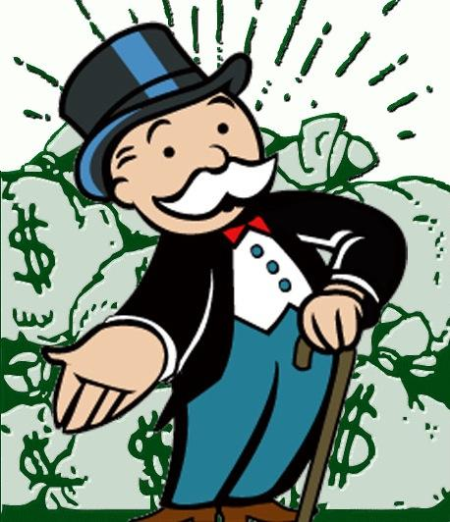
* Learning Objective: p 148
Financial resources
Success Criteria:
Income
Effects
Poverty
Why am I doing this ?
Money makes a difference to health

Slide 2
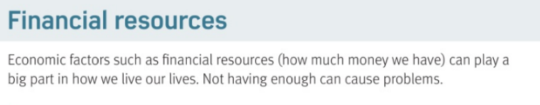
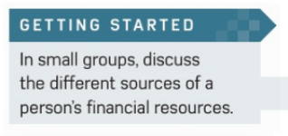
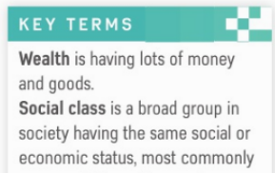

Slide 3
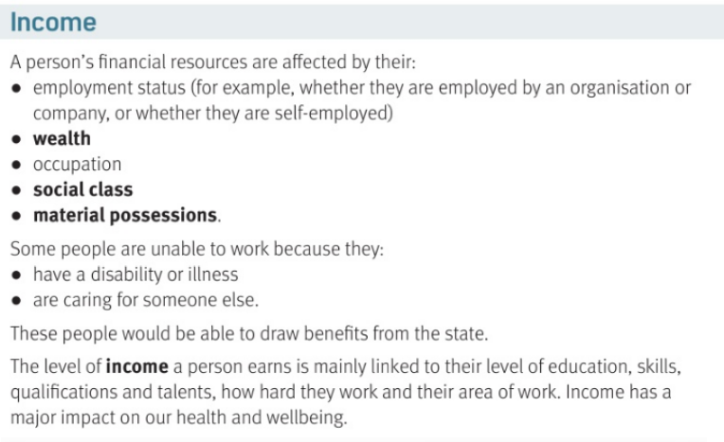

Slide 4
Financial resources
Wealth means.. | Social Class means…
Material Possessions means… | Income means…
Money can have a big impact on your…….
2 reasons why someone might not have a job
Without a job, what can you get from the government?
Lots of money
Upper , middle or lower wealth people
Luxuries you can buy
Money you get each month
health
ill
carer
benefits

Slide 5
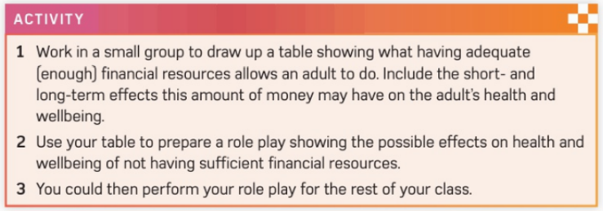
Optional

Slide 6
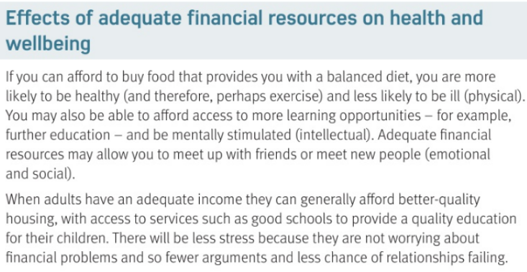

Slide 7
Money & PIES = Being rich affects your…
Physical | Intellectual
Emotional | Social
Balanced diet / Gym membership
Afford university
Less money stress
Go out with mates = happy

Slide 8
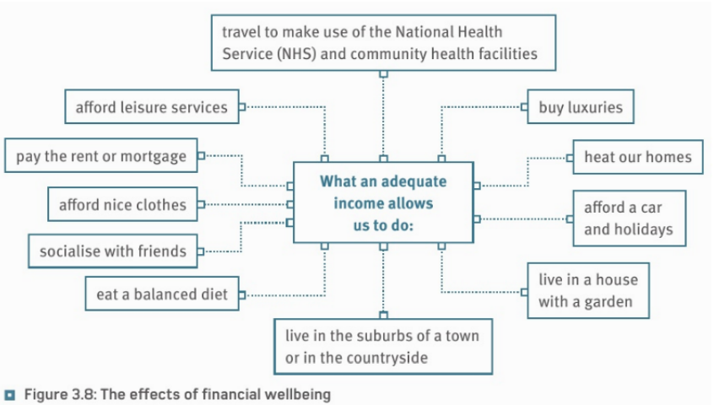

Slide 9
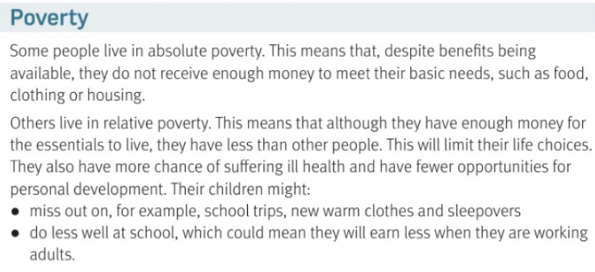

Slide 10
Poverty
Poverty means.. | How many kids live in poverty?
Absolute poverty means…. | Relative poverty means…
5 possible results of poverty | 1 miss out on school…
2 cant afford warm.. | 3. Never have…
4. do less well at … | 5 Earn less when they are
No money
3.9 Million
Cant afford basics
Lots less than others
Trips
clothes
sleepovers
school
adults

Slide 11
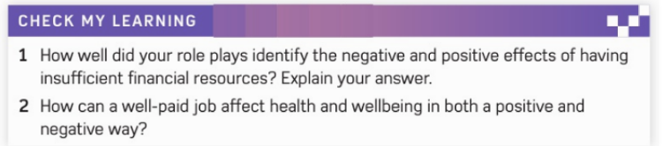
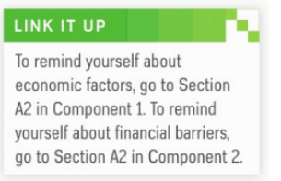
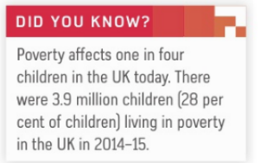

Slide 12
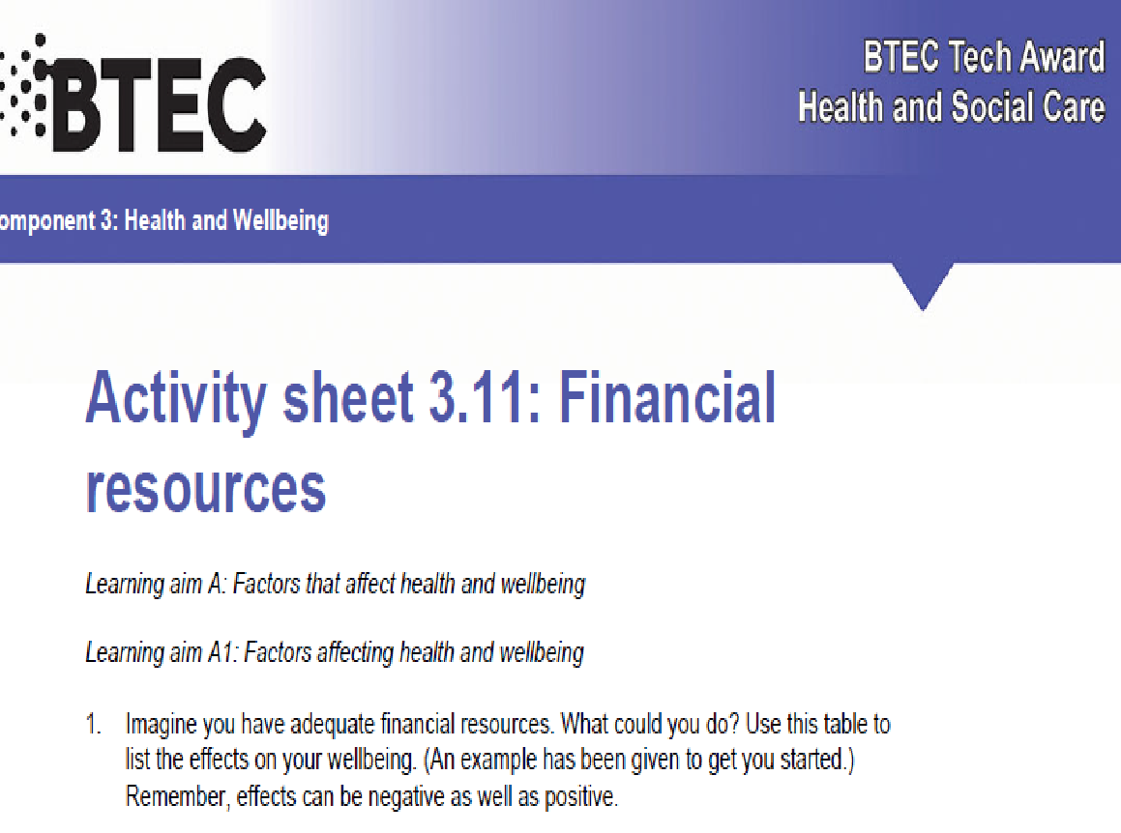

Slide 13
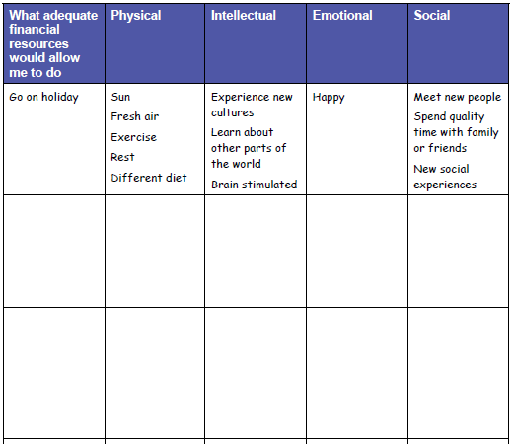

Slide 14
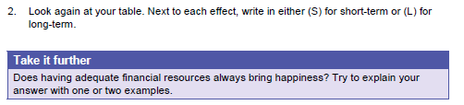

Slide 15
Smhw
c3 laa definitions & GENETICS & Financial
Video
https://www.youtube.com/watch?v=ZPVwgnp3dAc

Slide 16
* Learning Objective: p 148
Financial resources
Success Criteria:
Income
Effects
Poverty
Why am I doing this ?
Money makes a difference to health

