Slide 1

* Learning Objective:p 136
Exercise
Success Criteria:
Benefits
Taking exercise
Not taking exercise
Why am I doing this ?
Use it or lose it !

Slide 2
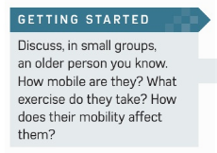

Slide 3
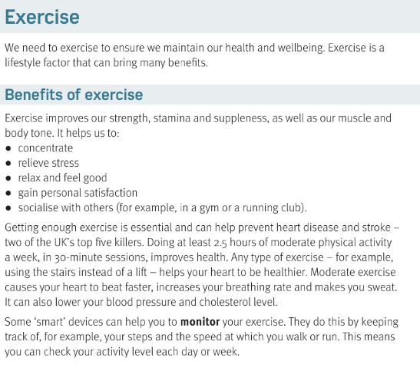
Exercise
We exercise to.. | What factor is it ? | What does it bring ?
Keep healthy
lifestyle
benefits

Slide 5
List 5 benefits of exercise | 1
2 | 3
4 | 5
Getting exercise helps prevent .. | How many hours should you do a week?
What dies exercise LOWER | Name a SMART tracker device?
concentrate
Less stress
relax
satisfaction
socialise
Heart disease & stroke
2.5
Blood pressure & Cholesterol
FITBIT?

Slide 6
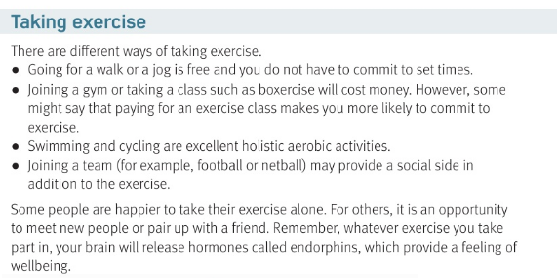

Slide 7
4 ways to take exercise
1 | 2
3 | 4
Walk / jog
gym
Join a club
Swim / bike

Slide 8
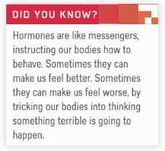
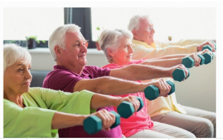

Slide 9
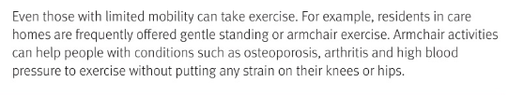
https://www.youtube.com/watch?v=QqOMtmL-T1I

Slide 10
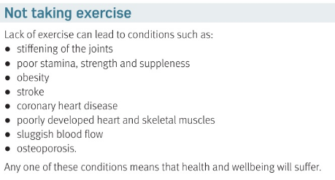

Slide 11
List 8 problems from not EXERCISING
1 | 2
3 | 4
5 | 6
7 | 8
Stiff JOINTS
Bad stamina
Obesity
Stroke
Heart disease
Weak skeleton
Bad blood flow
Osteoporosis / arthritis

Slide 12
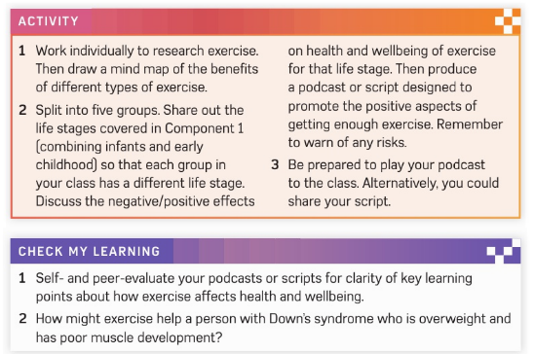

Slide 13
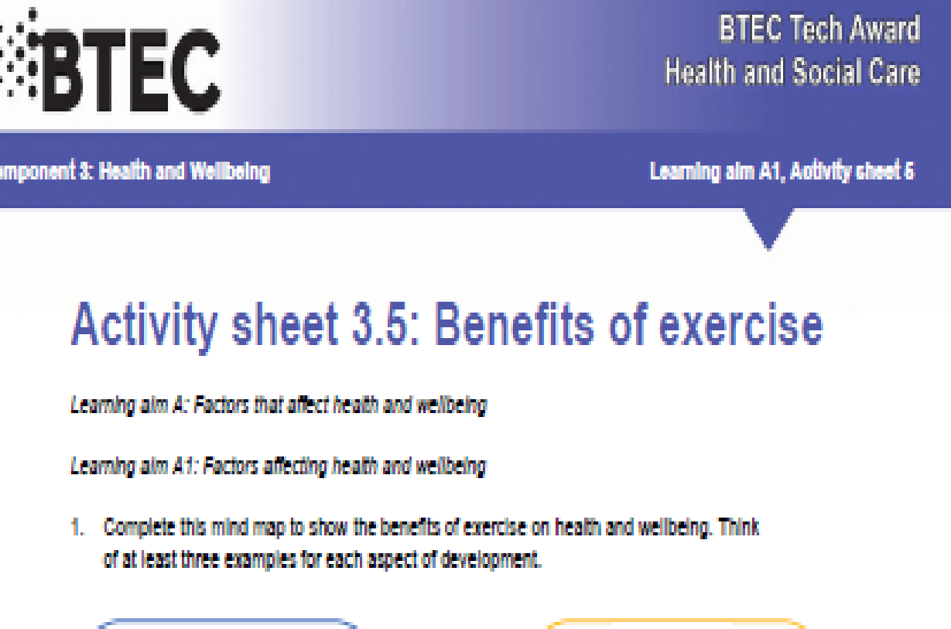

Slide 14
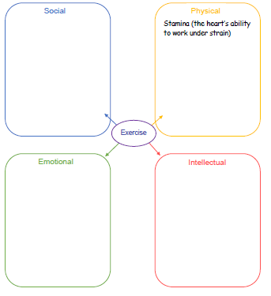
Stroke do it with people
Get stronger
Feel good
Stay calm

Slide 15
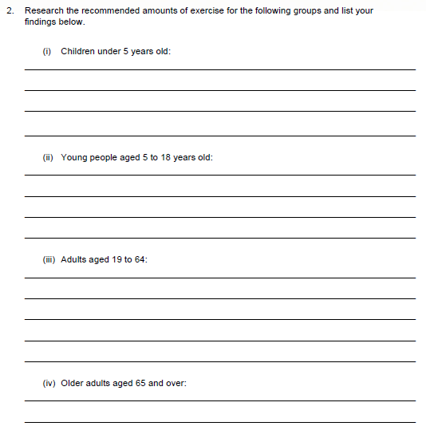
Only through play
One hour a day 3 days a week
150 minutes over 2 days a week
At least 150 minutes a week of moderate intensity activity such as brisk walking; At least 2 days a week of activities that strengthen muscles

Slide 16
SMHW c3
c3 laa definitions & GENETICS & Ill health & diet & exercise
Kahoot – https://create.kahoot.it/share/hsc-c3-laa-exercise/a5c137d2-d3aa-4ff6-9318-f76a19cc95f3

Slide 17
* Learning Objective:p 136
Exercise
Success Criteria:
Benefits
Taking exercise
Not taking exercise
Why am I doing this ?
Use it or lose it !

