Slide 1
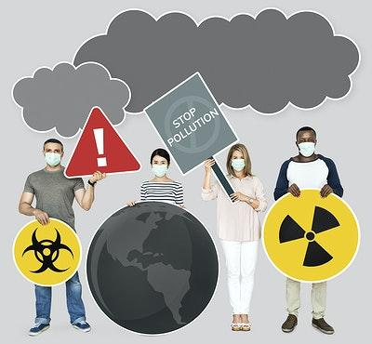
* Learning Objective: p 150
Environmental Conditions
Success Criteria:
Pollution
Air pollution
Noise pollution
Why am I doing this ?
WHERE you live will affect your health

Slide 2
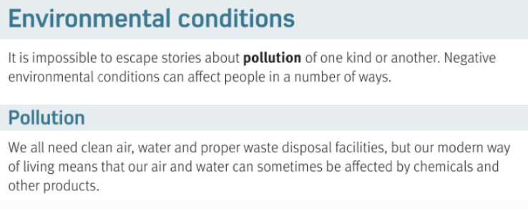
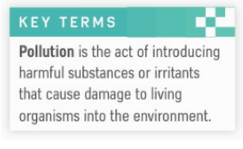
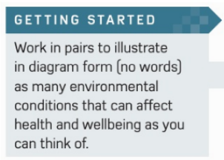

Slide 3
Environmental Conditions
What is Pollution?
What 3 things do we all need | 1 | 2 | 3
Bad stuff in the world
air
water
sewage

Slide 4
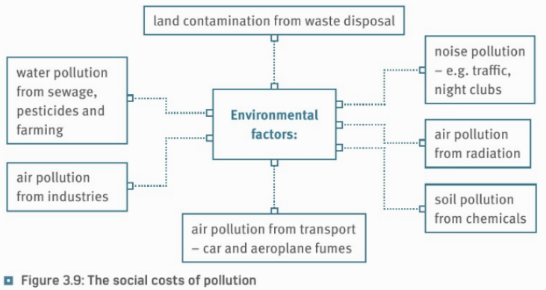

Slide 5
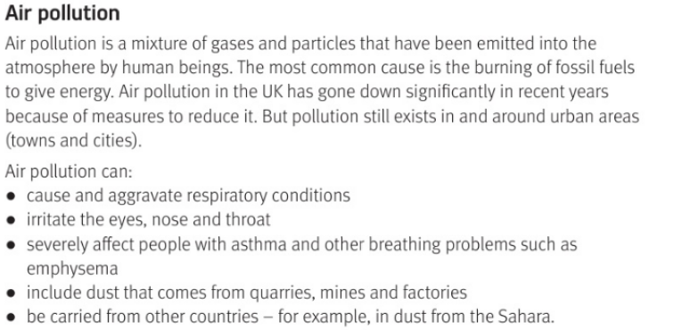

Slide 6
Air pollution
What is it ? | Where does it come from ?
Has it gone up or down? | Where is it worse?
5 effects of air pollution: | Respiratory means…
Irritate .. | Diseases like..
Dust from… | Come from other..
Bad gas & dust
Gas & petrol
down
Towns & cities
Lungs & breathing
Eyes nose throat
asthma
countries
factories

Slide 7
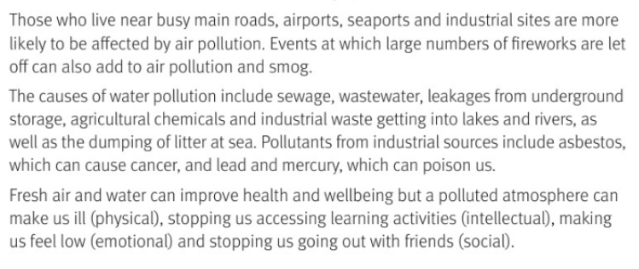

Slide 8
PIES EFFECTS
Physical | Intellectual
Emotional | Social
make us ill
Damage our brain
Make us sad
Stop us going out

Slide 9
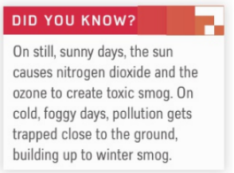
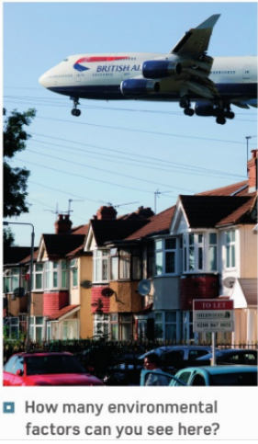

Slide 10
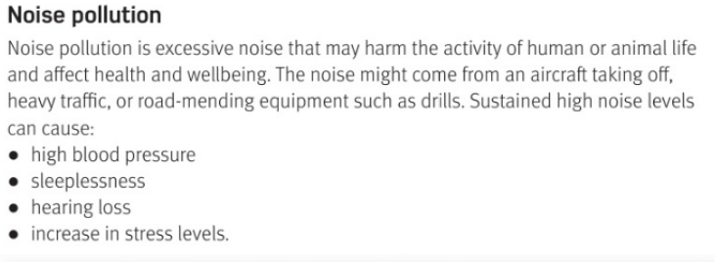

Slide 11
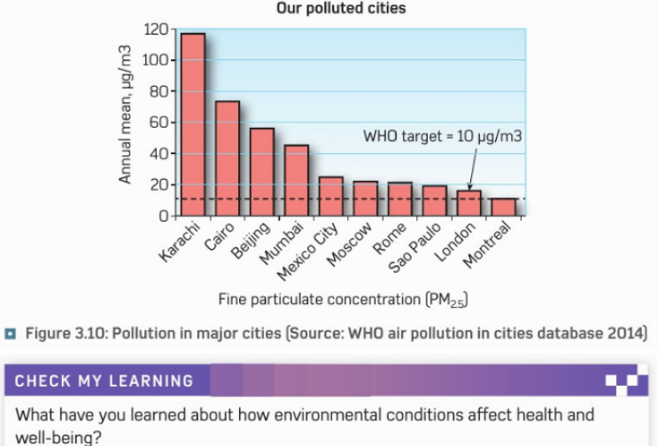

Slide 12
Noise pollution
3 examples | 1 | 2 | 3
Noise pollution can cause…
1 |  | 2
3 |  | 4
Is it worse in Richer or poorer cities?
aircraft
traffic
drills
High blood pressure
No sleep
deafness
stress
Poorer

Slide 13
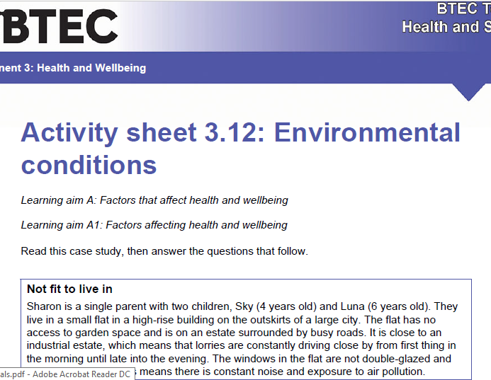

Slide 14
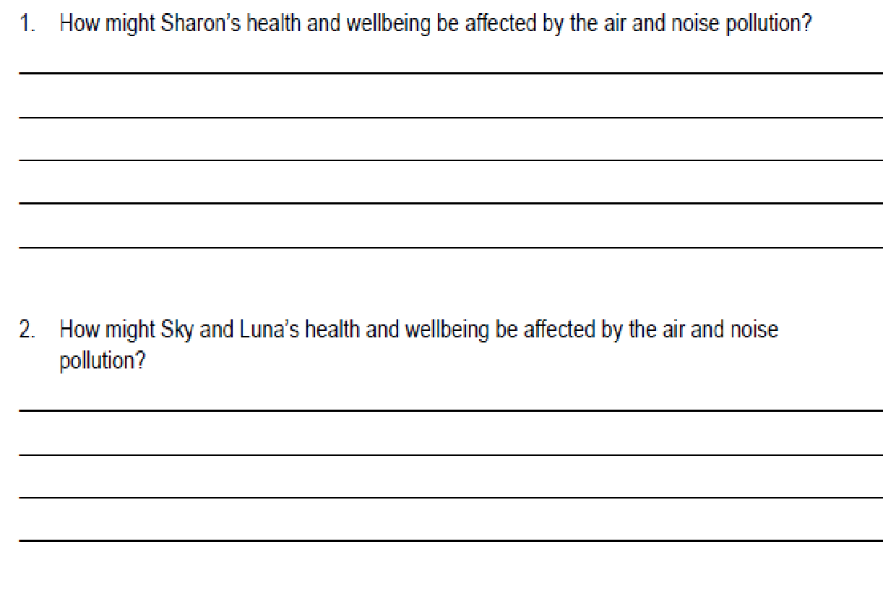

Slide 15
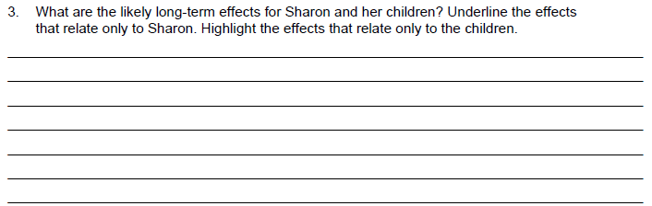
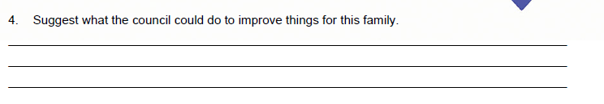

Slide 16
Smhw
c3 laa definitions & GENETICS & environmental
Video
https://www.youtube.com/watch?v=GVBeY1jSG9Y
https://www.youtube.com/watch?v=5jfmzufa8qo

Slide 17
* Learning Objective: p 150
Environmental Conditions
Success Criteria:
Pollution
Air pollution
Noise pollution
Why am I doing this ?
WHERE you live will affect your health

