Slide 1
Eduqas GCSE English Language
Writing Tasks
Reports

Slide 2
Aims of this presentation
introduce report writing
discuss features of report writing
focus on specific report writing tasks
share tips and look at how to write a successful report
consider sample plans and extracts
provide full marked examples
link to a revision sheet on report writing

Slide 3
Report writing: key information
What do you need to know?
Audience
Who are you writing your report for? Is there anything you need to consider when writing to this particular audience?
Purpose
What is your writing trying to achieve? For example, you may need to do at least one of the following:
give information
report specific details
give your views
make suggestions

Slide 4
Report writing: how to plan
Content
What are the main points you want to make?
Think about whether these points are clearly focused on the task that has been set.
Think about whether your points are consistent and the most logical way of presenting them.
Register
What is the appropriate tone for your writing?
A written report should be written in a formal way. The tone should be polite and respectful.
Format
What do you need to know about layout?
There are some conventions that can help you to organise your report in a sensible way. The next slide may give you some ideas to help with this.

Slide 5
Features: layout
Think carefully about the structure of your report. The following features may help you to organise your writing:
Title | This should briefly make clear the content of your report.
Introduction | This is an opening section that will outline why you are writing the report and what you will be writing about.
Subheadings | These can help you divide the content of your report into useful sections. It can be helpful to think about what these will be as part of the planning process.
Conclusion | A paragraph or section that addresses the task and considers any recommendations you wish to make.

Slide 6
Features: layout
Introduction:
Make sure you give a clear introduction to establish the direction of your report:
Introduction
As a student at D…… High School, I am writing this report to present my views on the strengths and weaknesses of our school. There are many strengths to our community-minded school and these are well known and will be easy to list. This report will also consider a few areas which could be strengthened, focusing primarily on the dated school environment and poor state of some of the older buildings. This report will also recommend ways in which these weaknesses could be improved in the near future.

Slide 7
Features: layout
Concluding statement:
Use your conclusion to revisit the task and give an overview of possible suggestions for the future:
Conclusion
Thank you for reading this report. I hope that the information contained here will provide evidence of the many strengths our school has to offer. The main weaknesses that need to be addressed are connected with our working environment. With some careful planning and reprioritising of funding, I hope that some of the more significant issues, such as the safety concerns with the mobile classroom, can be quickly resolved.

Slide 8
Report writing tasks
Examples of tasks:
Your school/college is keen to reduce waste. Write a report for the Headteacher/Principal suggesting ways this might be done. You could include: examples of waste at the moment your ideas about how the situation could be improved [20]
The governors who run your school are interested in the views of pupils about the strengths and weaknesses of the school. Write a report for the governors to give your views. You could include: examples of strengths and weaknesses of the school your ideas about how the school could be improved [20]
The local council have asked young people to write a report on your local area, outlining the areas that need improvement. Write a report for the local council to give your views. You could include: examples of areas that you feel need improvement your ideas about how improvements could be made [20]

Slide 9
Getting to grips with report writing
The governors who run your school/college are interested in the views of pupils about the strengths and weaknesses of the school/college.
Write a report for the governors to give your views. You could include:
examples of strengths and weaknesses of the school/college
your ideas about how the school/college could be improved [20]
To help you plan a response to this task, can you answer the following questions?
Question
Make a list of the main strengths of your school/college.
Make a list of the main weaknesses of your school/college.
How would you improve the weaknesses in your school/college?
What is the audience for this report?
What tone will you use?

Slide 10
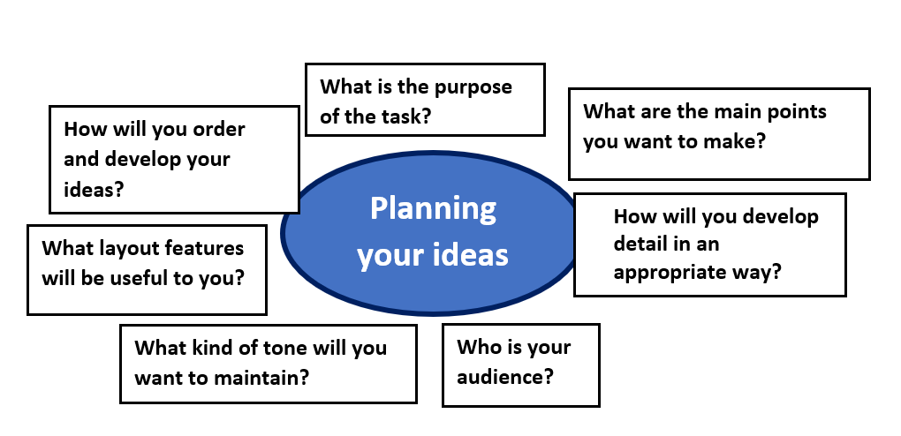
Getting to grips with report writing
The governors who run your school/college are interested in the views of pupils about the strengths and weaknesses of the school/college.
Write a report for the governors to give your views. You could include:
examples of strengths and weaknesses of the school/college
your ideas about how the school/college could be improved [20]
The questions that you answered for the previous slide will help you to create a plan for this task.
You can use this template to help.
A sample plan can be seen on the next slide.

Slide 11
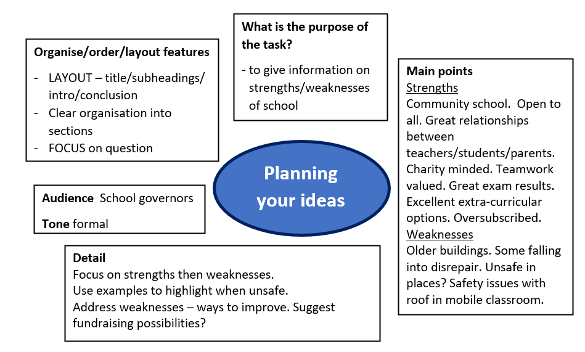
Report writing – sample plan
The governors who run your school/college are interested in the views of pupils about the strengths and weaknesses of the school/college.
Write a report for the governors to give your views. You could include:
examples of strengths and weaknesses of the school/college
your ideas about how the school/college could be improved [20]

Slide 12
Report writing – sample extract
The governors who run your school/college are interested in the views of pupils about the strengths and weaknesses of the school/college.
Write a report for the governors to give your views. You could include:
examples of strengths and weaknesses of the school/college
your ideas about how the school/college could be improved [20]
Look at the opening to this answer then look back at the plan on the previous page. Can you see how the plan has helped the student to write this answer?
Overview of the Strengths and Weaknesses of D…….. High School
Introduction
As a student at D………..High School, I am writing this report to present my views on the strengths and weaknesses of our school. There are many strengths to our community-minded school and these are well known and will be easy to list. This report will also consider a few areas which could be strengthened, focusing primarily on the dated school environment and poor state of some of the older buildings. This report will also recommend ways in which these weaknesses could be improved in the near future.
Key strengths of the school
As you are aware, D…………High School is first and foremost a community school. We are fortunate to enjoy good relationships with the vast majority of people who live in D……….. This is helped by the school sharing its facilities with local primary schools and, out of school time, with the community at large. We are fortunate to have large grounds and the students at D………. are not the only ones who benefit from these. Local sports clubs, such as the running, football and hockey clubs all use our facilities for training and matches…

Slide 13
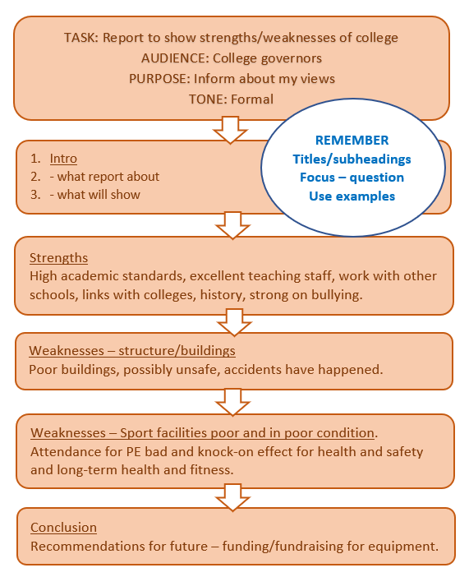
Report writing – sample plan
The governors who run your school/college are interested in the views of pupils about the strengths and weaknesses of the school/college.
Write a report for the governors to give your views. You could include:
examples of strengths and weaknesses of the school/college
your ideas about how the school/college could be improved [20]

Slide 14
Report writing – sample extract
The governors who run your school/college are interested in the views of pupils about the strengths and weaknesses of the school/college.
Write a report for the governors to give your views. You could include:
examples of strengths and weaknesses of the school/college
your ideas about how the school/college could be improved. [20]
Look at a middle section to this answer then look back at the plan on the previous page. Can you see how the plan has helped the student to write this answer?
Concerns over sporting facilities
Structurally, the main sports building is hazardous. Unstable, uneven floors, loose sockets, and crumbling plasterboard only add to the danger of the building. It is true that we are a historic school but this does not mean that the last known improvements to our facilities should date back to the middle of the last century. Changing room facilities are out-dated and very dangerous with crumbling tiles and rickety benches precariously balanced against walls.
As you are aware, attendance for PE has decreased alarmingly in recent years. Do you realise that poor attendance is inextricably linked to the poor facilities? There are no windows in the gym which means that students are forced to exercise in artificial light and stale air. This is not helpful in educating students on the benefits of a healthy lifestyle. Worse than this though, the poor state of our facilities has actually caused injury. As you are aware, William Jones recently suffered from a fractured arm caused during a PE lesson. He is one of the many casualties of our PE facilities. His accident was caused by the lack of mats beneath the climbing bars meaning he fell directly onto a concrete floor. Thankfully his injuries were limited to a broken limb.

Slide 15
Report writing – sample answer
Your school/college is keen to reduce waste.
Write a report for the Headteacher/Principal suggesting ways this might be done.
You could include:
examples of waste at the moment
your ideas about how the situation could be improved [20]
The task above was set as part of the Sample Assessment Materials. The following slides contain a marked answer to this task. Read it through and think about the comments made by the examiner.
Make notes or annotate the work with details on:
The ways in which you would improve on the content.
How you would correct any errors.

Slide 16
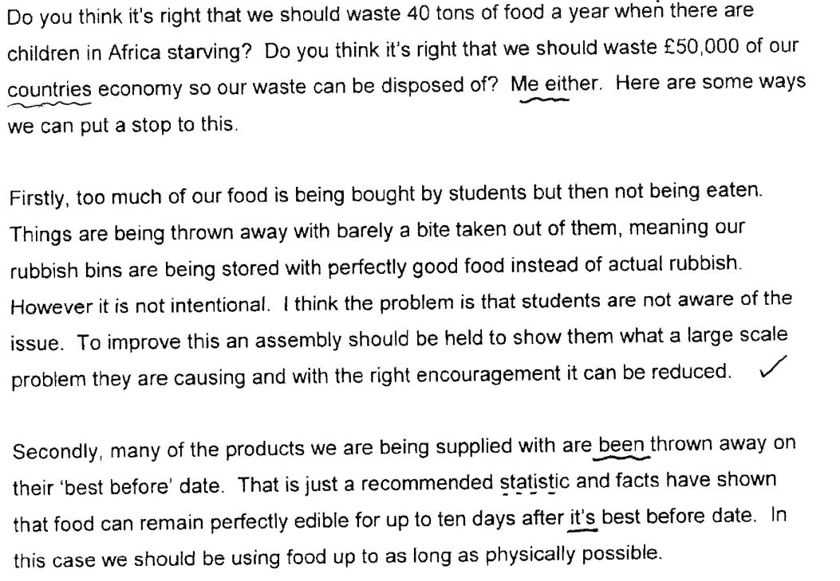
Report writing – sample answer

Slide 17
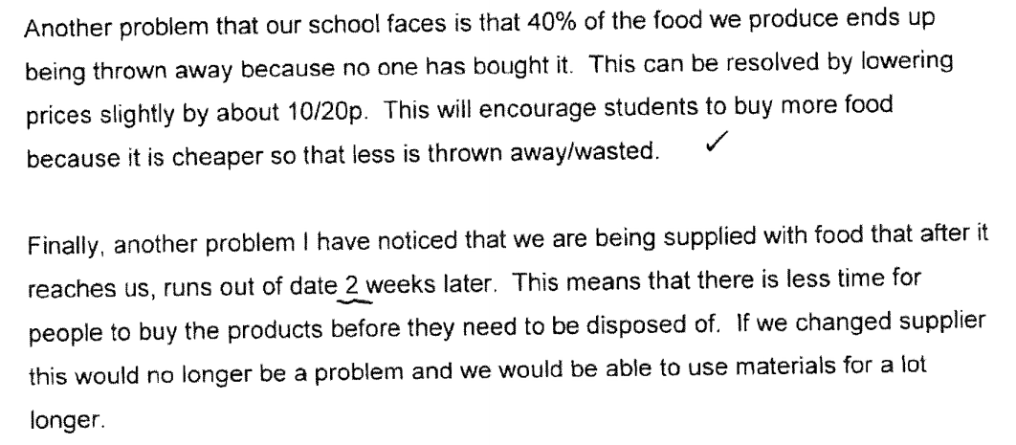
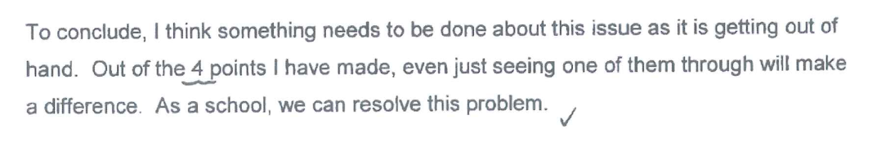
Report writing – sample answer

Slide 18
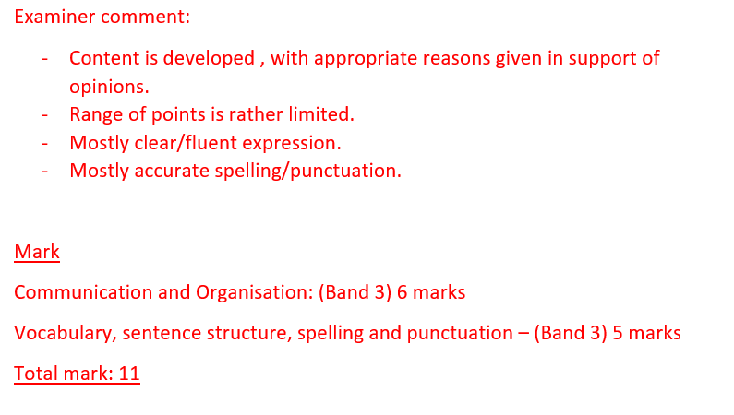
Report writing – sample answer

Slide 19
Report writing – task
The local council have asked young people to write a report on your local area, outlining the areas that need improvement.
Write a report for the local council to give your views.
You could include:
examples of areas that you feel need improvement
your ideas about how improvements could be made [20]
The example that you looked at on slides 16 and 17 would have benefitted from making more points and developing ideas more clearly. It may have also benefitted from a clearer focus on structure.
Use the guidance on how to plan from the previous slides in this presentation and plan your own answer to this question.
When you are happy with your plan, write an answer to this question.
You should spend around 25-30 minutes on this.

Slide 20
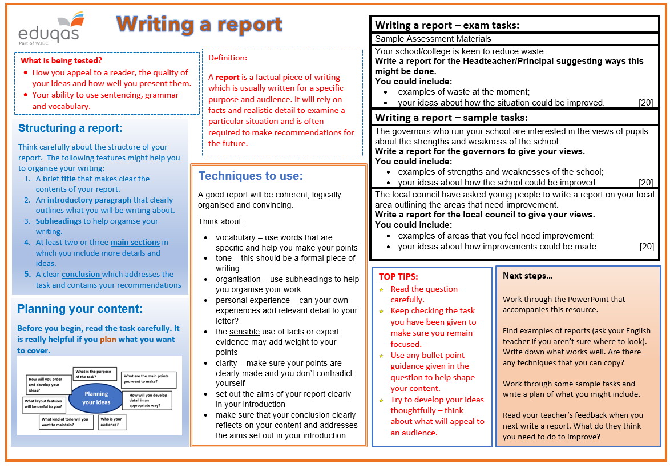
Revision sheet
Click on the link to the following revision sheet. You can print this off to help you when writing a report:

Slide 21
Finally…
We hope this resource has been helpful to you.
For further information and resources for GCSE English Language you can visit the digital resources section of our website. The following link will take you there:
https://resources.eduqas.co.uk/Pages/ResourceByArgs.aspx?subId=11&lvlId=2

