Slide 1
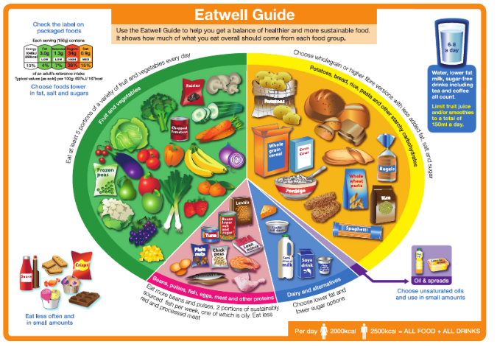
* Learning Objective: P 134
Diet
Success Criteria:
Balance
Lifestyle choice
Eating well
Risks
Why am I doing this ?
You ARE what you EAT

Slide 2
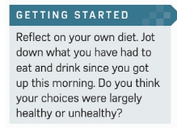
https://www.youtube.com/watch?v=ZcJjMnHoIBI

Slide 3
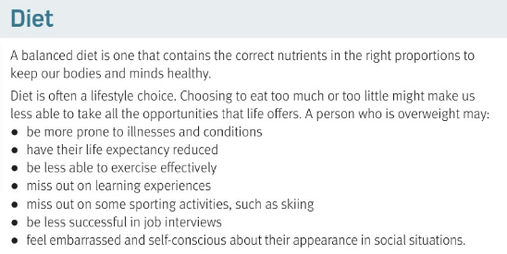

Slide 4
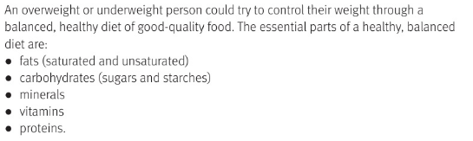

Slide 5
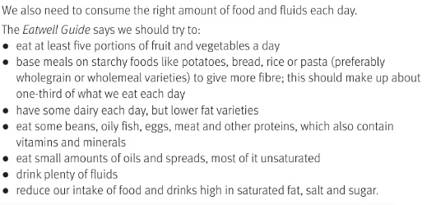

Slide 6


Slide 7
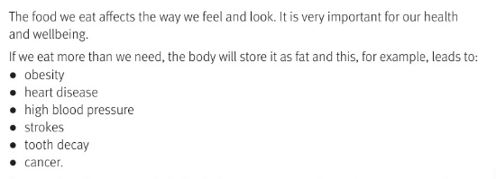
https://www.youtube.com/watch?v=N-ciIB9-4KM

Slide 8
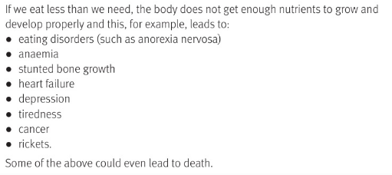
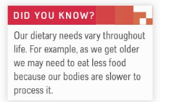
https://www.youtube.com/watch?v=I0ES3B1b14c

Slide 9
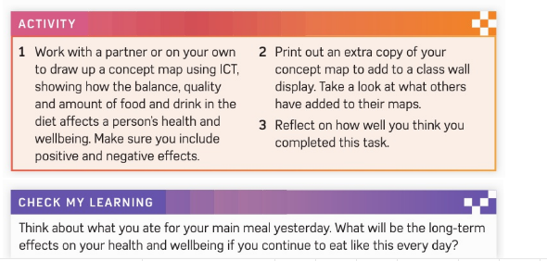

Slide 10
c3 laa definitions & GENETICS & Ill health & diet
SMHW
https://create.kahoot.it/share/b8812f76-cca9-42ee-8821-8c879b9ab6ab

Slide 11
* Learning Objective: P 134
Diet
Success Criteria:
Balance
Lifestyle choice
Eating well
Risks
Why am I doing this ?
You ARE what you EAT

