Slide 1

* Learning Objective: p 128
Component 3 Health & well being
Success Criteria:
Know that Unit 3 builds on the first 2 units
Know that there will be a real exam at the end
Know lots of definitions
Why am I doing this ?
This is about putting your theory into practice

Slide 3
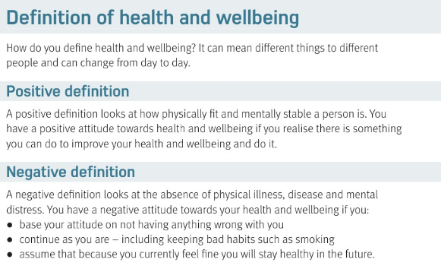

Slide 4
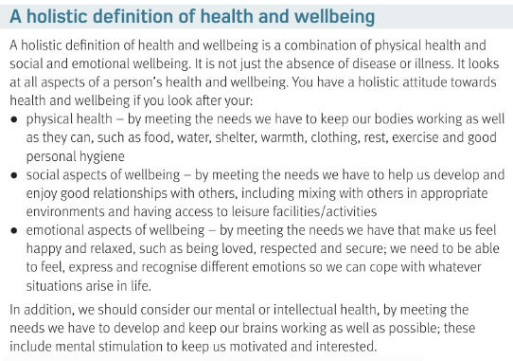

Slide 5
Definitions of Health & wellbeing
A positive definition…. |  | A negative definition …
Holistic ( Whole) definition
Physical like… | Social like…. |  | Emotional like…
FITNESS AND HOW TO GET BETTER
ABSENCE OF ILLNESS, DO NOTHING, HOPE IT WILL BE OK
FOOD
WATER
SHELTER
CLOTHING
REST
EXERCISE
CLEAN
RELATION-SHIPS
MIXING
LEISURE
HAPPY
RELAXED
LOVED
RESPECTED
SECURE

Slide 6
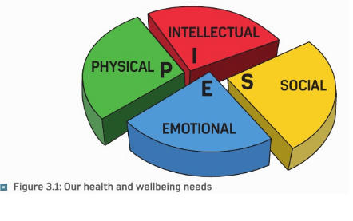

Slide 7
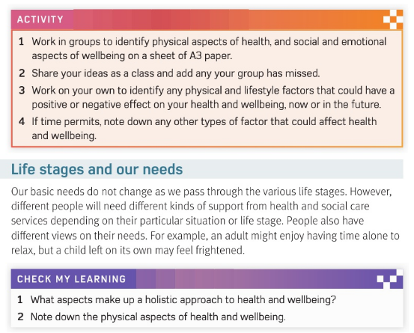

Slide 8
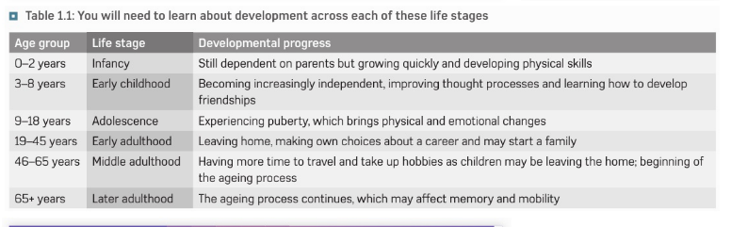

Slide 9
OUR BASIC NEEDS DO NOT ________ AS WE PASS TRHOUGH LIFE STAGES, BUT WE WILL NEED DIFFERENT Kinds of ________.
needs
support

Slide 10
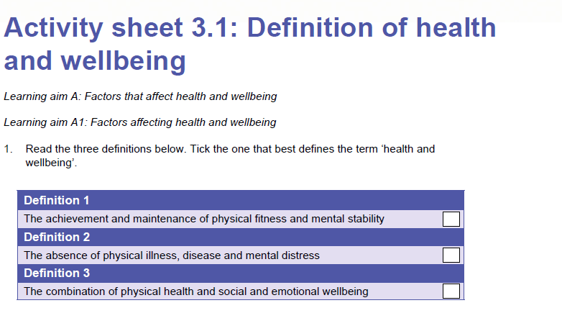

Slide 11
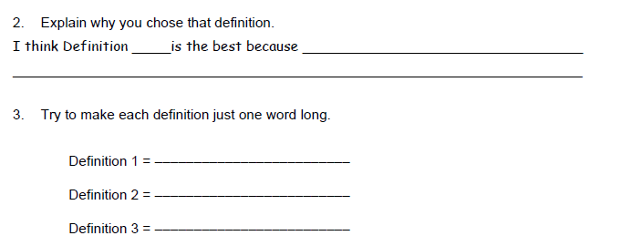

Slide 12
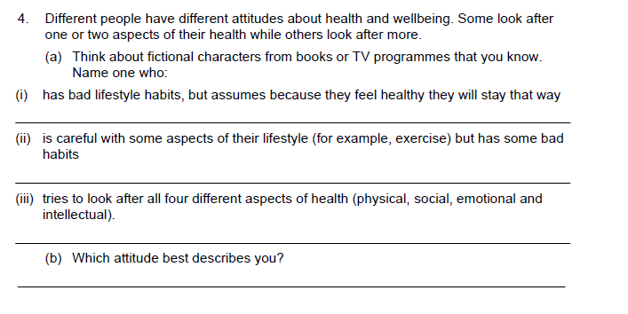

Slide 13
c3 laa definitions on SMHW
https://create.kahoot.it/share/00ba393e-528b-4951-bc3d-a5cc755be554

Slide 14
* Learning Objective: p 128
Component 3 Health & well being
Success Criteria:
Know that Unit 3 builds on the first 2 units
Know that there will be a real exam at the end
Know lots of definitions
Why am I doing this ?
This is about putting your theory into practice

