Slide 1
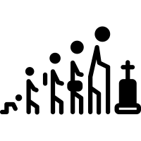
* Learning Objective: P 156 impact OF life EVENTS/ CHANGES IN LIFE CIRCUMSTANCES
Success Criteria:
IMPRISONMENT
PIES
EXPECTED
UNEXPECTED
Why am I doing this ?
SOMETIMES WE DON’T KNOW WHATS COMING

Slide 2
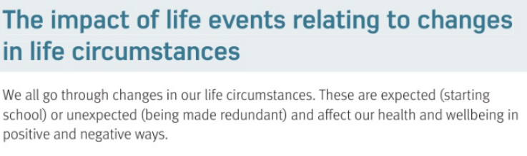
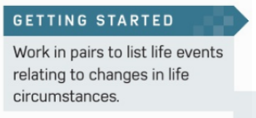

Slide 3
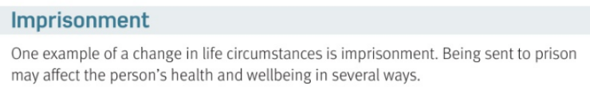


Slide 4
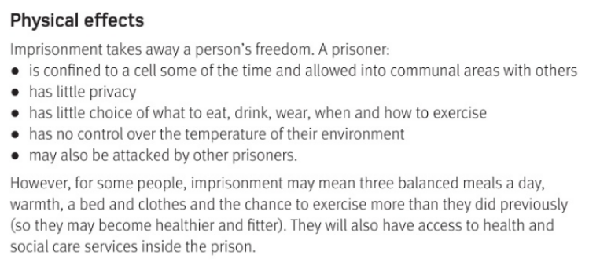

Slide 5
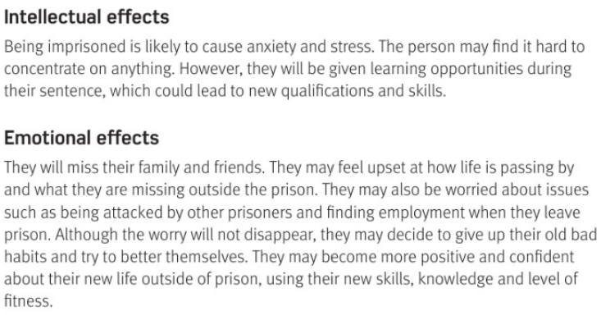

Slide 6
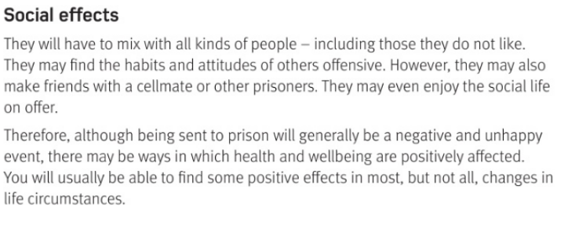

Slide 7

IMPACT OF LIFE CIRCUMSTANCES
EG GOING TO PRISON
PHYSICAL | INTELLECTUAL
EMOTIONAL | SOCIAL
NO EXERCISE
NO PRIVACY
NO CHOICE OF FOOD
MIGHT BE ATTACKED
ANXIETY
STRESS
HARD TO CONCENTRATE
MIX WITH OTHER PRISONERS
MISS FAMILY
WORRIED

Slide 8
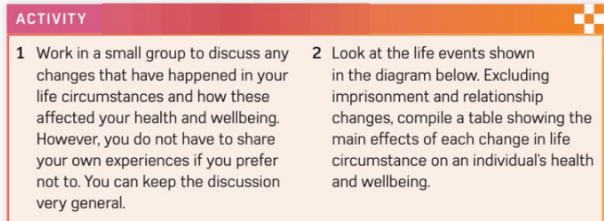

Slide 9
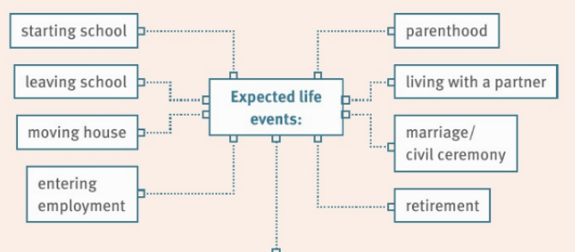

Slide 10
My choice of expected life event:
PHYSICAL | INTELLECTUAL
EMOTIONAL | SOCIAL

Slide 11
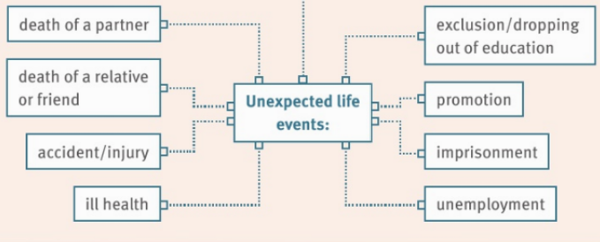

Slide 12
My choice of unexpected life event:
PHYSICAL | INTELLECTUAL
EMOTIONAL | SOCIAL

Slide 13
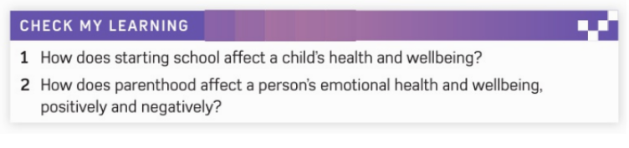
https://www.youtube.com/watch?v=NaPBcUUqbew

Slide 14
* Learning Objective: P 156 impact OF life EVENTS/ CHANGES IN LIFE CIRCUMSTANCES
Success Criteria:
IMPRISONMENT
PIES
EXPECTED
UNEXPECTED
Why am I doing this ?
SOMETIMES WE DON’T KNOW WHATS COMING

