Slide 1
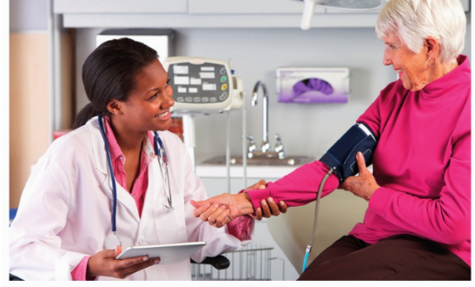
* Learning Objective:p 164
Blood pressure
Success Criteria:
Blood pressure
High blood pressure
Low blood pressure
measurement
Why am I doing this ?
This is why Mr Hallam has to cycle to work and eat less crisps

Slide 2
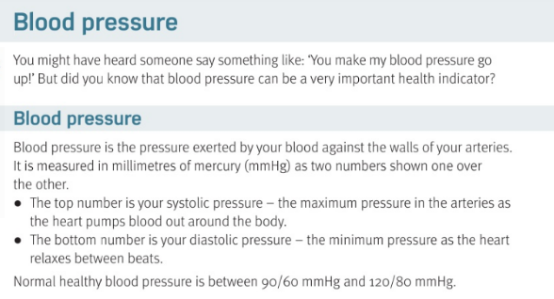

Slide 3
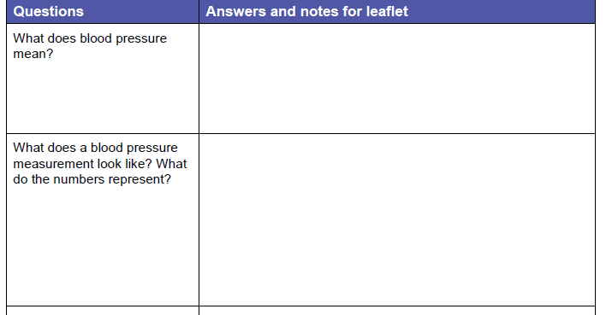
The pressure exerted by your blood against the walls of your arteries. Measured in millimeters of mercury mmHg
2 numbers one above another;
Top = systolic maximum pressure
Bottom diastolic – minimum pressure

Slide 4
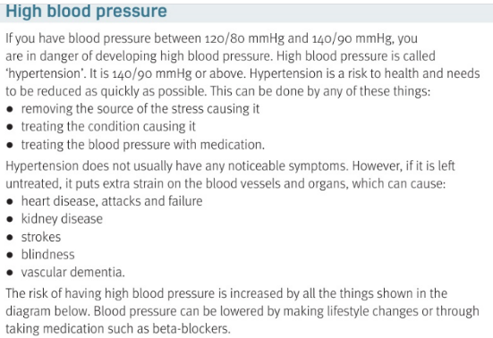

Slide 5
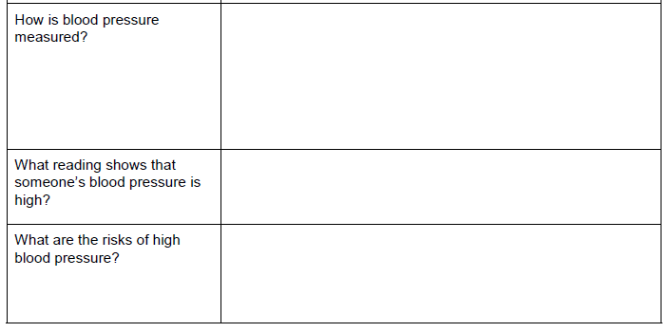
Sphygmomanometer – stethoscope, arm cuff, pump & dial & digitally
https://www.youtube.com/watch?v=GSNZVaW1Wg4
120/80 up to 140/90 = hypertension
Heart attack; kidney disease; strokes; blindness, dementia

Slide 6
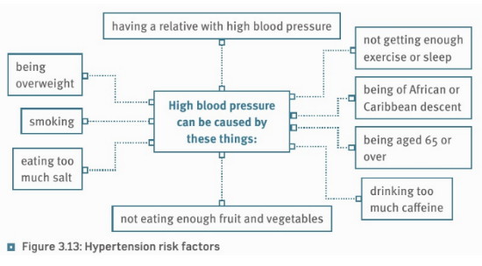

Slide 7
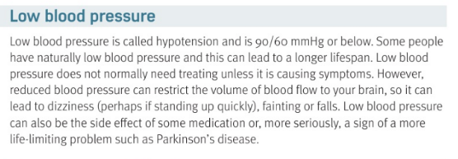

Slide 8
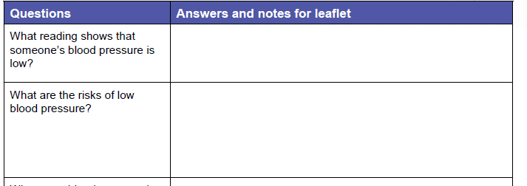
90/60 or below
Dizziness; fainting; falls; a sign of other problems

Slide 9
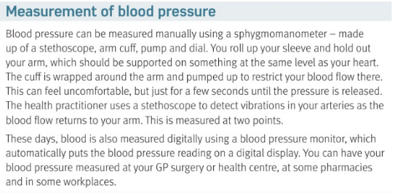

Slide 10
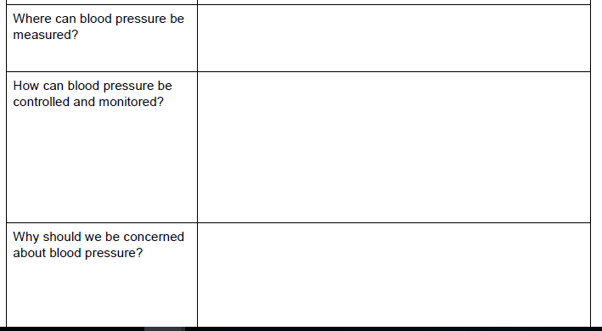
GP; pharmacy; workplace
Less stress; treatment; medication; regular checks
It’s an early sign of other problems

Slide 11
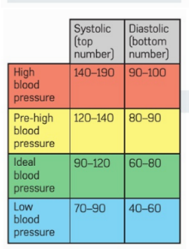
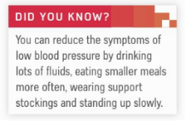
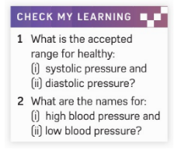

Slide 12
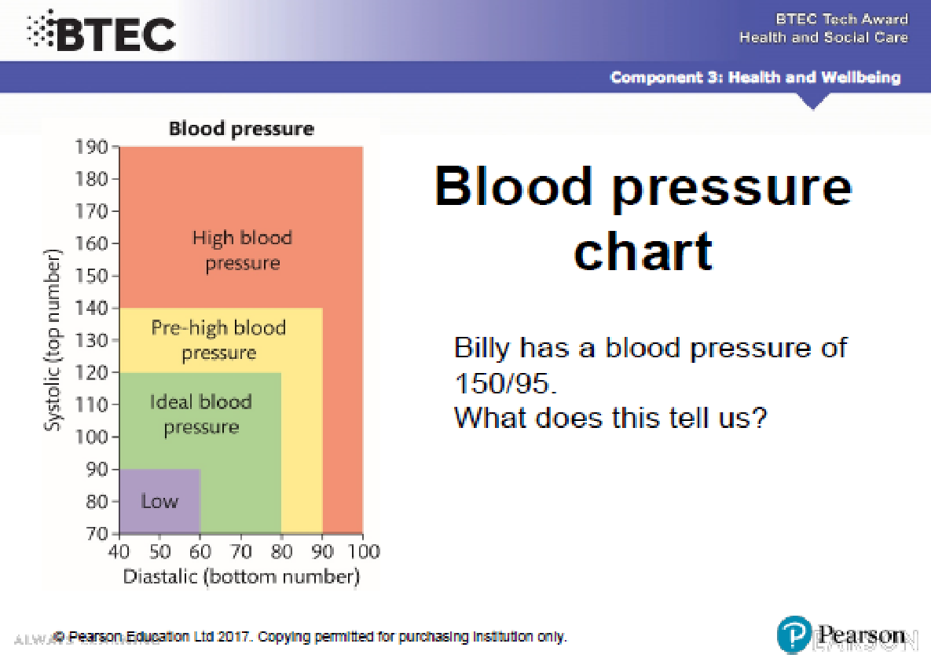

Slide 13
H&SC c3 lab blood pressure
Smhw quiz
https://www.youtube.com/watch?v=Ab9OZsDECZw

Slide 14
* Learning Objective:p 164
Blood pressure
Success Criteria:
Blood pressure
High blood pressure
Low blood pressure
measurement
Why am I doing this ?
This is why Mr Hallam has to cycle to work and eat less crisps

