Slide 1

* Learning Objective: p 206
Barriers to accessing Identified services
Success Criteria:
Barriers
Physical
Psychological
Financial
Geographical
Cultural & Language
Resources
Why am I doing this ?
What STOPS you getting better?

Slide 2
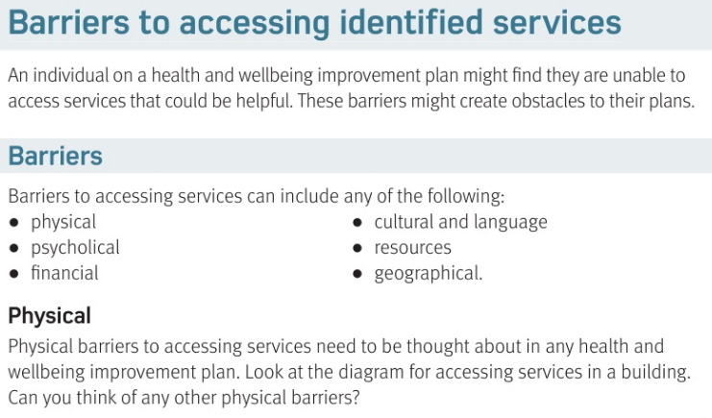

Slide 3
Barriers to Accessing Identified Services
A Barrier is something that ..
Physical Means.. | Cultural & language means..
Psychological means.. | Resources Means..
Financial Means.. | Geographical means..
Gets in the way & stops you
Religion & race
Your body
Having the right materials & people
mental
money
Where you live

Slide 4
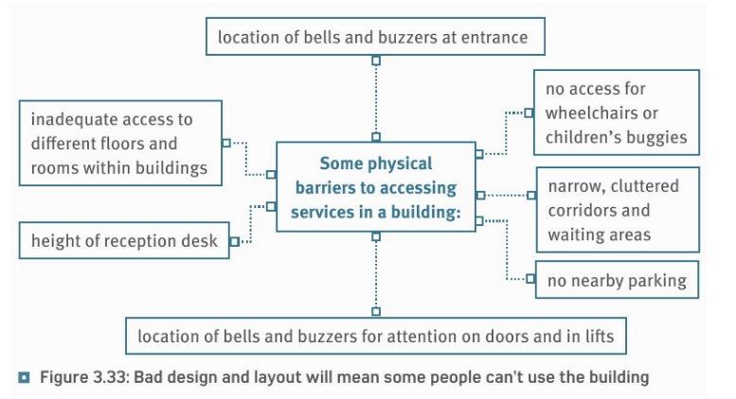

Slide 5
Physical Barriers can be overcome by…
Ramps; low buttons; spaced seating; wide corridors & disabled toilets

Slide 6
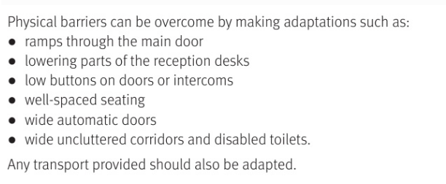

Slide 7
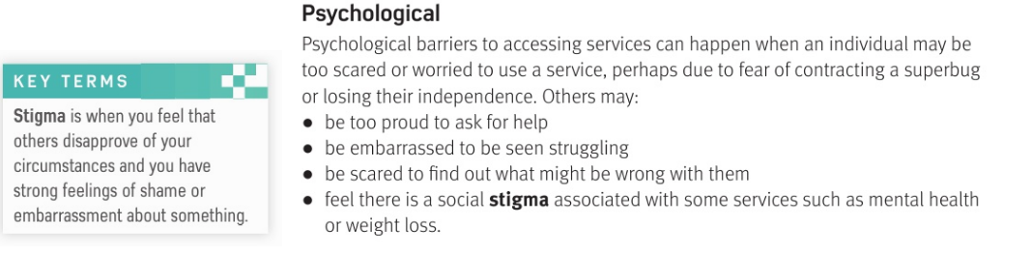
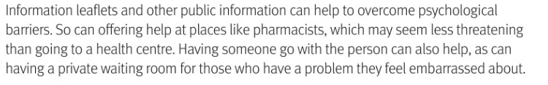

Slide 8
4 examples of PSYCHOLOGICAL barriers
1 too.. | 2 embarrassed to be…
3. Feeling …… | 4. Stigma means..
Proud to ask for help
Admit struggling
scared
Feeling that other people disapprove

Slide 9
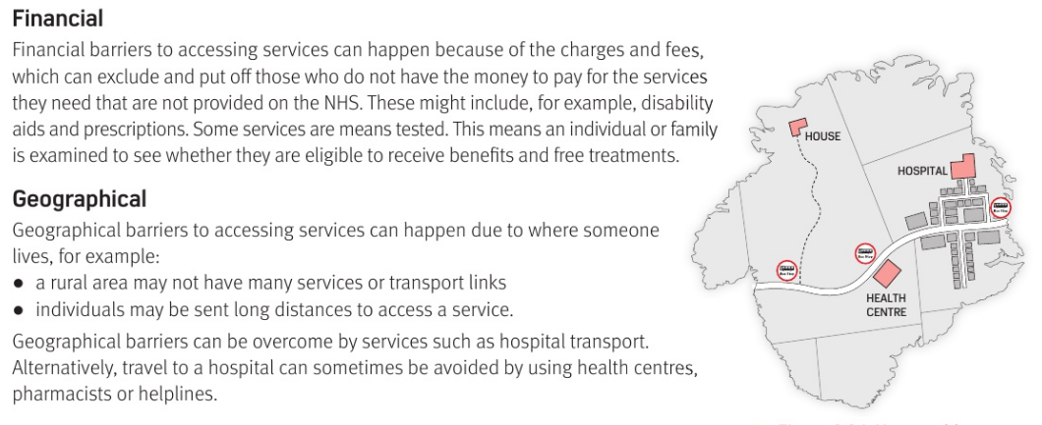

Slide 10
Examples of Financial problems =
Examples of Geographical problems =
Cant afford prescriptions
Live far away from hospital and no car

Slide 11
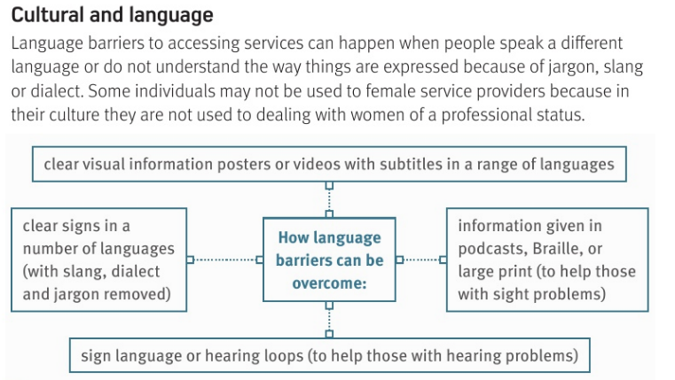

Slide 12
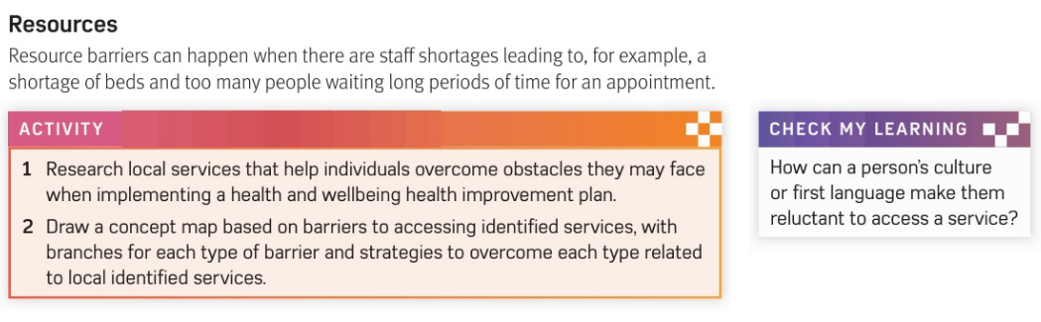

Slide 13
Cultural Barriers include…
Cant understand whats being said
Resources barrier example =
Not enough nurses or doctors

Slide 14
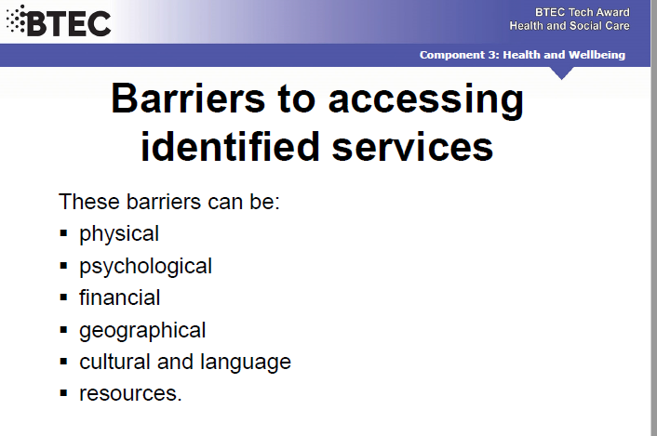

Slide 15
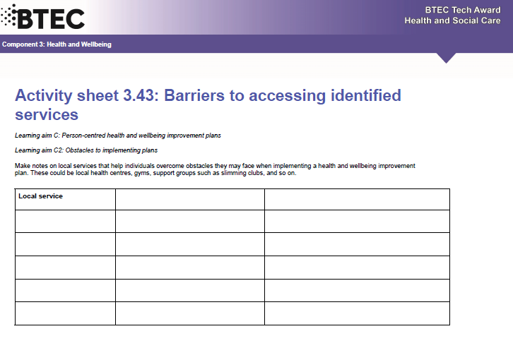
extension

Slide 16
Smhw
h&sc c3 lac barriers 2
Video
https://www.youtube.com/watch?v=JCc20BifI5k
Ex - https://www.youtube.com/watch?v=7hm_W5j71T0

Slide 17
* Learning Objective: p 206
Barriers to accessing Identified services
Success Criteria:
Barriers
Physical
Psychological
Financial
Geographical
Cultural & Language
Resources
Why am I doing this ?
What STOPS you getting better?

