Slide 1
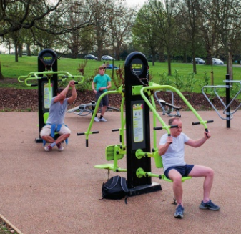
* Learning Objective: P 198
AVAILABILITY OF RESOURCES
Success Criteria:
FINANCIAL
PHYSICAL
Why am I doing this ?
YOU CANT FOLLOW A PLAN, IF YOU DON’T HAVE THE NECESSARY EQUIPMENT

Slide 2
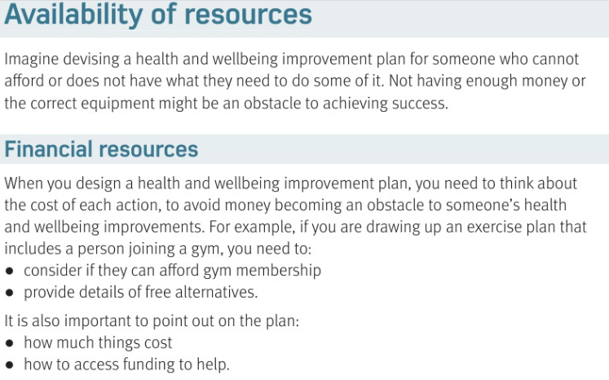

Slide 3
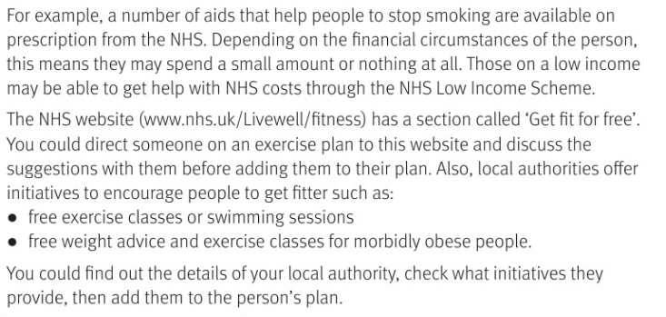

Slide 4
AVAILABILITY OF RESOURCES
What use is a H&W plan if the person cant afford items they need? | No money or equipment is an…..
Financial
When you make a H&W plan you need to think about .. | For example…
You should also include how to access… | For example…
What’s the name of the NHS website to help ? | What do some councils provide?

Slide 5
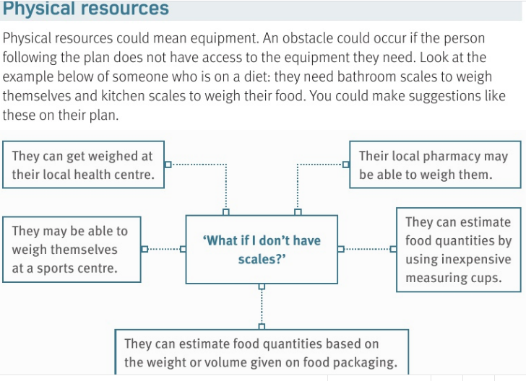

Slide 6
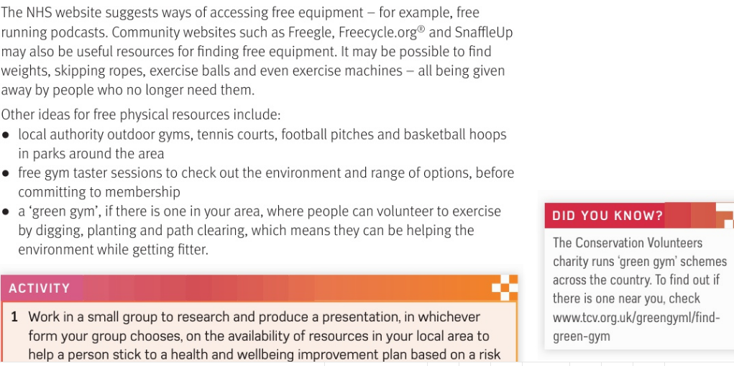

Slide 7
You can get free equipment from.. | Local councils provide..
Gyms offer… | Green Gym is.. https://www.youtube.com/watch?v=mADsl9QkDGc

Slide 8
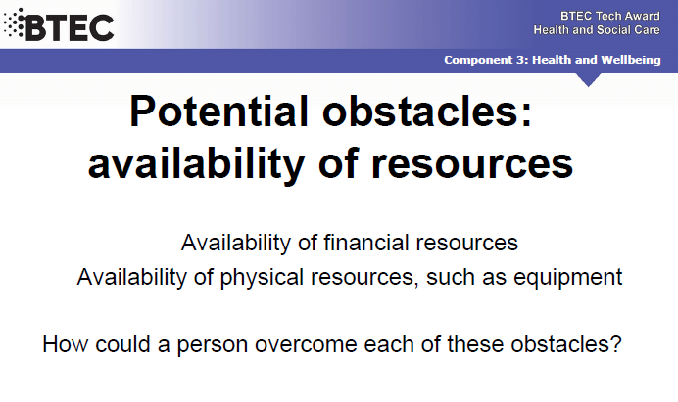

Slide 9
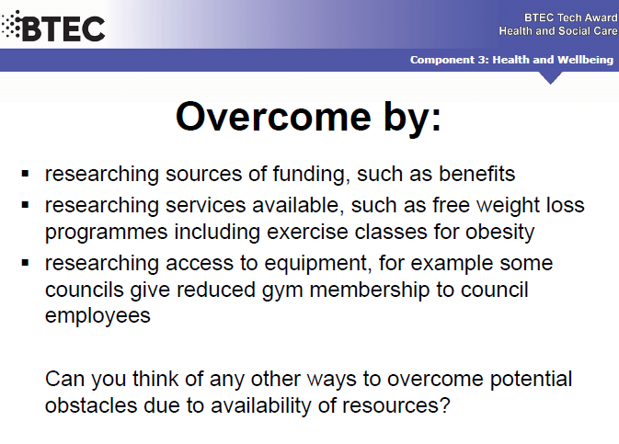

Slide 10
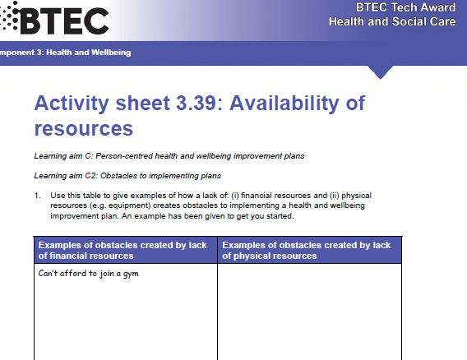
Ex TASK

Slide 11
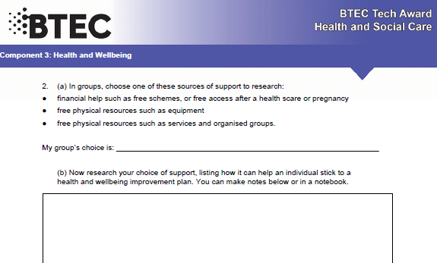

Slide 12
SMHW
h&sc c3 lac availability
VIDEO
https://www.youtube.com/watch?v=_kS1oy64EiM
EX
https://www.youtube.com/watch?v=vlVZKZNXYBA

Slide 13
* Learning Objective: P 198
AVAILABILITY OF RESOURCES
Success Criteria:
FINANCIAL
PHYSICAL
Why am I doing this ?
YOU CANT FOLLOW A PLAN, IF YOU DON’T HAVE THE NECESSARY EQUIPMENT

