Slide 1

* Learning Objective: p 178
Alcohol Data
Success Criteria:
Who makes it ?
What does it show
New Safe limits
Why am I doing this ?
Ask Mr Hallam about his alcoholic Brother..

Slide 2
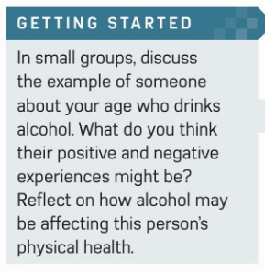

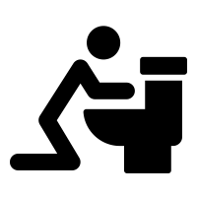

Slide 3
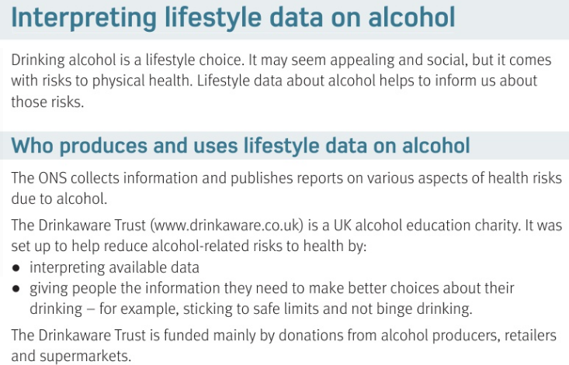
https://www.youtube.com/user/drinkawaretrust

Slide 4
What is the Drinkaware trust and what does it do ?
How is it paid for ?
Alcohol education charity , set up to interpret data and give people information on safe drinking
Donations from alcohol producers and shops

Slide 5
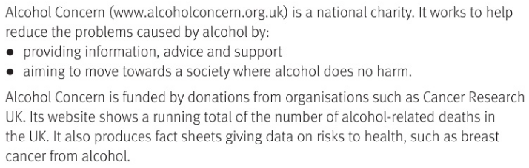
https://www.youtube.com/channel/UCW2B1q11-w4RVaD25SduYew

Slide 6
What is alcohol concern and what does it do ?
How is it paid for ?
Alcohol education charity , set up to reduce alcohol problems and provide support
donations form cancer research

Slide 7
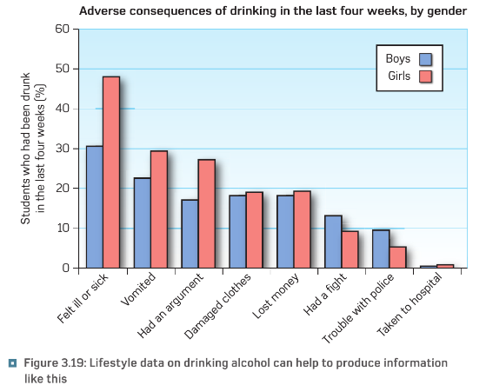

Slide 8
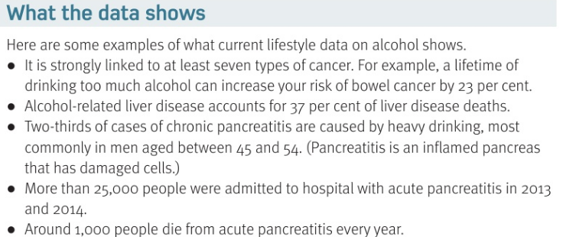

Slide 9
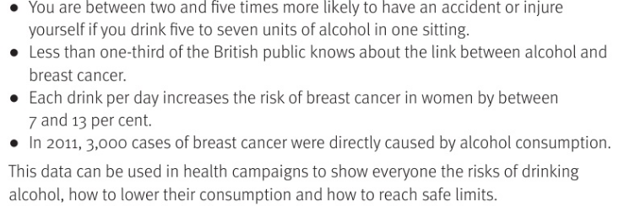

Slide 10
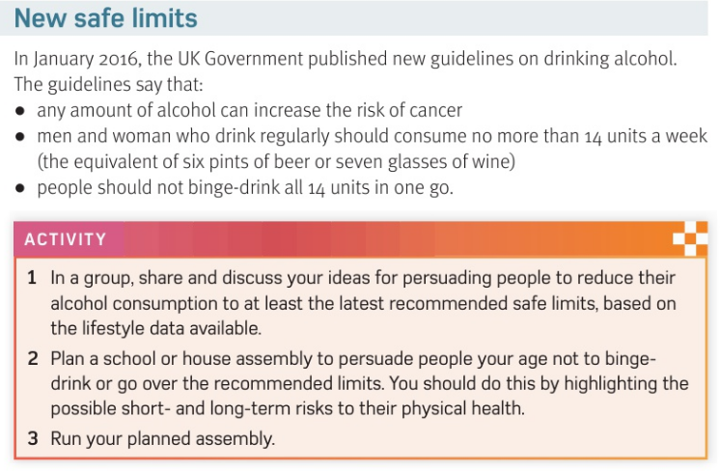

Slide 11
What does the 2016 guidelines on alcohol say :
1 | 2 | 3
Dont binge drink all 14 units in one go
Any amount of alcohol can increase cancer risk
Drink no more than 14 UNITS a week – 6 pint or 7 wineglasses

Slide 12
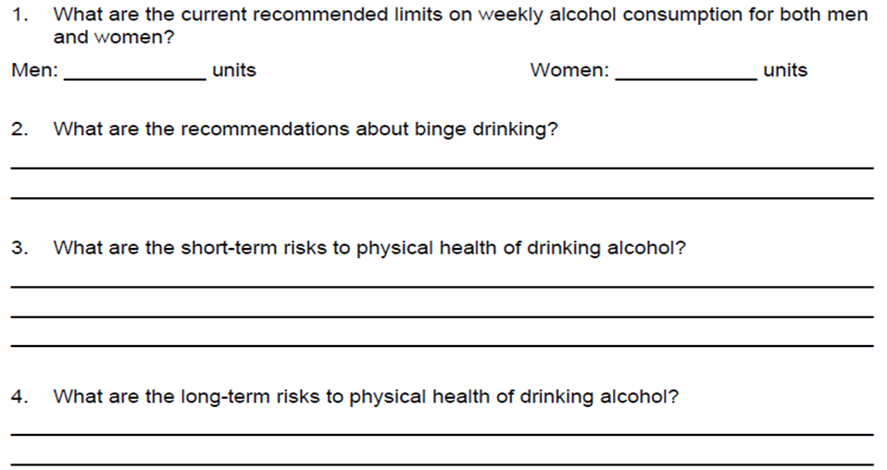
The current UK guidelines advise limiting alcohol intake to 14 units a week for women and men. This is equivalent to drinking no more than 6 pints of average-strength beer (4% ABV) or 7 medium-sized glasses of wine (175ml, 12% ABV) a week
Sick; hangover, accident
Cancer, liver disease

Slide 13
H&SC c3 lab alcohol
SMHW
27 minutes
https://www.youtube.com/watch?v=ZzxoLN25FAw

Slide 14
* Learning Objective: p 178
Alcohol Data
Success Criteria:
Who makes it ?
What does it show
New Safe limits
Why am I doing this ?
Ask Mr Hallam about his alcoholic Brother..

