Slide 1

* Learning Objective: p 204
Disability & addiction
Success Criteria:
Ability
Disability
Addiction
Why am I doing this ?
Addiction is being trapped- Avoid it at all costs

Slide 2
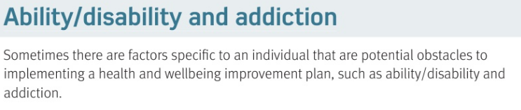
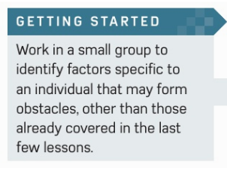

Slide 3
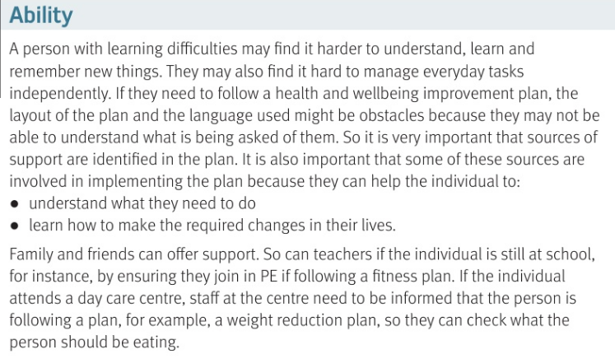

Slide 4
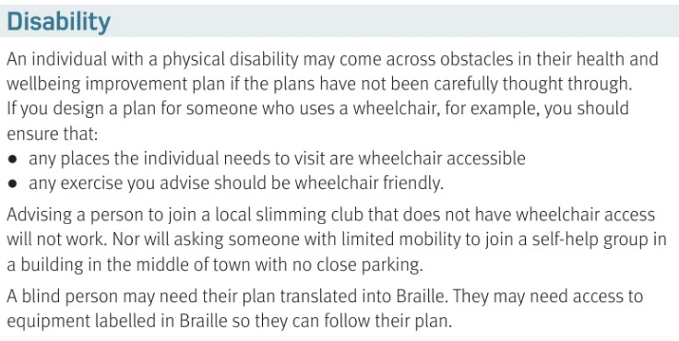

Slide 5
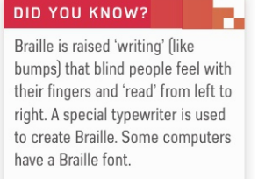
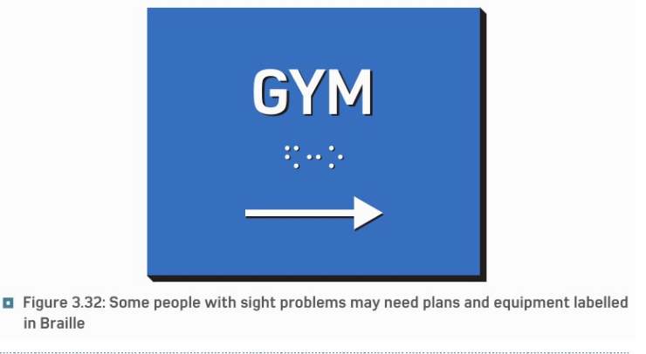
https://www.youtube.com/watch?v=o9BOQ6IpTSE

Slide 6
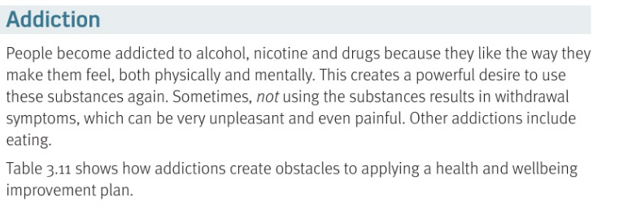

Slide 7
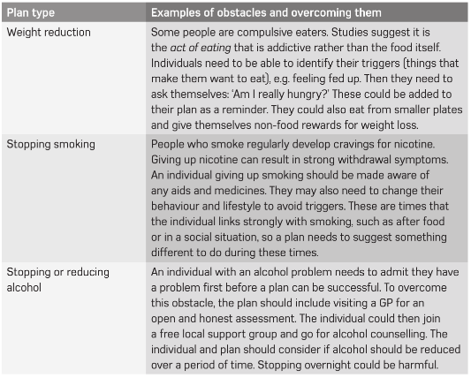

Slide 8
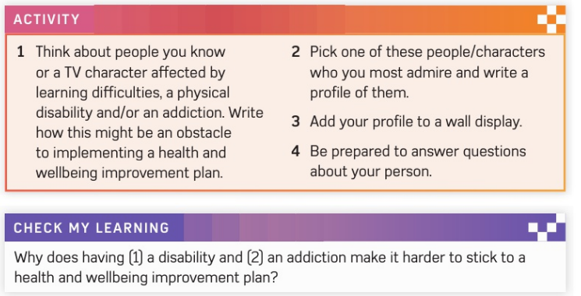
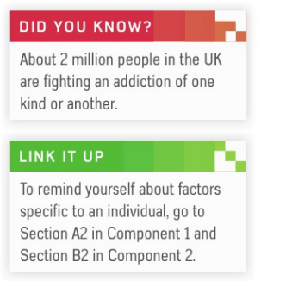
EXTENSION

Slide 9
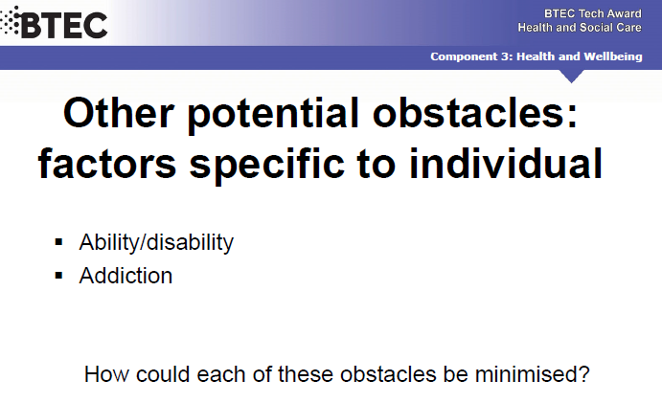

Slide 10
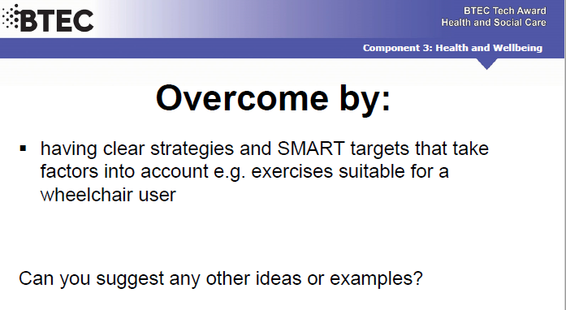

Slide 11
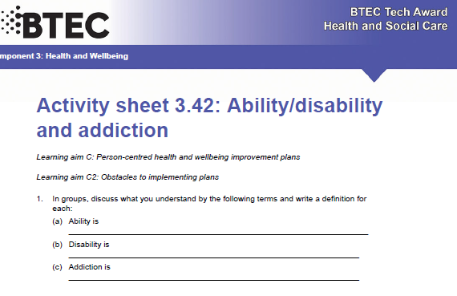

Slide 12
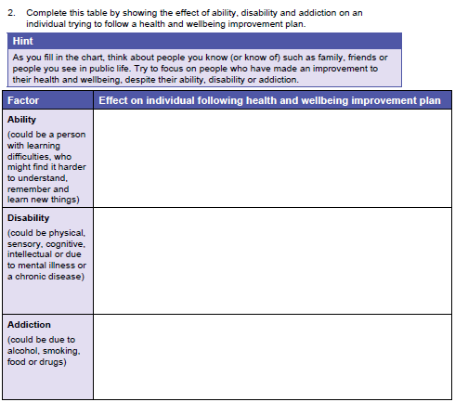

Slide 13
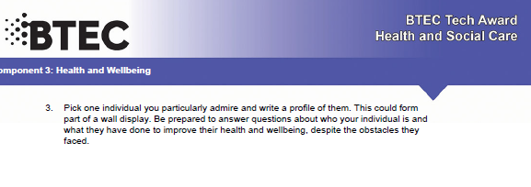
EXTENSION
SMHW h&sc c3 lac addiction | Video Sensitive https://www.youtube.com/watch?v=EPI51QU2U-M Safe https://www.youtube.com/watch?v=um5hmc-XgWI

Slide 14
* Learning Objective: p 204
Disability & addiction
Success Criteria:
Ability
Disability
Addiction
Why am I doing this ?
Addiction is being trapped- Avoid it at all costs

